Slide 1


Slide 2
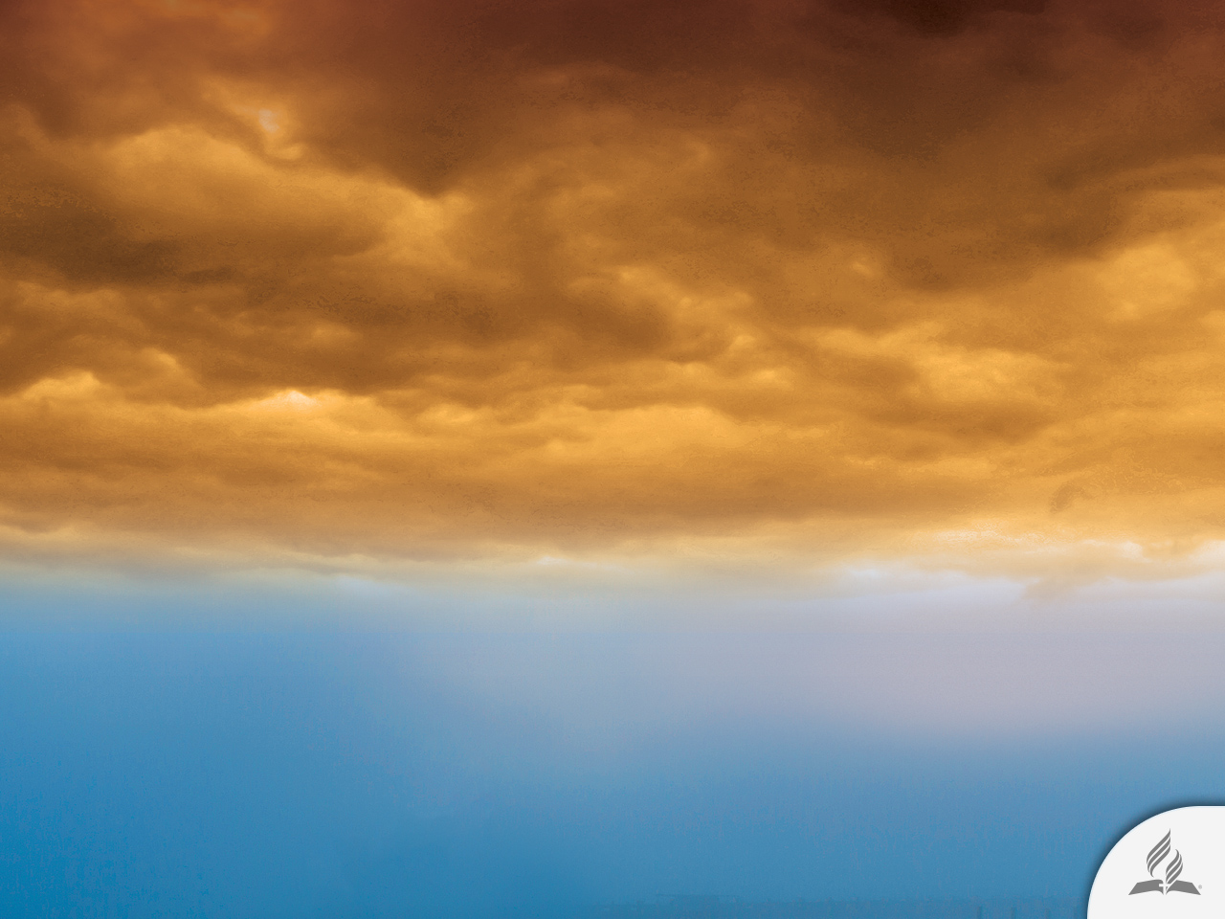
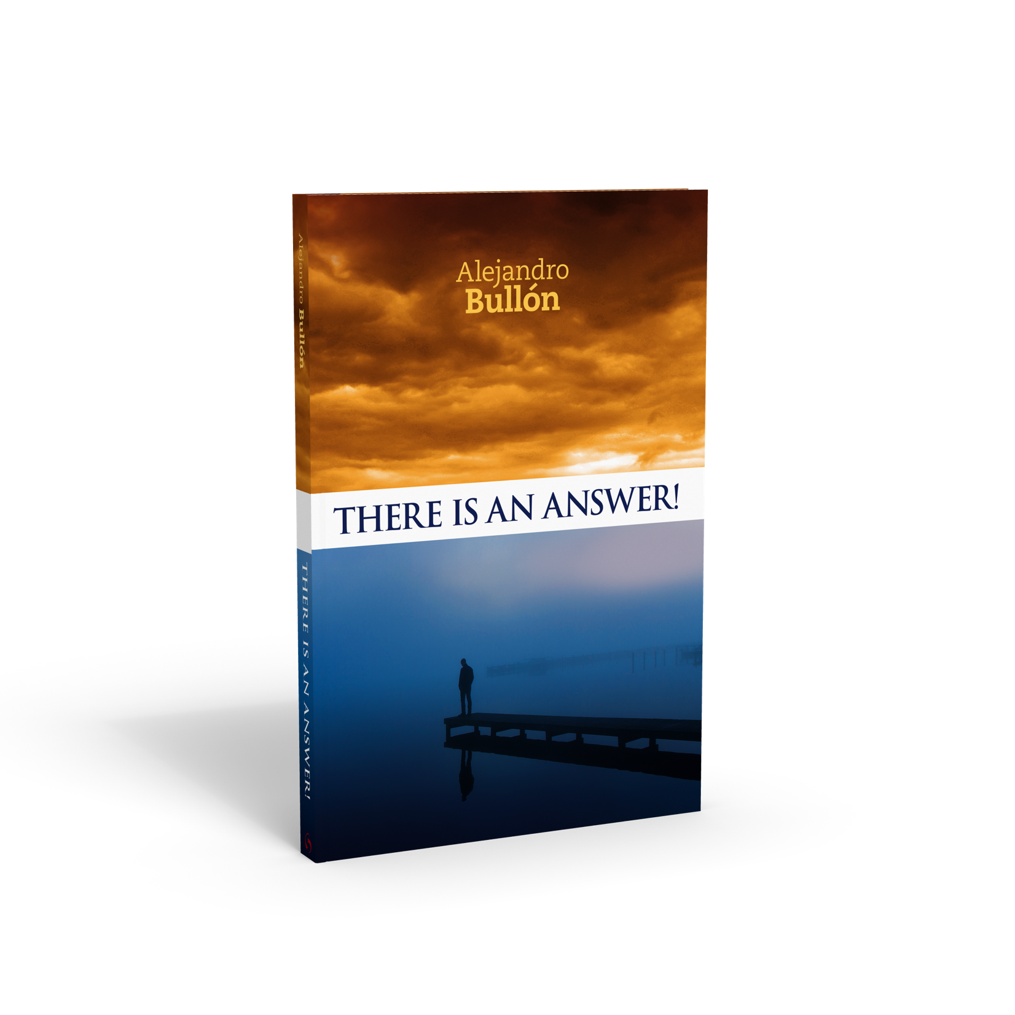


Will a New World
Order Be Established?
Topic 10

Slide 3
A Disrupted World
We are accustomed to bad news.
Newspapers almost always have the same news, which is bad news.
Instability continues to profoundly impact the planet.
The spirit of protest is ongoing.
In Syria, fighting has reached levels of brutal massacres, in which thousands of innocent people have lost their lives, while facing the apparent indifference of Western governments.

Slide 4
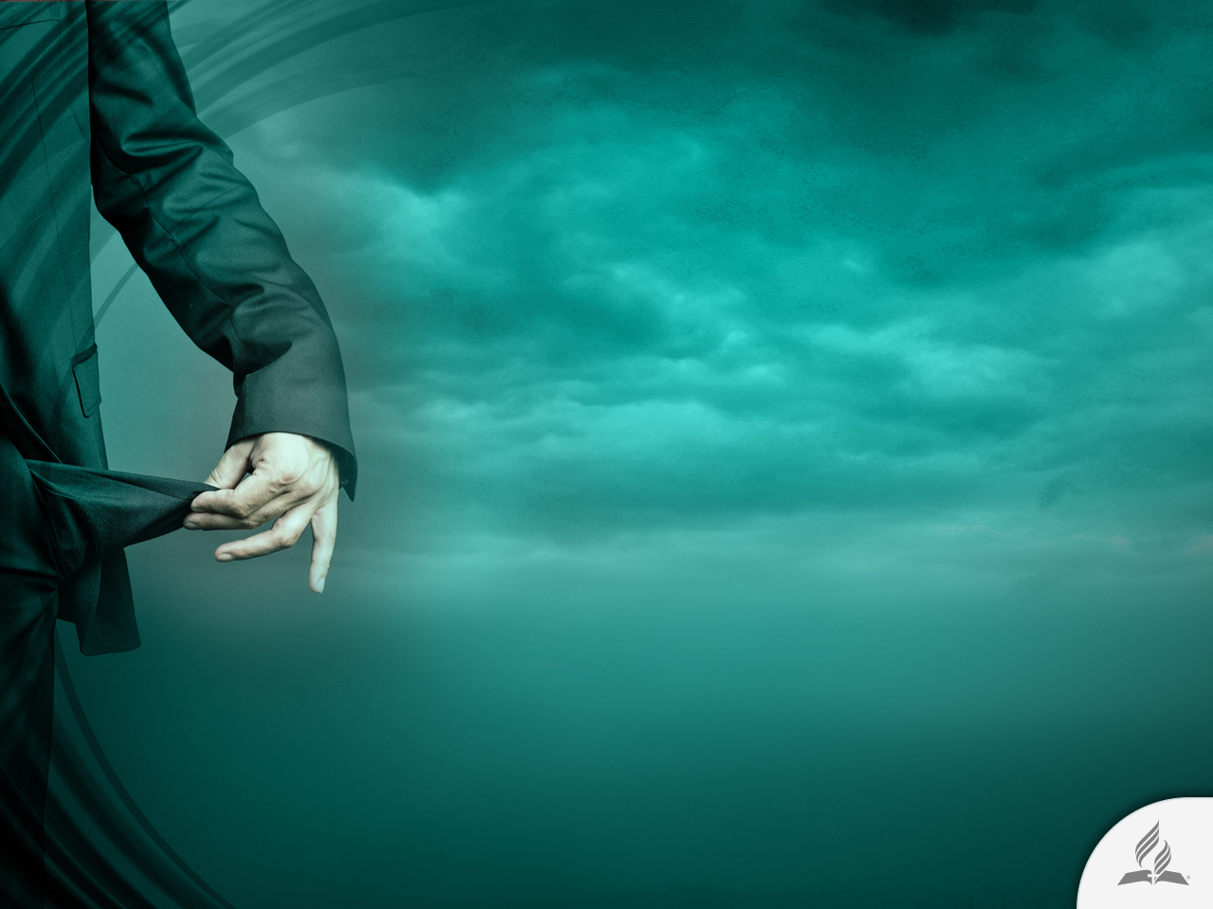
A Disrupted World
Things are not going well in the world.
The global economy continues to drown in the quicksand of public indebtedness, of political crises, of fiscal cutbacks, and high unemployment rates.
The excesses of financial speculators in the past decade came to an end with a mountain of loans impossible to repay, driving into bankruptcy hundreds of large companies and banks, which had to be rescued by governments.

Slide 5
A Disrupted World
Global climate change has already had observable effects on the environment.
Glaciers have shrunk, ice on rivers and lakes is breaking up faster than before, plant and animal ranges have shifted and trees are flowering sooner.
Effects that scientists had predicted in the past would result from global climate change are now occurring: loss of sea ice, accelerated sea level rise and longer, more intense heat waves.
This is a great challenge to the leaders of the world. They must sign agreements to deal this great danger.

Slide 6

The Shadow of a New World Order

Slide 7
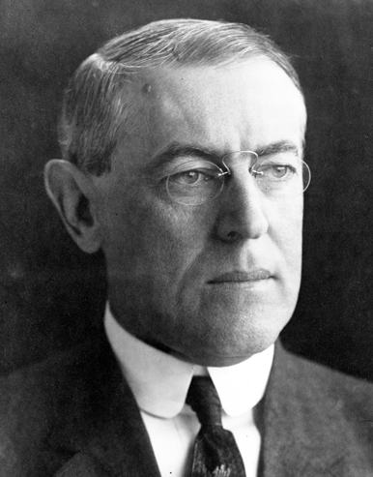
A League of Nations
The first time the expression, a “new world order,” appeared was in a document prepared by T. Woodrow Wilson, the twenty-eighth president of the United States, who, after World War I, recommended the creation of a League of Nations, which later gave rise to the United Nations.

Slide 8
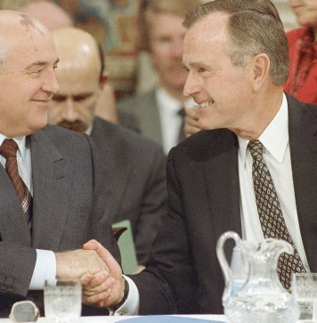
A New Spirit of Cooperation
The expression a “new world order” was used again, now at the end of World War II.
However, its use increased during the last period of the Cold War, when Russian president Mikhail Gorbachev and United States president George H. W. Bush employed the term to describe the spirit of cooperation sought between the two great world powers.

Slide 9
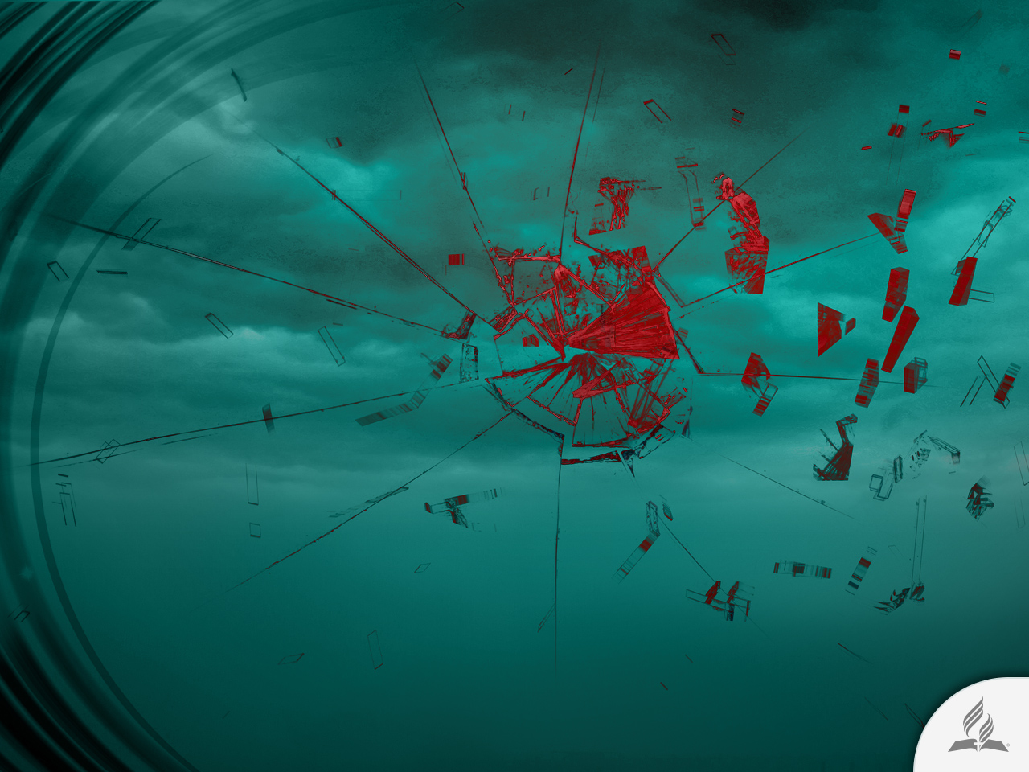
The Need of a New World Order
A new world order is the desire of every sensible heart.
Today, it is more appealing to think about order in a planet where disorder rules in matters such as organized crime, violence, unemployment, corruption, increase in disease, environmental pollution, and so forth.
The masses dream of a world in which there is only one flag, without borders, differences, or prejudices. Is it merely a utopian dream, or is it a possibility?

Slide 10

A More Feasible Reality
In recent years, with the development of technology and social networks, the dream of a new world order seems more feasible.
The globalized world we live in has become even smaller. In the global village, news travels from one ocean to another in only a few seconds. Distances have been shortened.
Spaces have been reduced. Voids have been filled. Hope for new world order is perceived as less utopian.

Slide 11
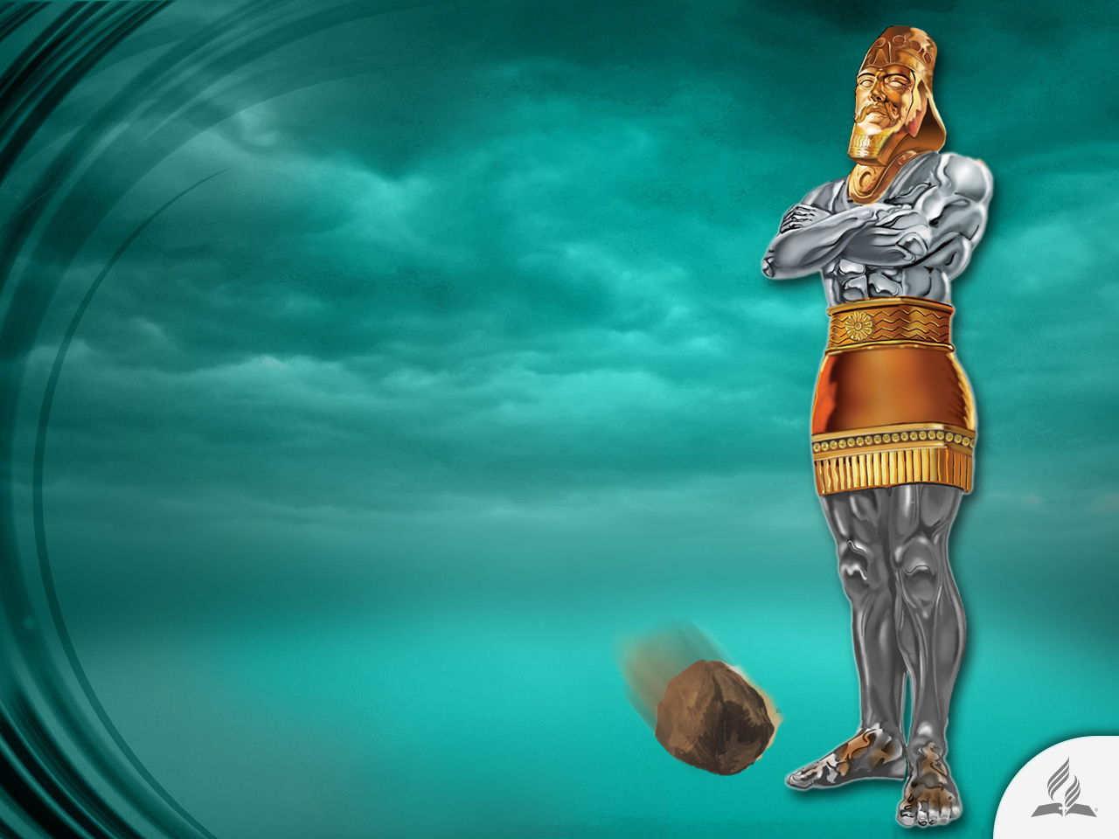
Human History
SUMMARIZED in a dream

Slide 12
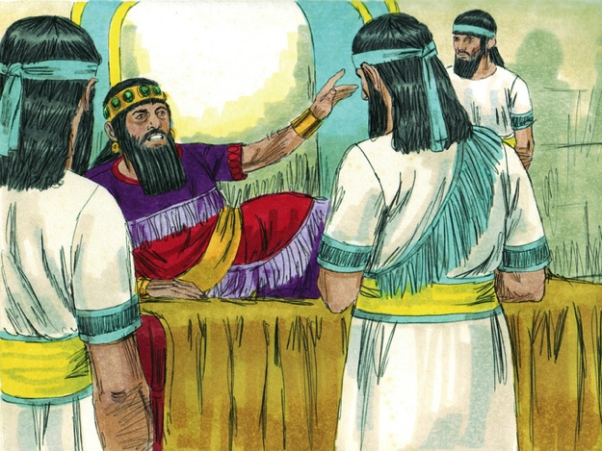
Nebuchadnezzar’s Dream
The Bible says that king Nebuchadnezzar had a dream inspired by God (Dan. 2:1-6).
Ancient Babylonians believed that dreams where divine messages.
The Lord is also interested in those who do not believe in Him.

Slide 13
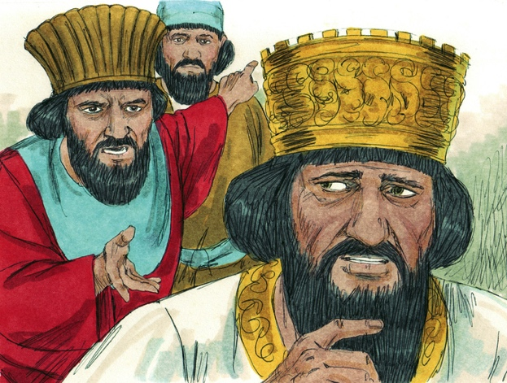
The King Does Not Remember the Dream
The inability to remember a dream was an evidence that it was a divine message.
The king called his counselors, astrologers, and magicians.
But they could not reveal the dream.
Then Nebuchadnezzar threatened to kill all the wise people of the kingdom.

Slide 14
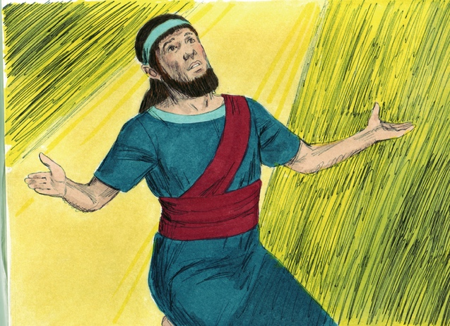
Daniel Asks for Time
He knows that God is the only one who can disclose him this mystery.
So he prays with his friends and asks the Lord for help.
God reveals to him the dream and its meaning!

Slide 15
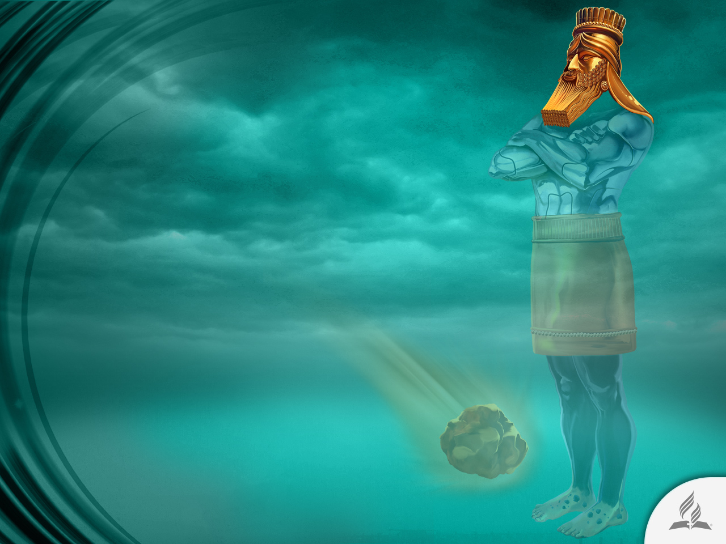
The Golden Head
“You are that head of gold” (Dan. 2:38).
It represents the Neo-Babylonian Empire (605-539 BC).
Gold was highly utilized among Babylonians.
In the same way that gold is the best among metals, this reign will be magnificent.

Slide 16
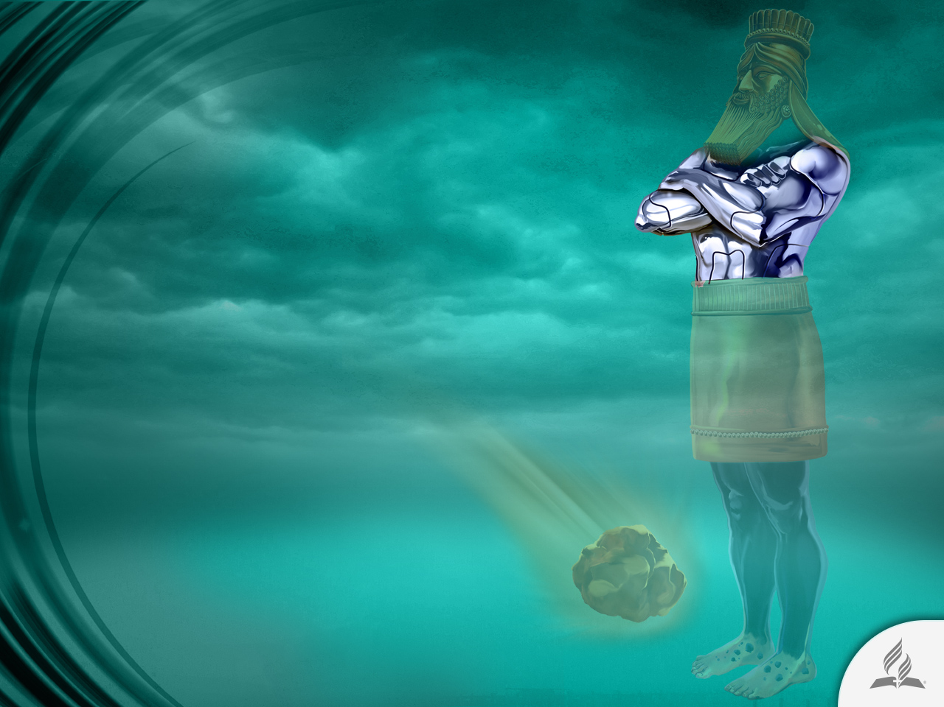
The Silver Chest and Arms
“After you, another kingdom will arise, inferior to yours…” (Dan. 2:39).
It represents the Medo-Persian Empire (539-331 BC).
For them, silver was the principle metal for making financial transactions.

Slide 17
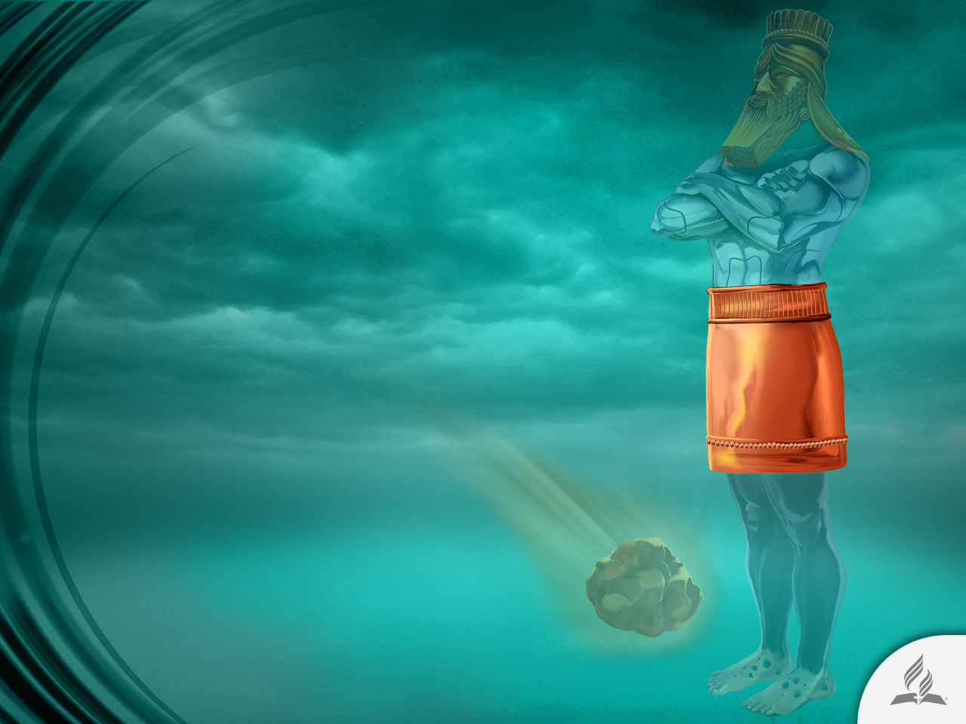
The Bronze Belly
“Next, a third kingdom, one of bronze, will rule over the whole earth” (Daniel 2:39).
It represents the Greek Empire (331-168 BC).
The Greek army used bronze armor.

Slide 18
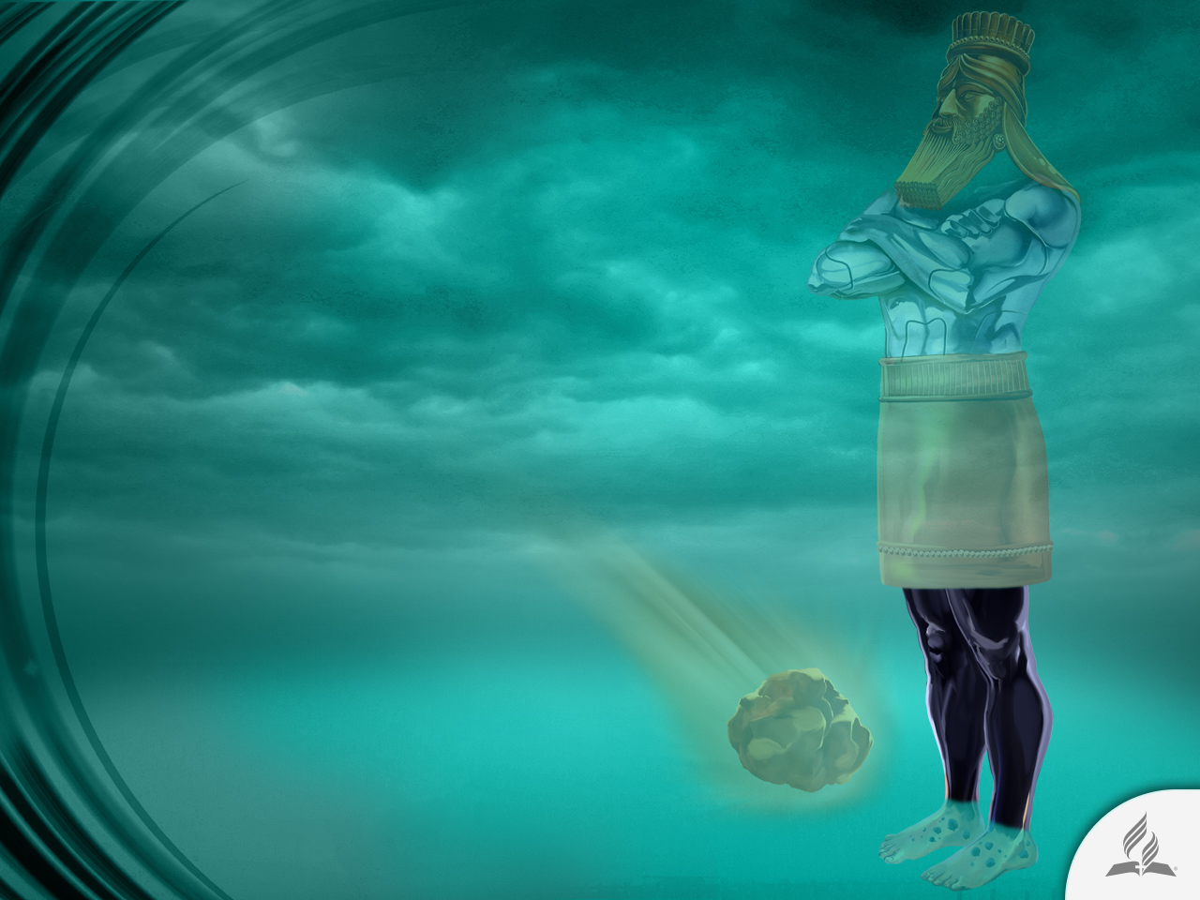
The Iron Legs
“Finally, there will be a fourth kingdom, strong as iron —for iron breaks and smashes everything—and as iron breaks things to pieces, so it will crush and break all the others” (Daniel 2:40).
It represents the Roman Empire (168 BC-476 AD).
The Roman empire was perhaps the best organized institution in history.

Slide 19
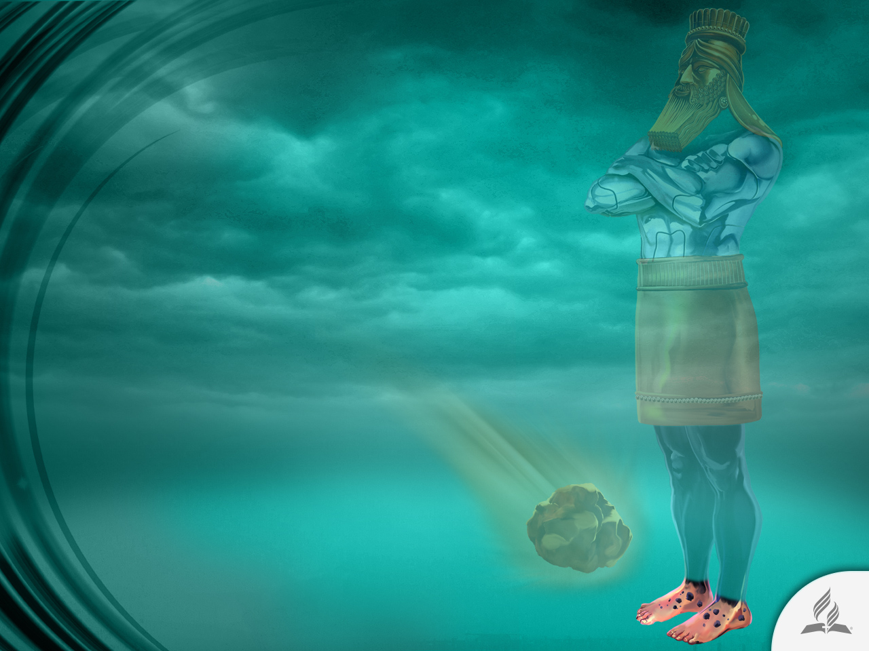
The Clay and Iron Feet
“This will be a divided kingdom... As the toes were partly iron and partly clay, so this kingdom will be partly strong and partly brittle” (Dan. 2:41-42).
It represents the subsequent organization of the world:
Barbarian tribes
European countries

Slide 20
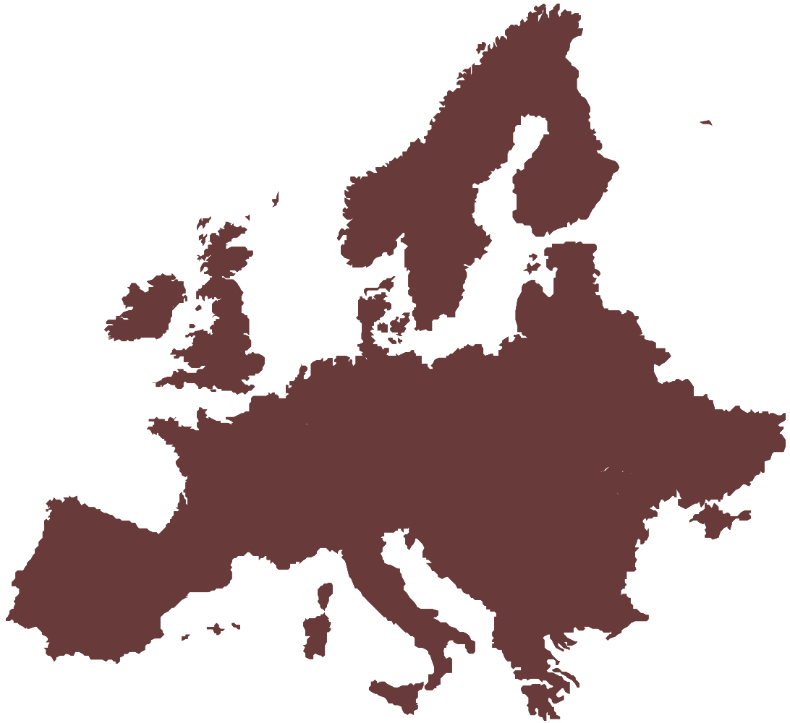
A Divided World
The world is divided by powerful and weak countries.
Disunity and lack of harmony are important characteristics of our planet.

Slide 21
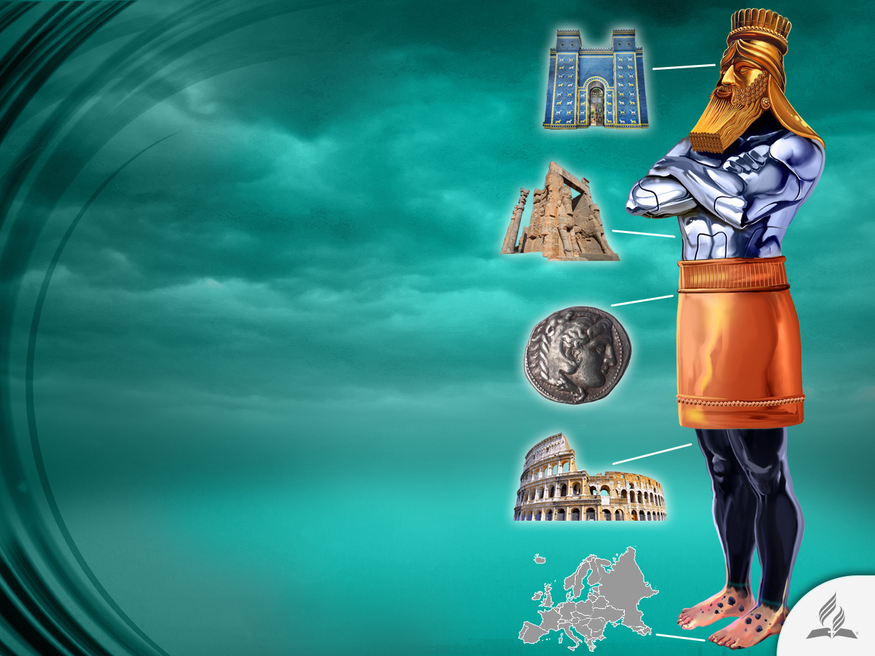
World’s History Abridged
Golden head: Babylon
Silver chest and arms: Medo-Persia
Bronze belly: Greece
Iron Legs: Rome
Clay and iron feet: European countries

Slide 22
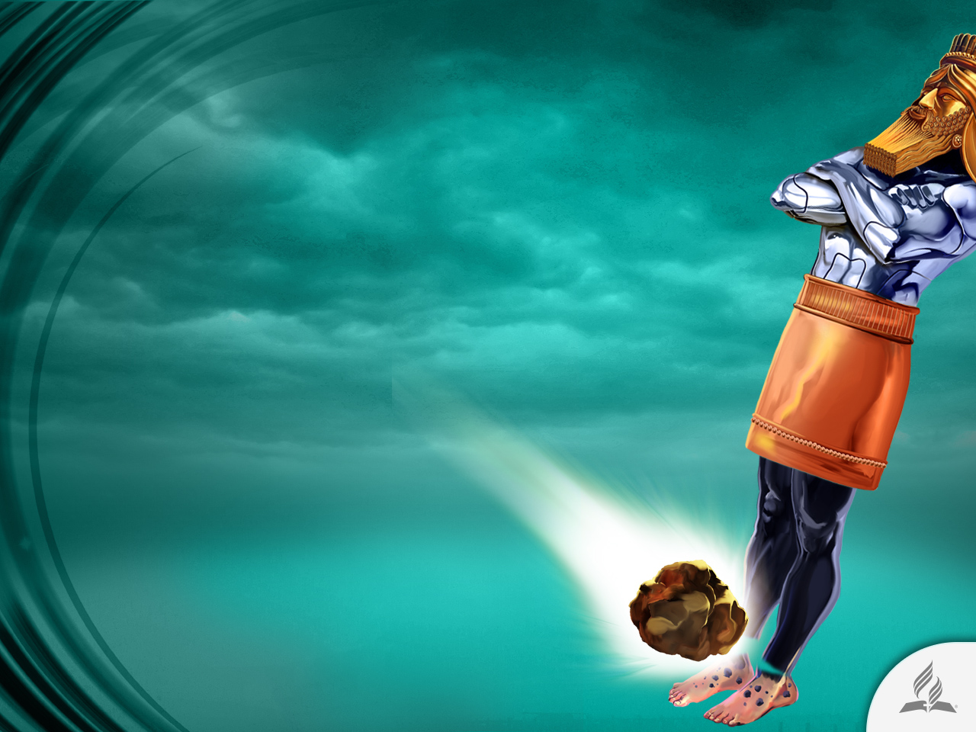
A Rock Destroys the Statue
“While you were watching, a rock was cut out, but not by human hands. It struck the statue on its feet of iron and clay and smashed them…. The statue became a huge mountain and filled the whole earth” (Dan. 2:34-35).

Slide 23
A New Attempt at World Unity

Slide 24
The Beast that Rises from the Water
“The dragon stood on the shore of the sea. And I saw a beast coming out of the sea. It had ten horns and seven heads, with ten crowns on its horns, and on each head a blasphemous name. The beast I saw resembled a leopard, but had feet like those of a bear and a mouth like that of a lion. The dragon gave the beast his power and his throne and great authority. One of the heads of the beast seemed to have had a fatal wound, but the fatal wound had been healed. The whole world was filled with wonder and followed the beast. People worshiped the dragon because he had given authority to the beast, and they also worshiped the beast and asked, ‘Who is like the beast? Who can wage war against it?’

Slide 25
The Beast that Rises from the Water
The beast was given a mouth to utter proud words and blasphemies and to exercise its authority for forty-two months. It opened its mouth to blaspheme God, and to slander his name and his dwelling place and those who live in heaven. It was given power to wage war against God’s holy people and to conquer them. And it was given authority over every tribe, people, language and nation. All inhabitants of the earth will worship the beast—all whose names have not been written in the Lamb’s book of life, the Lamb who was slain from the creation of the world” (Revelation 13:1-8).

Slide 26
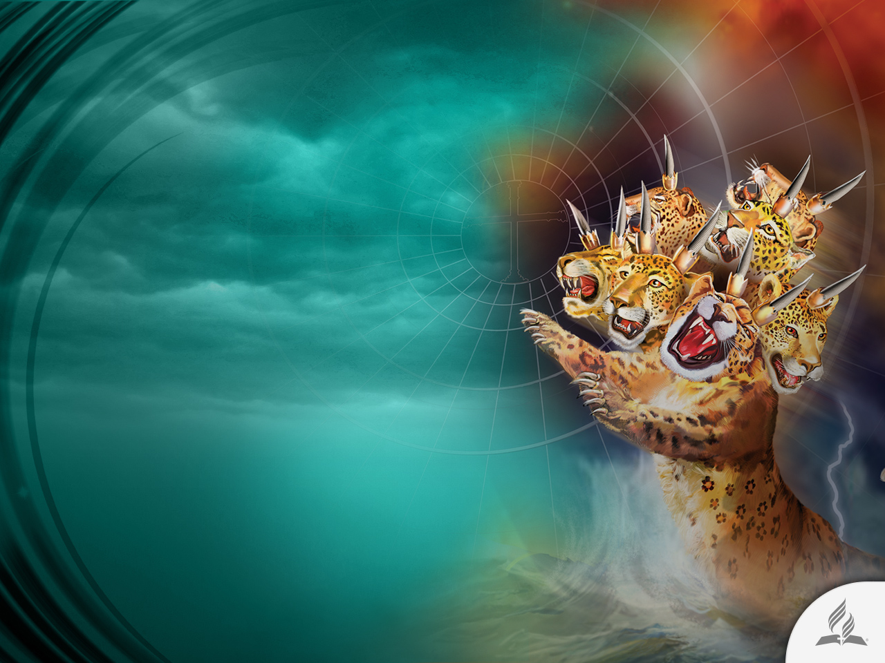
Characteristics of the Beast that Rises from the Water
The dragon gave the beast its power, its throne, and great authority.
The world worshiped the dragon that gave great authority to the beast. They worshiped the beast, saying “Who is like the beast and who can fight against it?”
One of its heads suffered a fatal wound.

Slide 27
Characteristics of the Beast that Rises from the Water
It was given a mouth that spoke arrogant words and blasphemies.
It was allowed to wage war against holy people, and defeat them.
It was given authority to persecute for 42 months (1,260 years).
The number of the beast is the number of a man: 666 (Rev. 13:18).

Slide 28
A Political-Religious System
The dragon is a symbol of Satan, clearly identified in Daniel and Revelation, acting through the Roman Empire.
The beast represents a power or political-religious system that intends to usurp the authority of God.
It will seek to change God’s laws and impose economic sanctions and impose the death penalty on those who oppose its efforts.

Slide 29
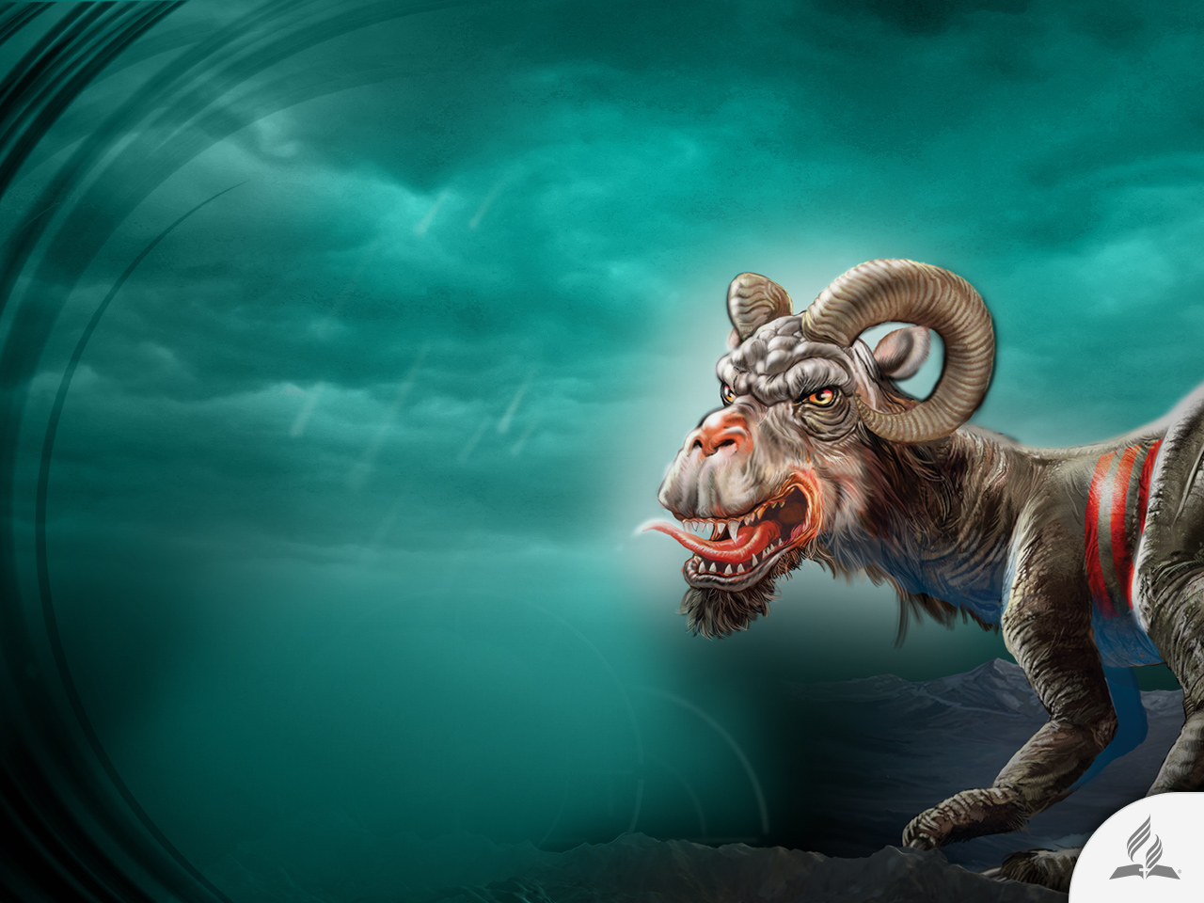
A Second Beast Arises
“Then I saw a second beast, coming out of the earth. It had two horns like a lamb, but it spoke like a dragon. It exercised all the authority of the first beast on its behalf, and made the earth and its inhabitants worship the first beast, whose fatal wound had been healed. And it performed great signs, even causing fire to come down from heaven to the earth in full view of the people” (Rev. 13:11-13).

Slide 30
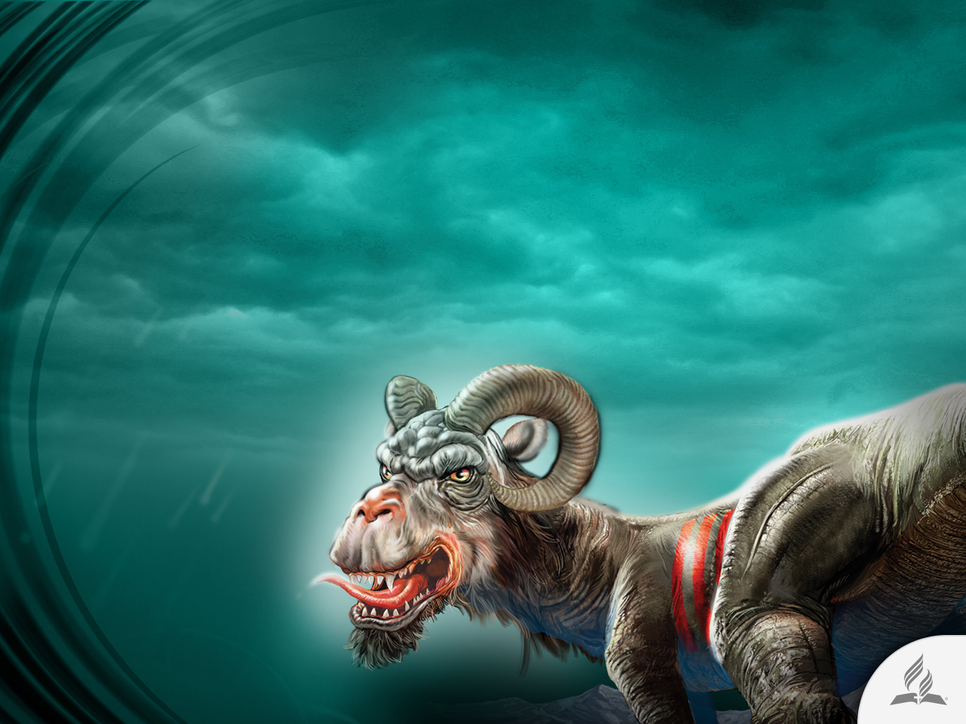
A Second Beast Arises
Comes out of the earth.
Has horns like a lamb and acts like it.
Speaks like a dragon.
Imitates the ruling way of the first beast.
Forces the world to obey the first best.

Slide 31
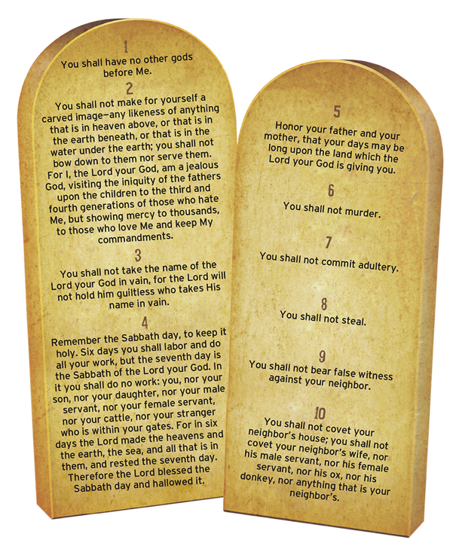
The Mark of the Beast
The mark of the beast consists of extolling human religious tradition above the commandments of God. It places human standards above the latter and gives preference to ecclesiastic dogmas over inspired revelation. This involves a false system of worship that will try to replace the holy day, namely, the Sabbath of the Creator.
The mark does not consist of something physical; it is a symbol of rebellion and infidelity to God’s government.

Slide 32
The Mark of the Beast
Whereas number seven in the Bible represents what is perfect and whole in the work of God (see Rev. 1:20; 5:1; 8:2; 16:17), number six is a symbol of what is incomplete and partially true, which can be more dangerous than a complete lie.
Number six repeated three times (666) refers to a trinity that proclaims lies, falsehood, and deceit.
In this case, it is a triple trap for “man” and a human organization.

Slide 33
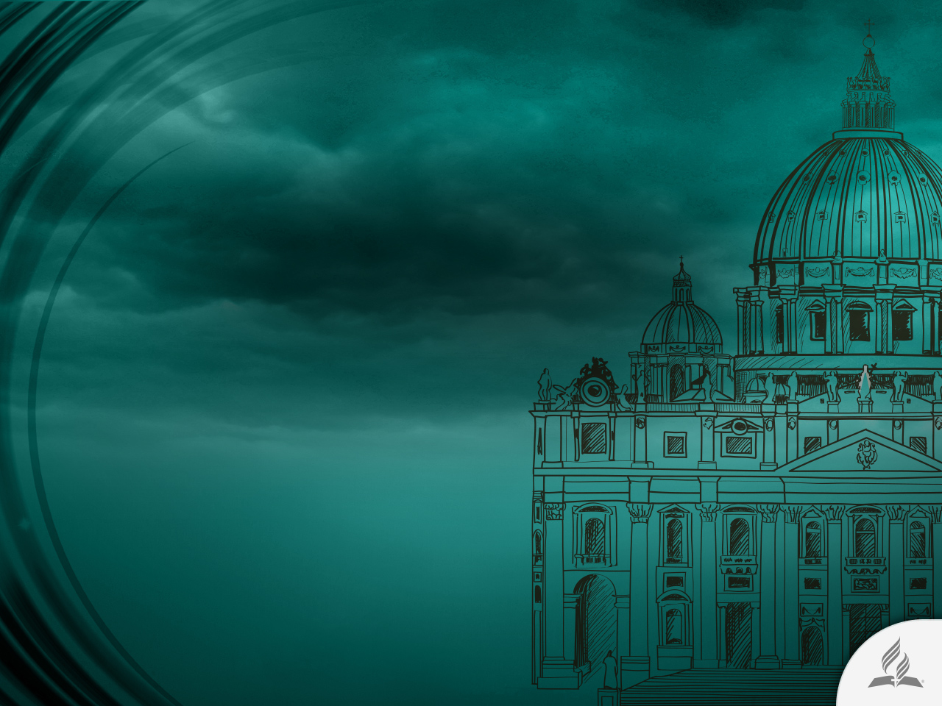
Who are these Beasts?
The papacy conforms to the characteristics of the beast, which, through support from the second beast in Revelation 13:11-18, identified as the United States of America, will require the observance of Sunday as the day of rest.

Slide 34
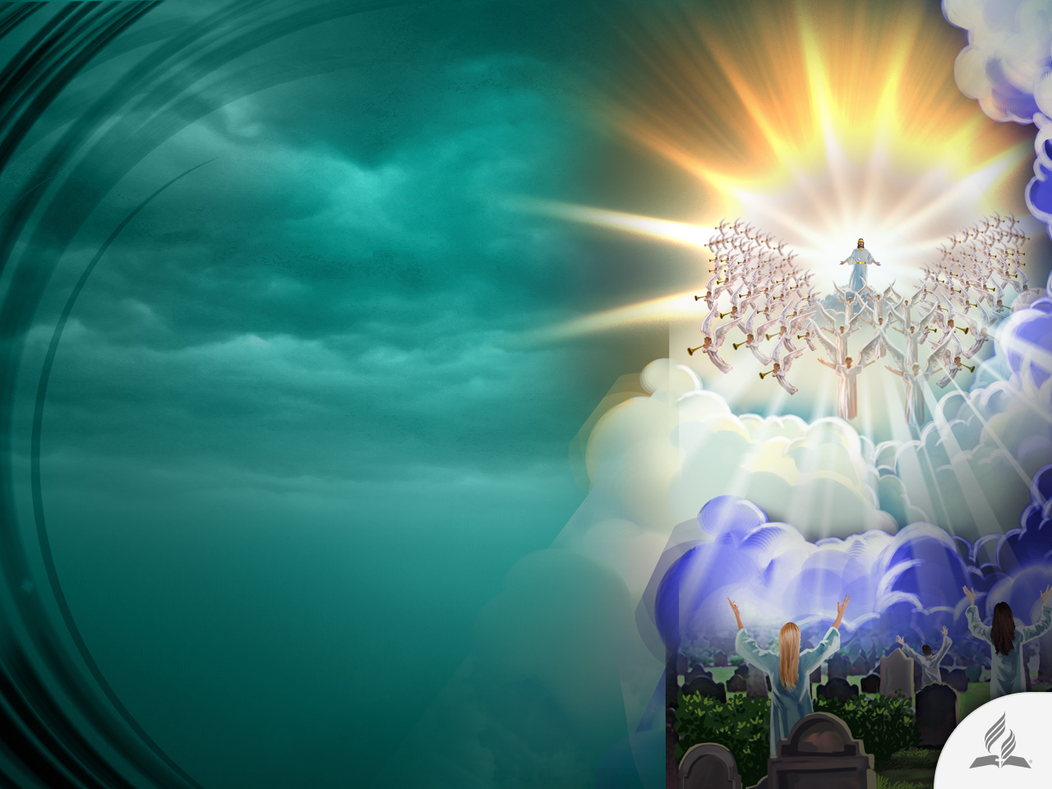
The Establishment of
God’s Kingdom
“In the time of those kings, the God of heaven will set up a kingdom that will never be destroyed, nor will it be left to another people. It will crush all those kingdoms and bring them to an end, but it will itself endure forever” (Dan. 2:44).

Slide 35
Summary
We live in a disrupted world. Instability continues to greatly disrupt the planet.
Today, with the development of technology and social networks, the dream of a new world order, an ancient desire of many people, seems more feasible.
The Bible says that in the past there were some empires that tried to establish a world order.
According to the Bible, at the end of times there would be another attempt for establishing a new world order.
This time it would be a political-religious alliance that would challenge God’s plans.
At the end, Jesus will come and establish an eternal kingdom.

Slide 36
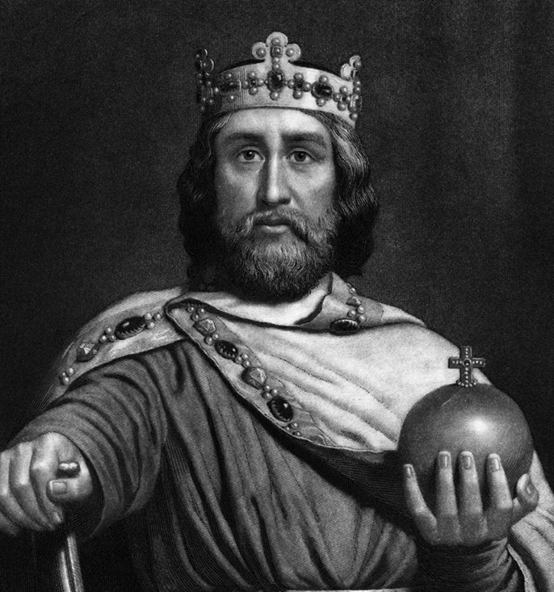
Ancient Attempts to Establish a New World Order: Charlemagne
He united a large part of Europe during the early Middle Ages.
He took the Frankish throne in 768 and became King of Italy in 774.
From 800 he became the first Holy Roman Emperor—the first recognized emperor in Western Europe since the fall of the Western Roman Empire.

Slide 37
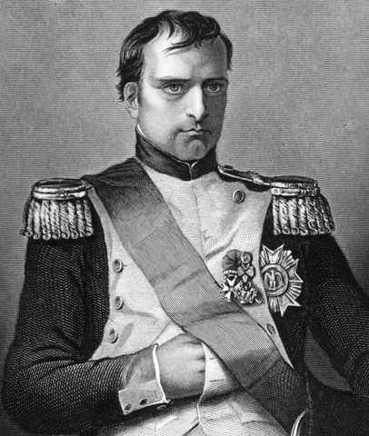
Ancient Attempts to Establish a New World Order: Napoleon
Napoleon dominated European and global affairs for more than a decade while leading France against a series of coalitions in the Napoleonic Wars.
He won most of these wars and the vast majority of his battles, building a large empire that ruled over continental Europe before its final collapse in 1815.

Slide 38
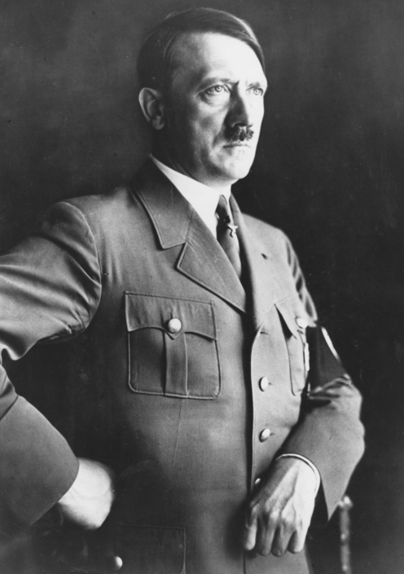
Ancient Attempts to Establish a New World Order: Adolf Hitler
He was leader of the Nazi Germany from 1934 to 1945.
He started the World War II in Europe in 1939 and invaded many countries, all in an attempt to create a new world order.

Slide 39
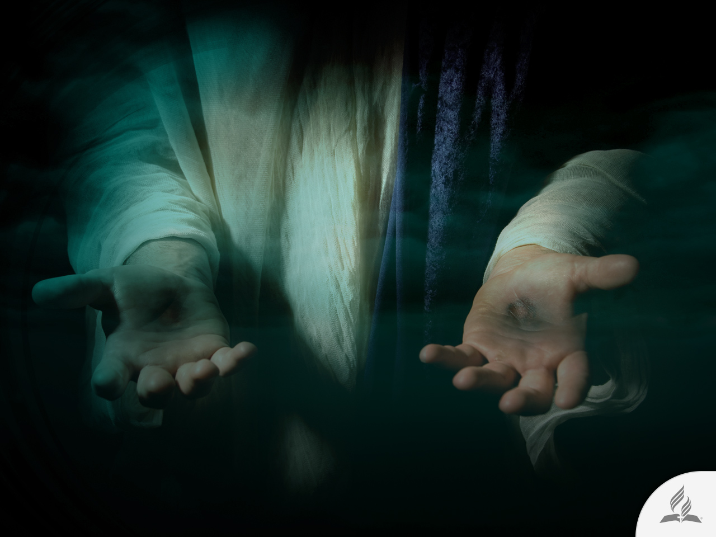
My Decision
Jesus said: “And surely I am with you always, to the very end of the age” (Matt. 28:20).
Are you willing to accept this promise Jesus offers you?

Slide 40
Next Topic:
WHEN WILL THE END OF
THE WORLD COME?
A Recurring Thought
The Most Extraordinary Event in History
A Deranged Society
Why Has Jesus Not Come Yet?
The Promise Remains Valid

