Slide 1


Slide 2
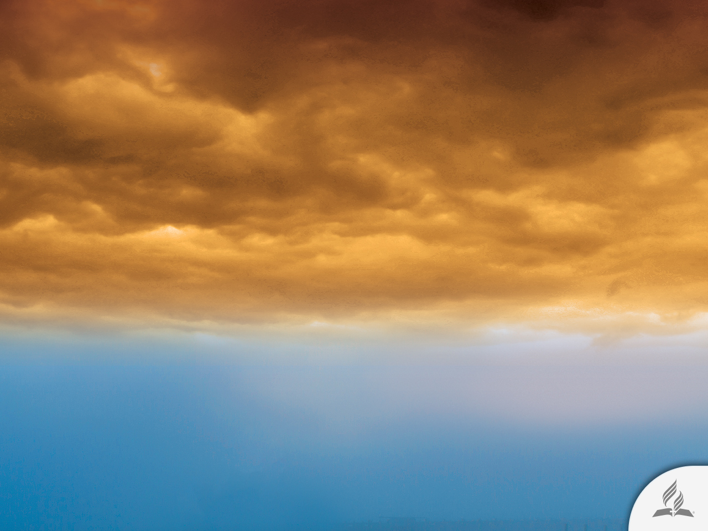



When Will the End of the World Come?
Topic 11

Slide 3
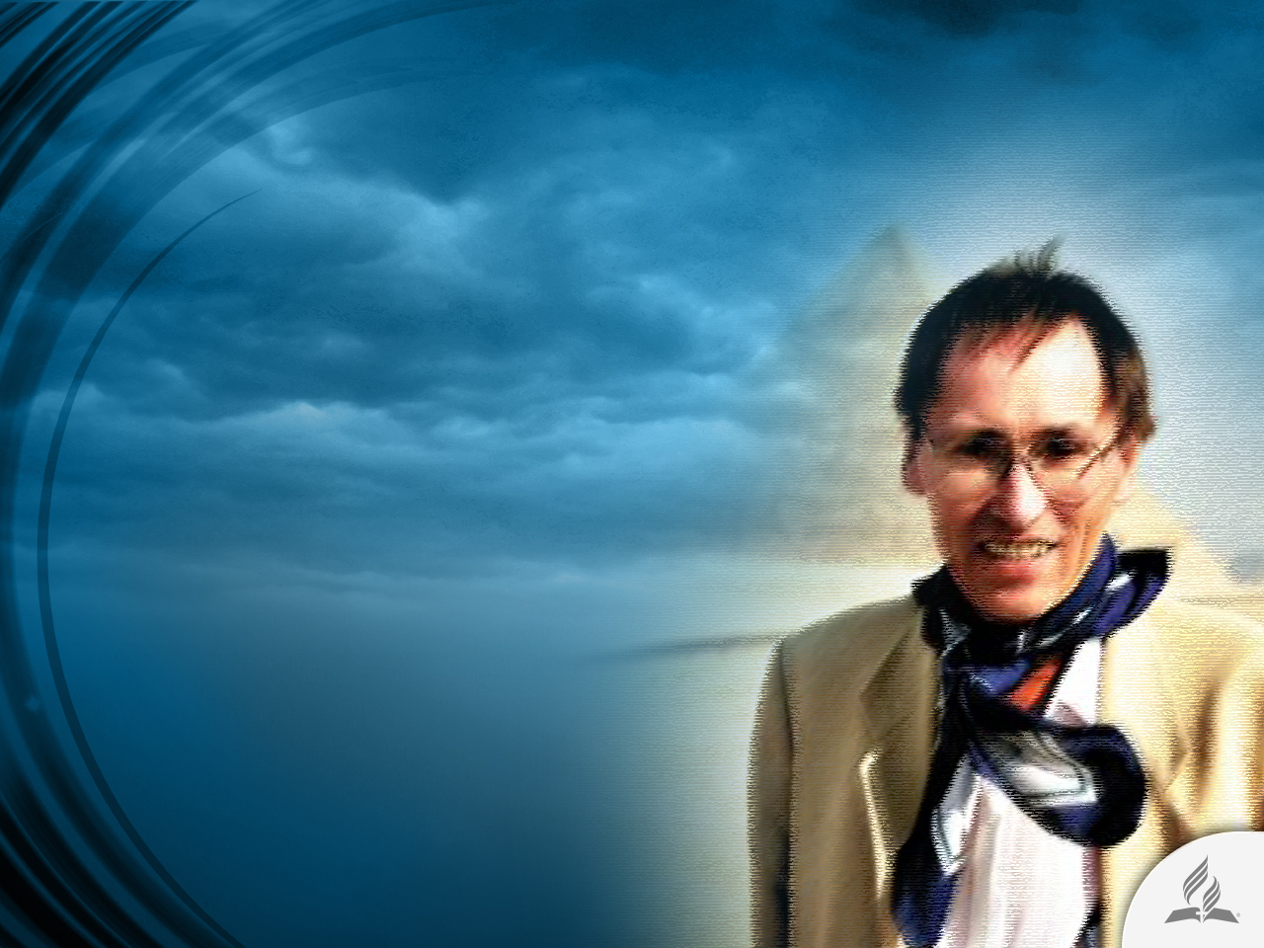
Waiting for the End of the World
In the Sierra Nevada Mountains in southern Spain, Belgian writer Patrick Geryl built a bunker where he planned on hiding from the cataclysm that, according to him, would destroy the planet on December 21, 2012.
“We want a place that is 2,000 meters above sea level,” he explains. He and his supporters were attempting to shelter 5,000 people in a place that would “withstand the horrors of the end of the world.”

Slide 4
A Disrupted World
December 2012, the end of the world month, was a recurring theme thanks to certain “prophetic” discoveries.
The first theory to surface was that the earth would be struck by the planet Nibiru in 2012.
Next, discussions arose about the Mayan Calendar, which apparently ended on December 21 of the same year.

Slide 5
A Disrupted World
Later, interpreters of Nostradamus, and some “specialists” in geological and astronomical predictions, prepared a list of catastrophes that awaited the world. These included: the earth’s magnetic field inversion; a change in the earth’s rotational axis; a devastating solar storm; and an alleged planetary alignment in which our world would end up in the center of the Milky Way. All of this by December 2012.
But December 2012 is history, and the world continues with its daily struggles.

Slide 6
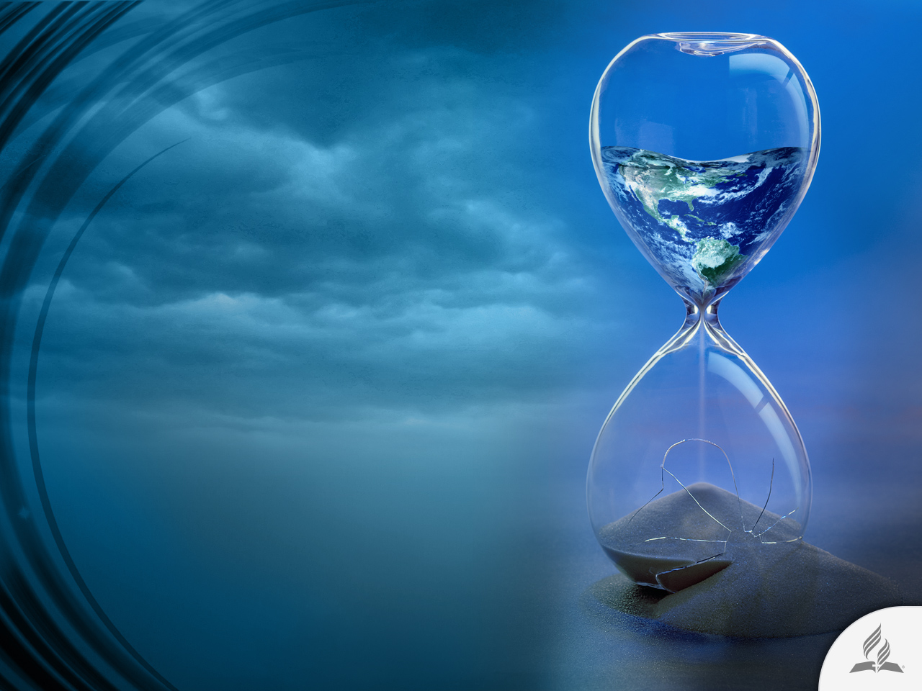
A Recurring Thought
The idea of the end of the world terrifies humanity.
People have their own way of facing it.
Some laugh or remain indifferent, others despair, and others, such as the Belgian writer, try to prepare a place to escape from the “final cataclysm.”

Slide 7
Some Movies about the End of the World
The Day After (1983)
Miracle Mile (1988)
The Rapture (1992)
Time of the Wolf (2003)
The Day after Tomorrow (2004)
War of the Worlds (2005)
I Am Legend (2007)
The Invasion (2007)
Fish Story (2009)
2012 (2009)
Take Shelter (2011)
Melancholia (2011)
4:44: Last Day on Earth (2011)
Seeking a Friend for the End of the World (2012)
This Is The End (2013)
These Final Hours (2013)
Zodiac: Signs of the Apocalypse (2014)

Slide 8
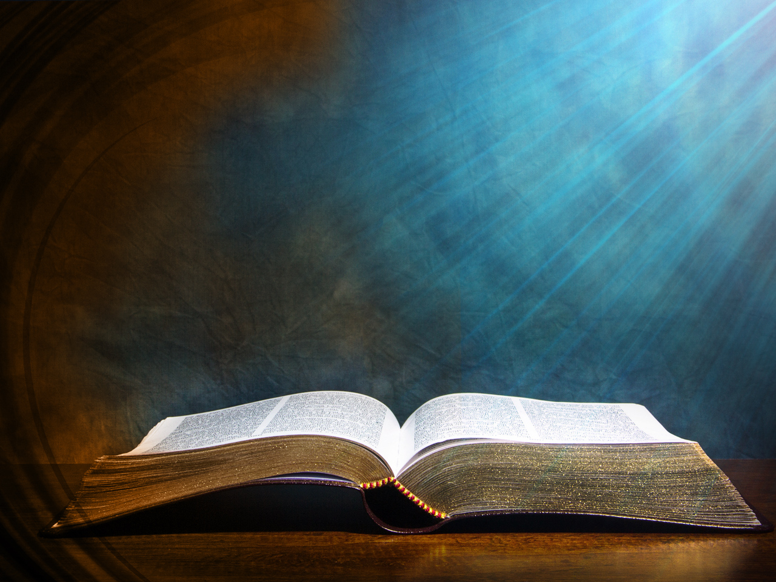
WHAT DOES THE BIBLE SAY ABOUT THE END OF THE WORLD?

Slide 9
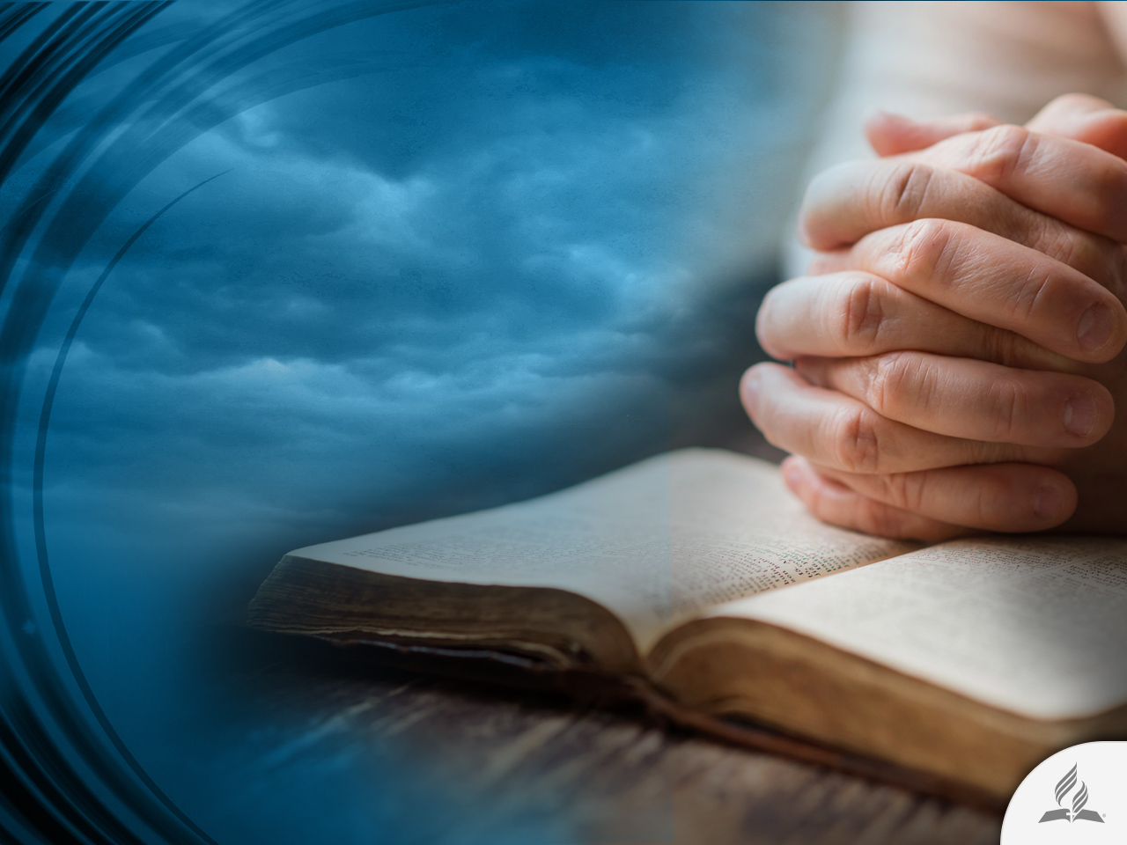
Words of Comfort and Encouragement
“Do not let your hearts be troubled. You believe in God; believe also in me. My Father’s house has many rooms; if that were not so, would I have told you that I am going there to prepare a place for you? And if I go and prepare a place for you, I will come back and take you to be with me that you also may be where I am” (John 14:1-3).

Slide 10
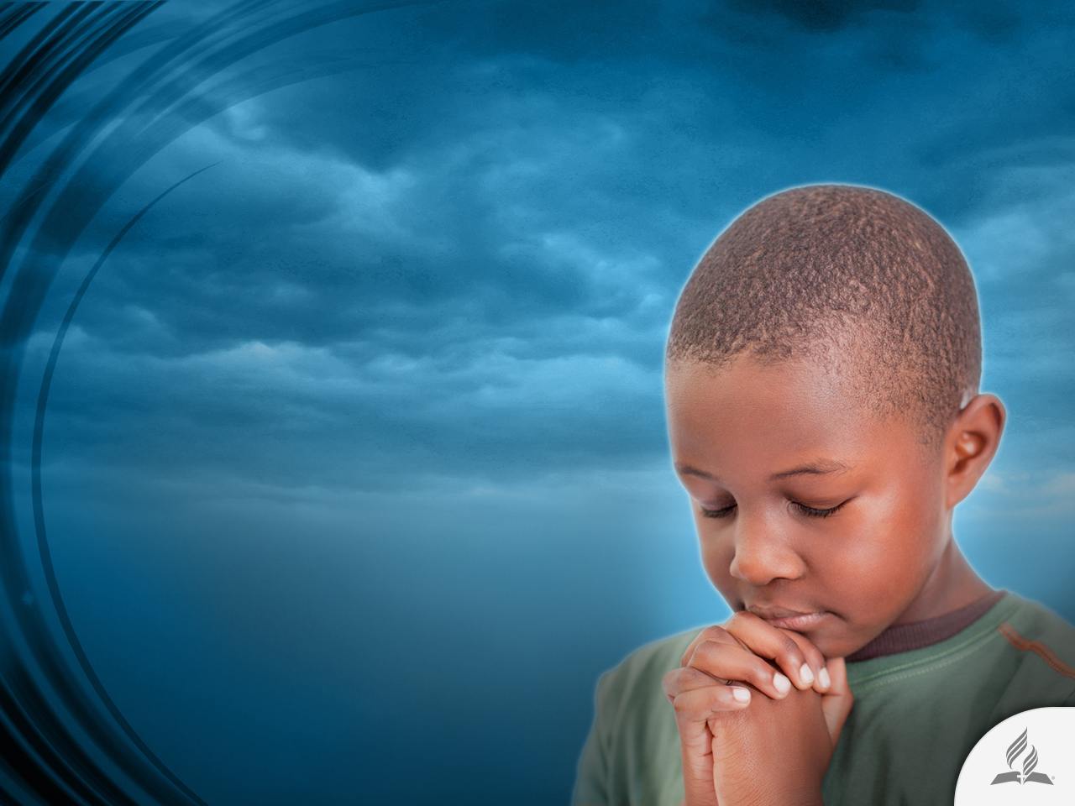
Belief in God
It gives us sense and purpose of life.
Origin
Identity
Strength

Slide 11
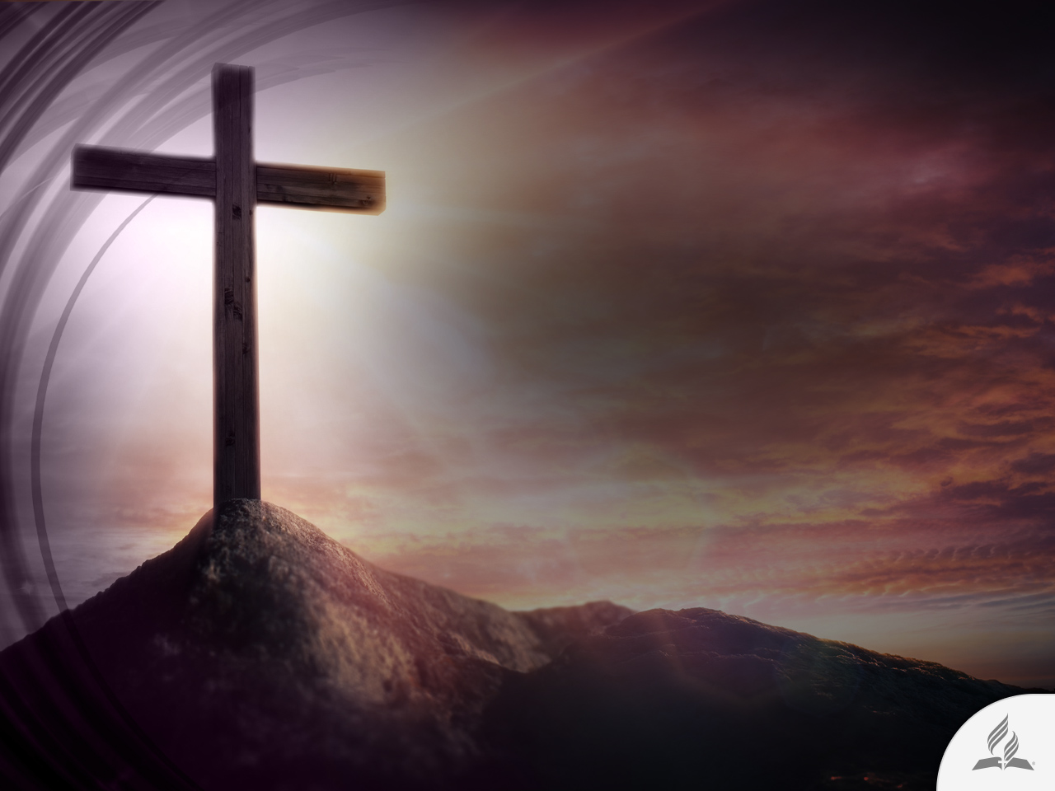
Belief in Jesus
Jesus gives us forgiveness, redemption, restoration, empathy, etc.
Without Him there is no salvation (Acts 4.12).

Slide 12
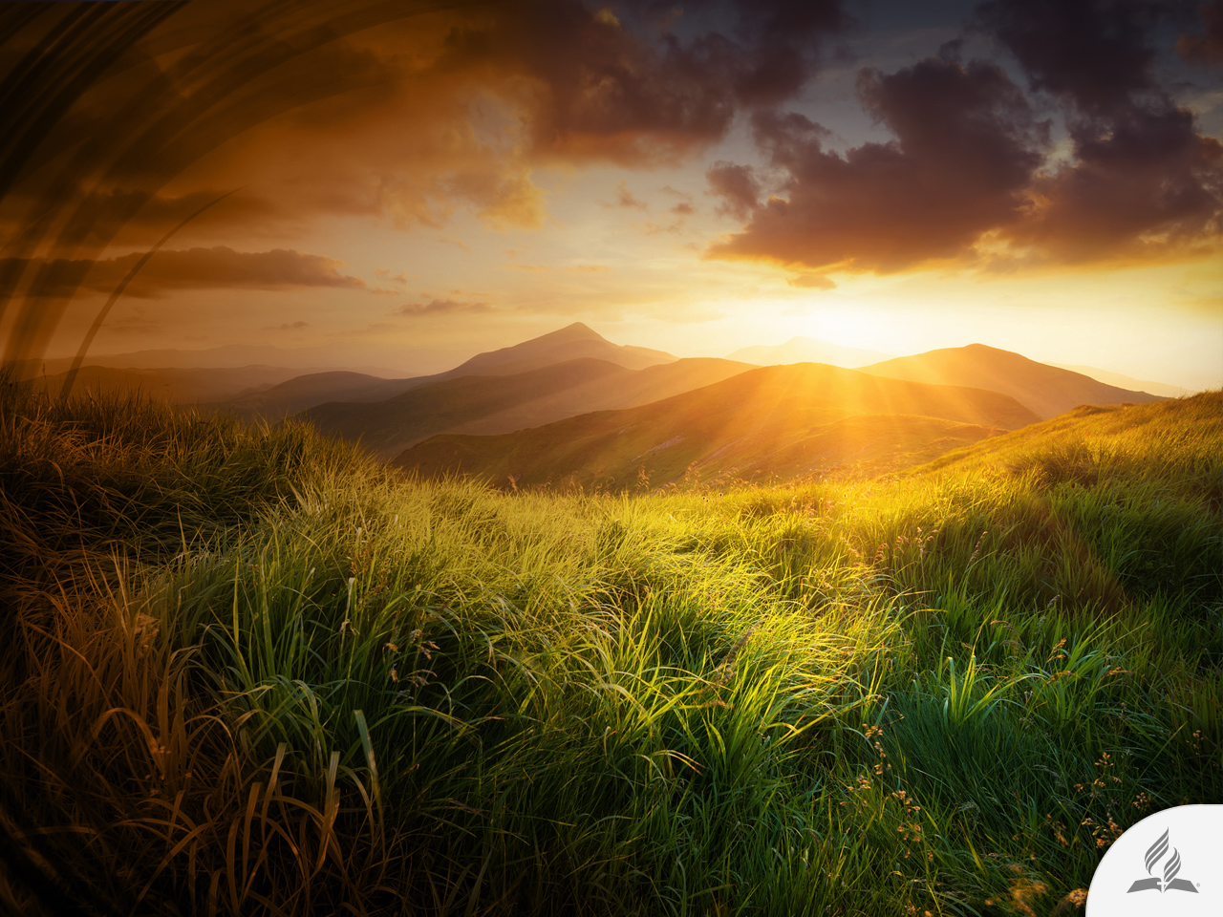
Belief in Heaven
It gives a belonging and security sense in order to face the future.
This our real home.

Slide 13
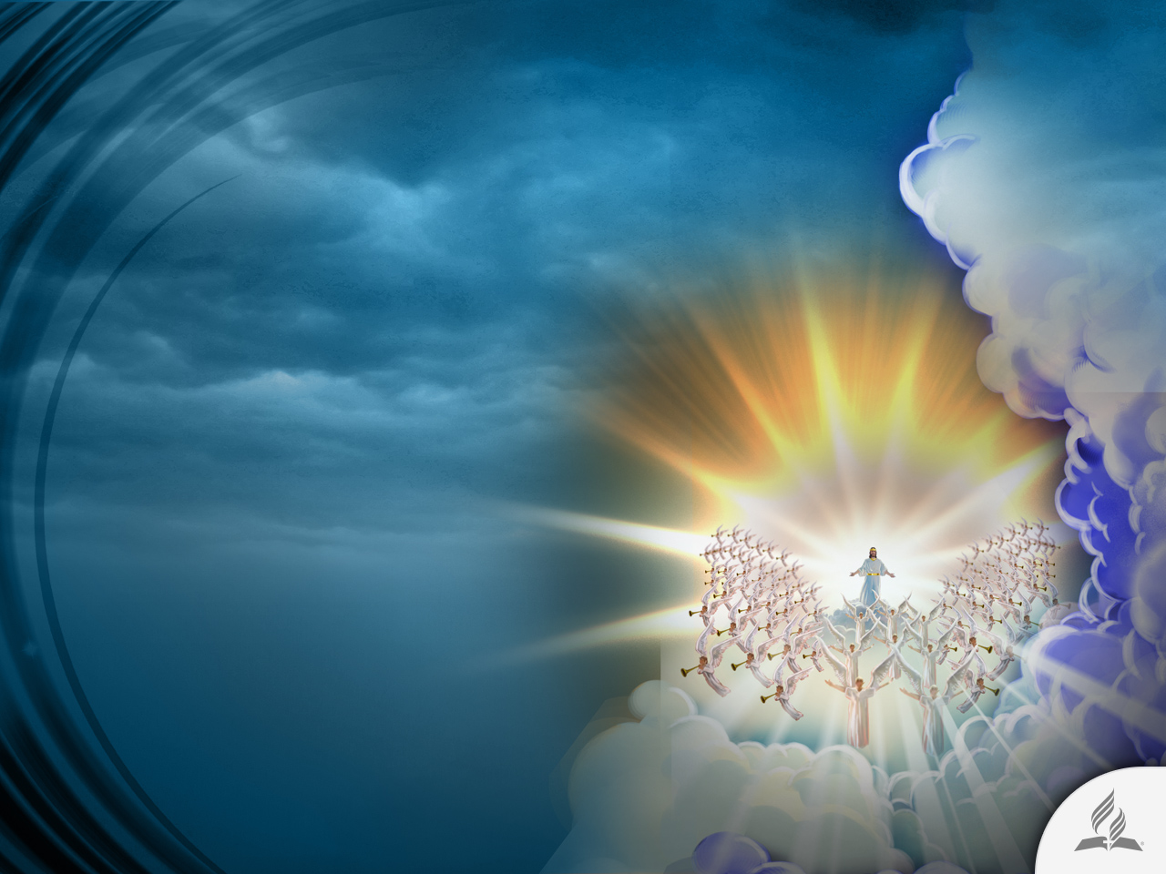
Belief in the Second Coming
It gives us hope to face the actual situation.
It also gives us energy for keeping us waiting for our Lord.
It reminds us that very soon the world’s conditions are going to change.

Slide 14
How Is Jesus Going to Come?
Visible (Rev. 1:7)
Audible (1 Thess. 4:16)
Sudden and unexpectedly (Matt. 24:36)
Glorious (Matt. 24:30)

Slide 15
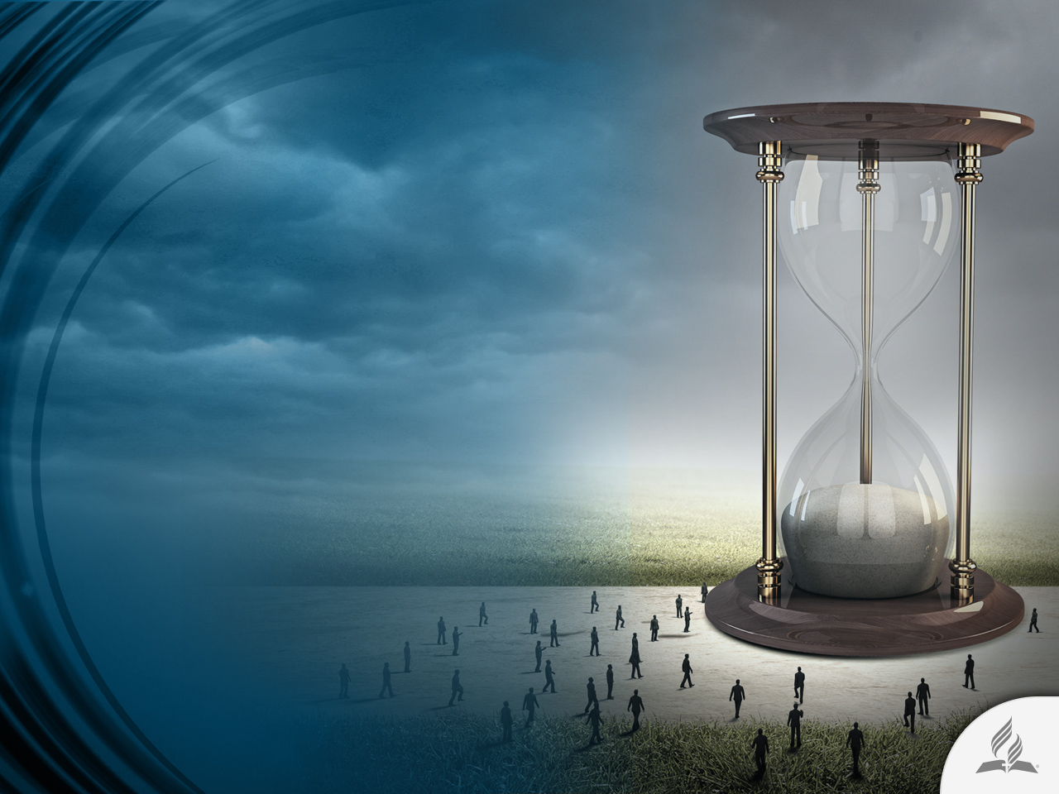
CHARACTERISTICS OF
THE END TIME

Slide 16
As in the Days of Noah
“As it was in the days of Noah, so it will be at the coming of the Son of Man. For in the days before the flood, people were eating and drinking, marrying and giving in marriage, up to the day Noah entered the ark; and they knew nothing about what would happen until the flood came and took them all away. That is how it will be at the coming of the Son of Man” (Matt. 24:37-39).

Slide 17
Four Characteristics of the Antediluvian World
Decadence
  Violence, immorality, unbelief, apostasy of the sons of God.
  “The Lord saw how great the wickedness of the human race had become on the earth” (Gen. 6:5).
Proclamation
  Noah proclaimed the Flood during 120 years.
  People did not hear him. Taunts and incredulity. Questioning of the Noah’s warning. God closed the Ark’s door (Gen. 7:17).
Judgment
  The Flood. Repentance came too late It rains during 40 days in a period of 150 days.
  The catastrophe endures for about one year.
Regeneration
  The Earth will be regenerated in order to be inhabited by the people of God.
  The Lord cleanses the world of evil because this planet will be His new home.

Slide 18

The Time: the Religious World
(Matt. 24:5, 11)
Spiritualism rises
Deceivers
False messiahs
False prophets
Strange Ideas
Religious ingenuity in the people

Slide 19
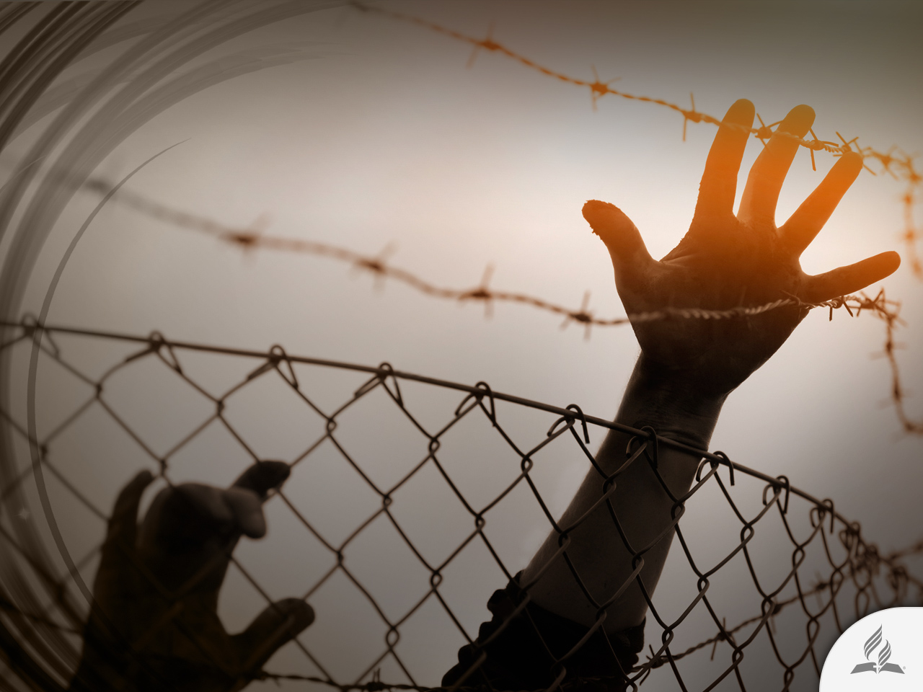
The Time: International Politics
(Matt. 24:6-7)
Wars
Rumors of wars
Corruption
Political instability
Social disillusionment with government leadership

Slide 20
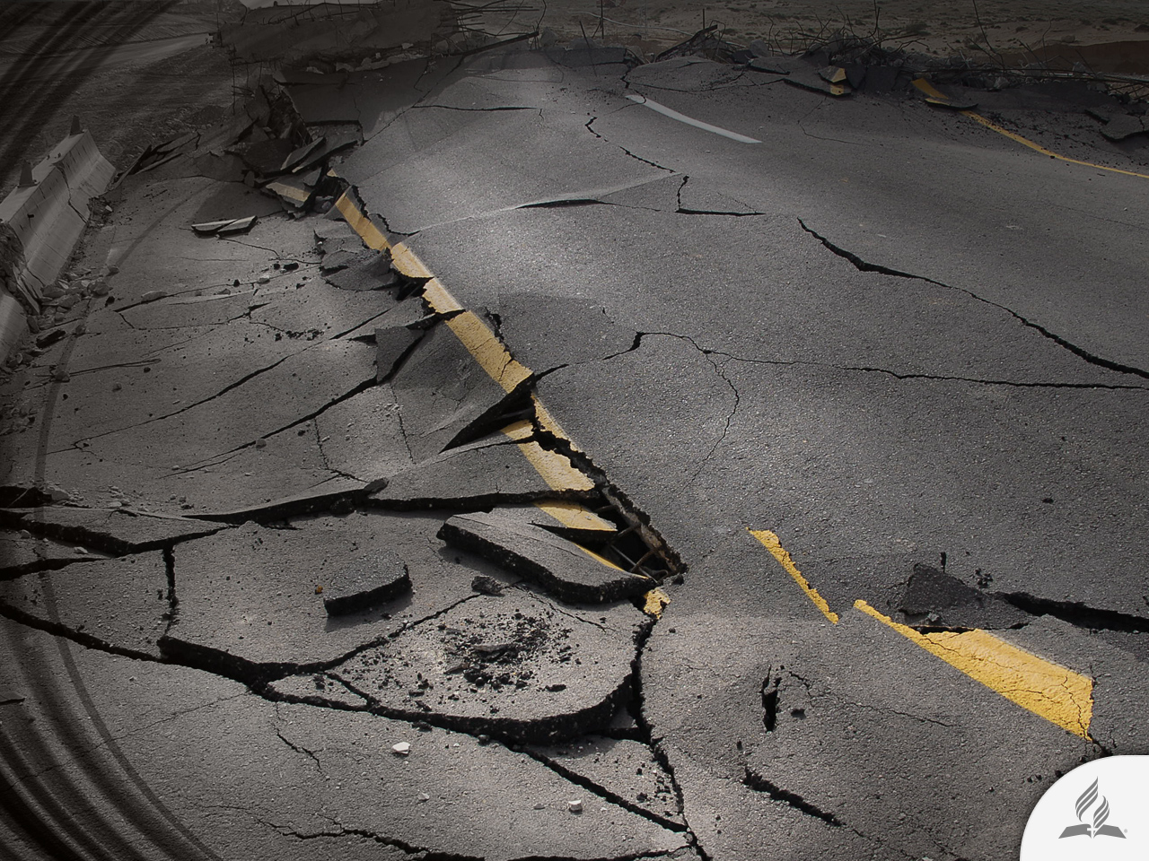
The Time: Natural Disasters
(Matt. 24:7)
Earthquakes
Famines
Drought
Floods
New diseases

Slide 21
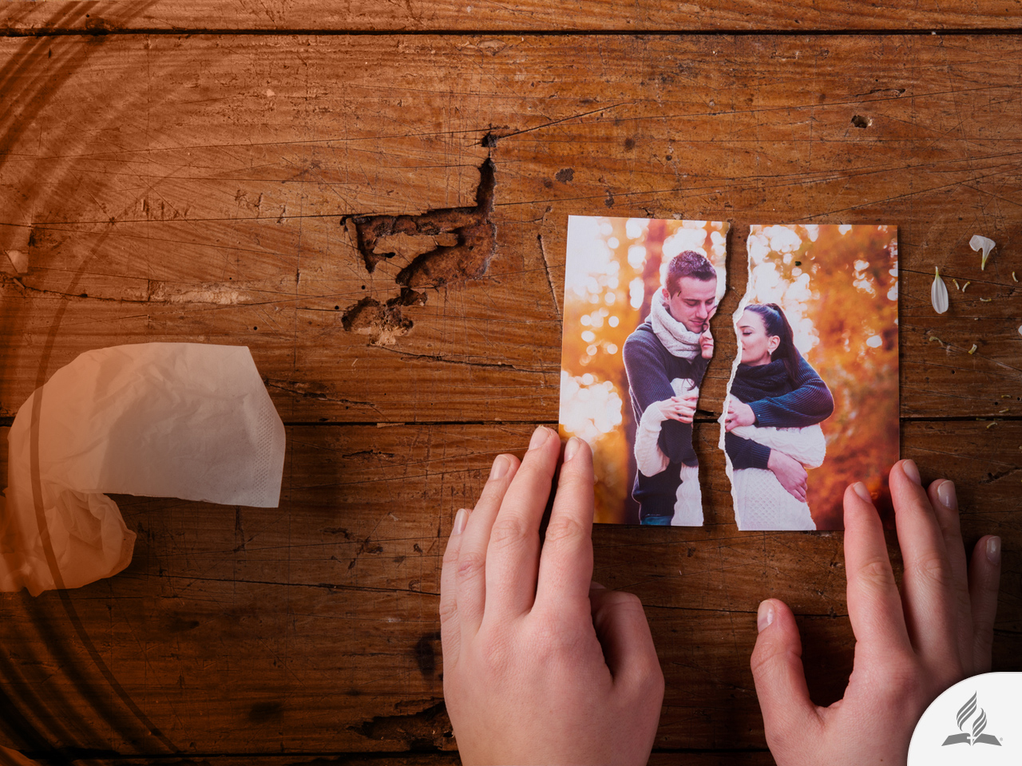
The Time: Society (Matt. 24:12)
Violence
Divorces
Selfishness
Avarice
Licentiousness
Insecurity

Slide 22
A Deranged Society
“Above all, you must understand that in the last days scoffers will come, scoffing and following their own evil desires. They will say, ‘where is this “coming” He promised? Ever since our ancestors died, everything goes on as it has since the beginning of creation’” (2 Pet. 3:3, 4).

Slide 23
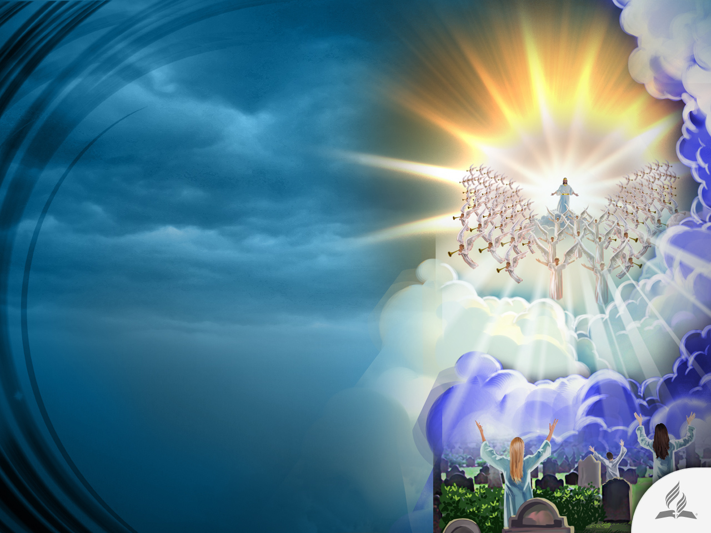
The Promise
Remains Valid

Slide 24
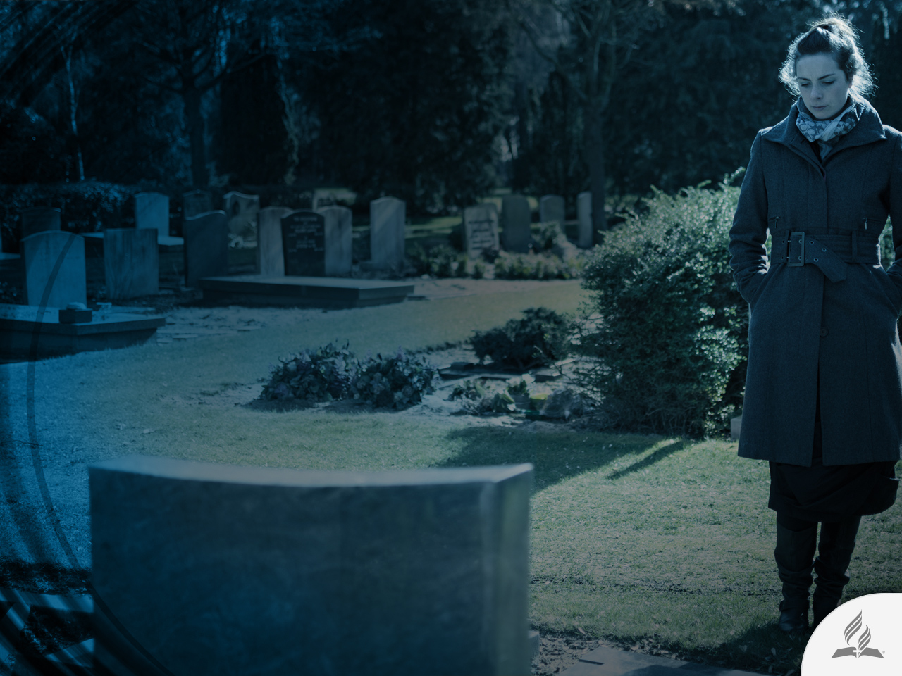
Why Is Jesus Going to Come?
To fulfill His promise of return to this world (John 14:1-3).
To liberate His people from the evil oppression.
To raise those who died believing in Him (1 Thess. 4:16).
To translate His people to the kingdom of Heaven.

Slide 25
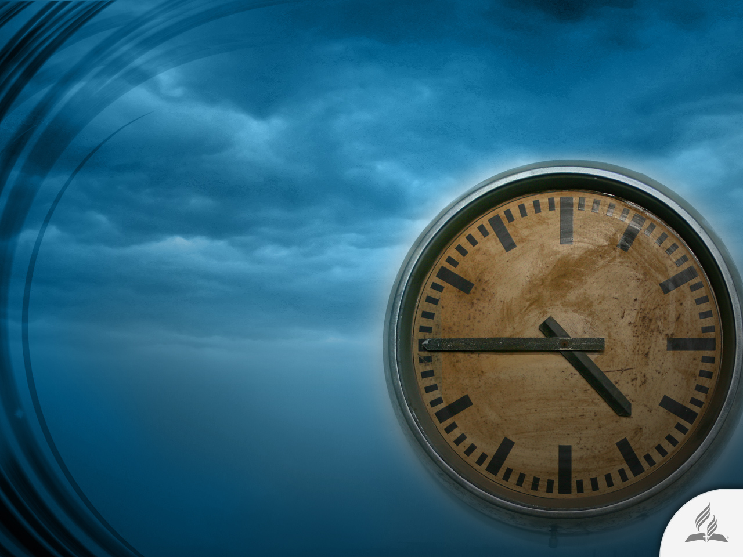
No One Knows Day or Hour
“But about that day or hour no one knows, not even the angels in heaven, nor the Son, but only the Father” (Matt. 24:36).

Slide 26

He Will Come as a Thief for Those Who Are Not Prepared
“But the day of the Lord will come like a thief. The heavens will disappear with a roar; the elements will be destroyed by fire, and the earth and everything done in it will be laid bare. Since everything will be destroyed in this way, what kind of people ought you to be? You ought to live holy and godly lives as you look forward to the day of God and speed its coming. That day will bring about the destruction of the heavens by fire, and the elements will melt in the heat” (2 Pet. 3:10-12).

Slide 27
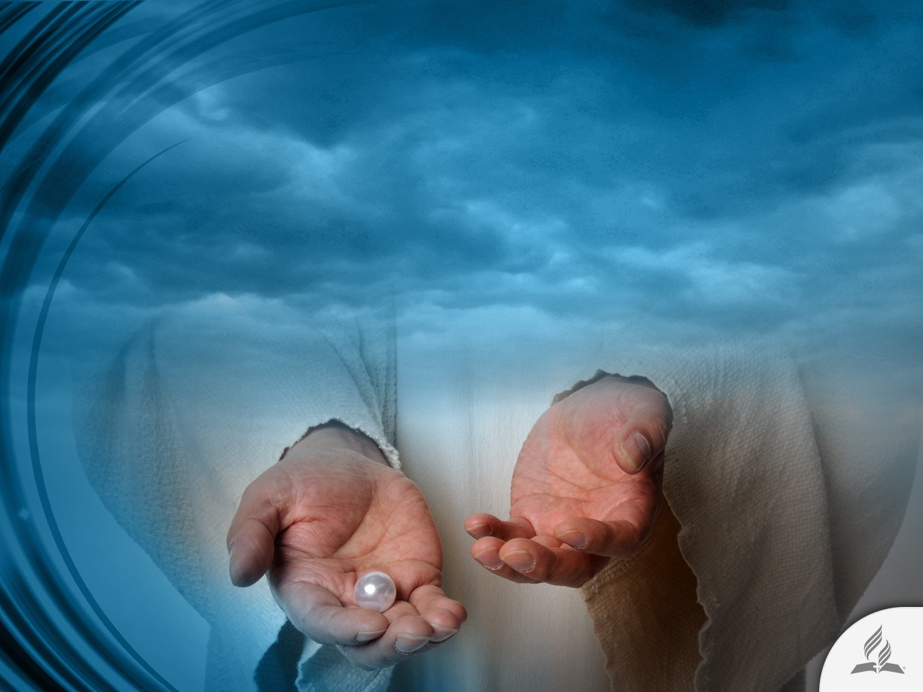
The Words of the Saints When
He Comes
“Surely this is our God; we trusted in him, and he saved us. This is the Lord, we trusted in him; let us rejoice and be glad in his salvation” (Is. 25:9).

Slide 28
Summary
The idea of the end of the world terrifies humanity.
People have their own way of facing it.
The Bible says that Jesus is going to come to this world and will establish His kingdom on this Earth.
Jesus said that before His Coming this world would be a troubled and dangerous place.
The end time is similar to the epoch when Noah preached in this world: disbelief, immorality, indifference toward the Word of God, etc.
Jesus did not tell us the time and hour of His coming. So we must wait for His return looking at the signs He gave us.

Slide 29
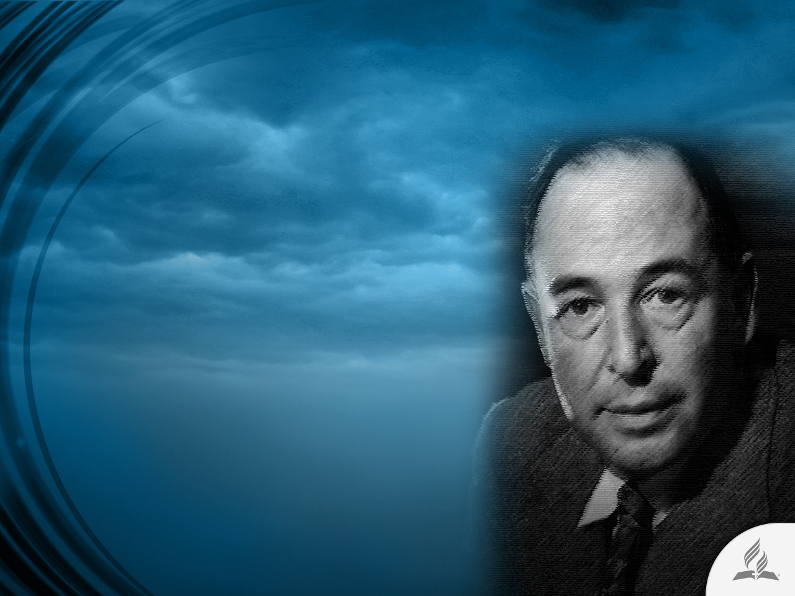
The Testimony of C. S. Lewis
He was a British novelist, poet, academic, literary critic, essayist, lay theologian, and lecturer.
He fell away from his faith during adolescence and became an atheist.
Lewis returned to belief at the age of 32.

Slide 30
The Testimony of C. S. Lewis
His faith profoundly impacted his work; his wartime radio broadcasts on the subject of Christianity brought him wide acclaim.
In reference to how the lost man will perceive the Second Coming of our Lord, he wrote: “When Christ returns, how awful to know that all of it was true, and that it is too late to do anything about it.”

Slide 31
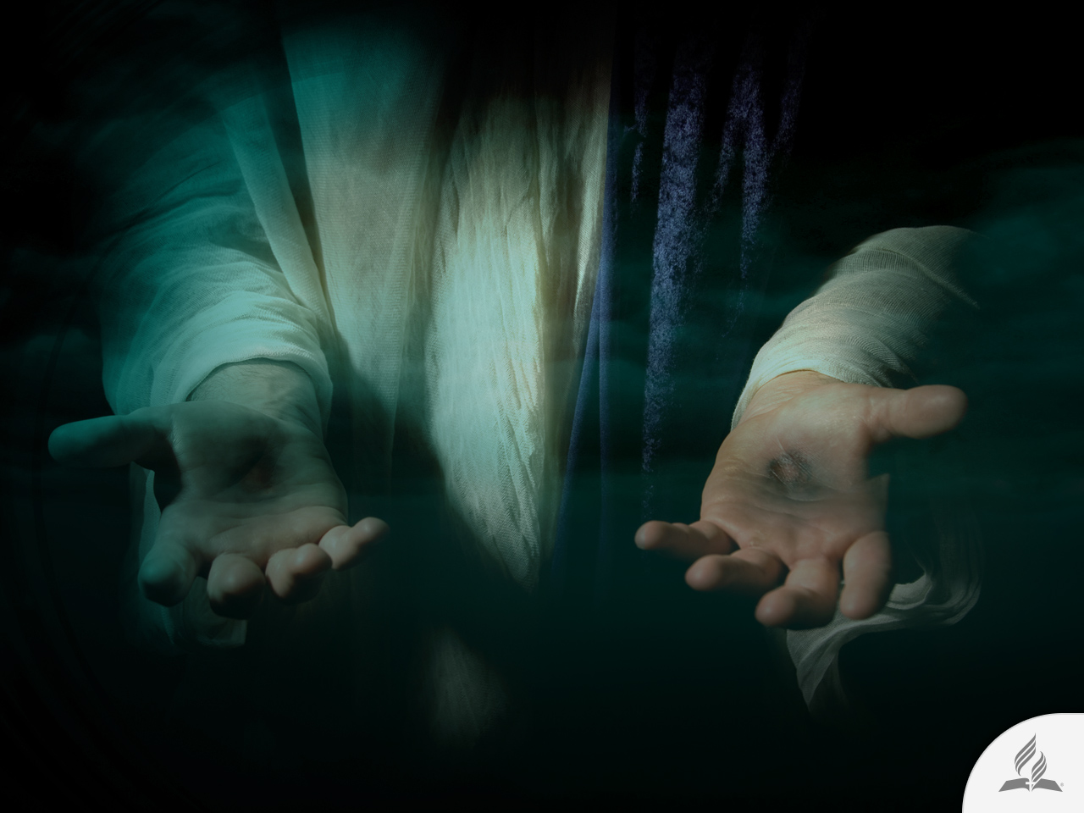
My Decision
Jesus said: “Look, I am coming soon! Blessed is the one who keeps the words of the prophecy written in this scroll” (Rev. 22:7).
Are you willing to accept the promise Jesus offers you?

Slide 32
Next Topic:
WILL THERE BE A NEW EARTH?
A New Dwelling
A Future of Little Hope
A Period of Renovation
A Reality beyond Imagination
A Blessed Hope

