Slide 1


Slide 2




WILL THERE BE A NEW EARTH?
Topic 12

Slide 3
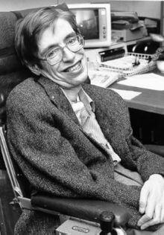
No Proof of Heaven
Stephen Hawking, former professor of Applied Mathematics and Theoretical Physics from the University of Cambridge (United Kingdom), in an interview with the newspaper The Guardian, said: “I regard the brain as a computer which will stop working when its components fail. There is no heaven or afterlife for broken down computers: that is a fairy story for people afraid of the dark.”

Slide 4
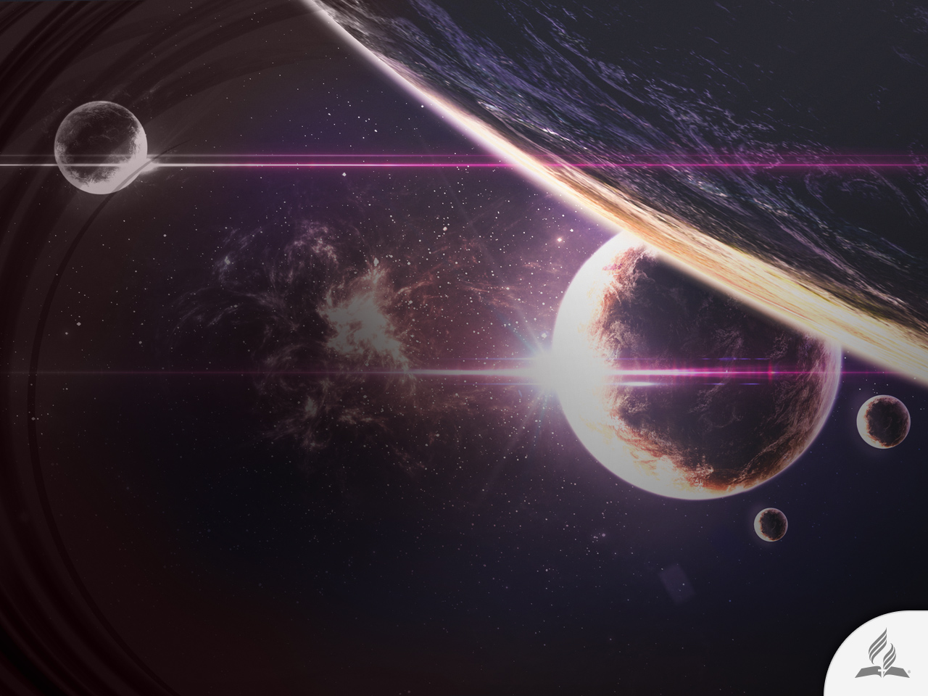
No Proof of Heaven
Hawking is right. There is no scientific proof regarding the existence of life after death.
Any idea on consciousness after death is pure speculation.
When the brain ceases to function, a person ceases to exist.
A proximate heaven or hell do not exist either.
A person’s conscious life ends when death arrives.

Slide 5
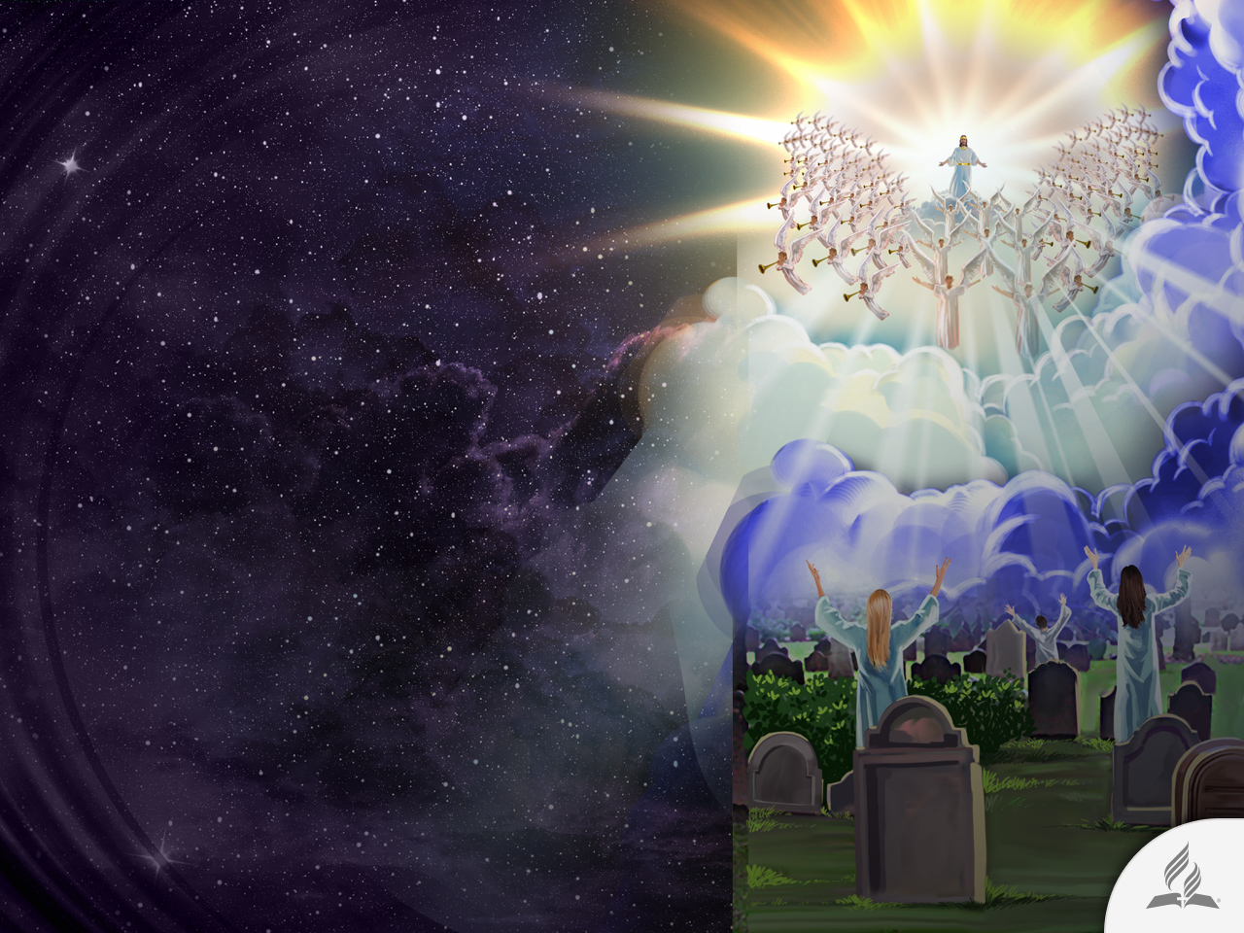
A Biblical Promise
However, the Bible teaches that death does not mark the end of existence, but merely a new chapter.
In death, people sleep, absent of all consciousness, only to awaken to the reality of the Second Coming of Christ and to enjoy eternal life.

Slide 6
LAST DAY EVENTS

Slide 7
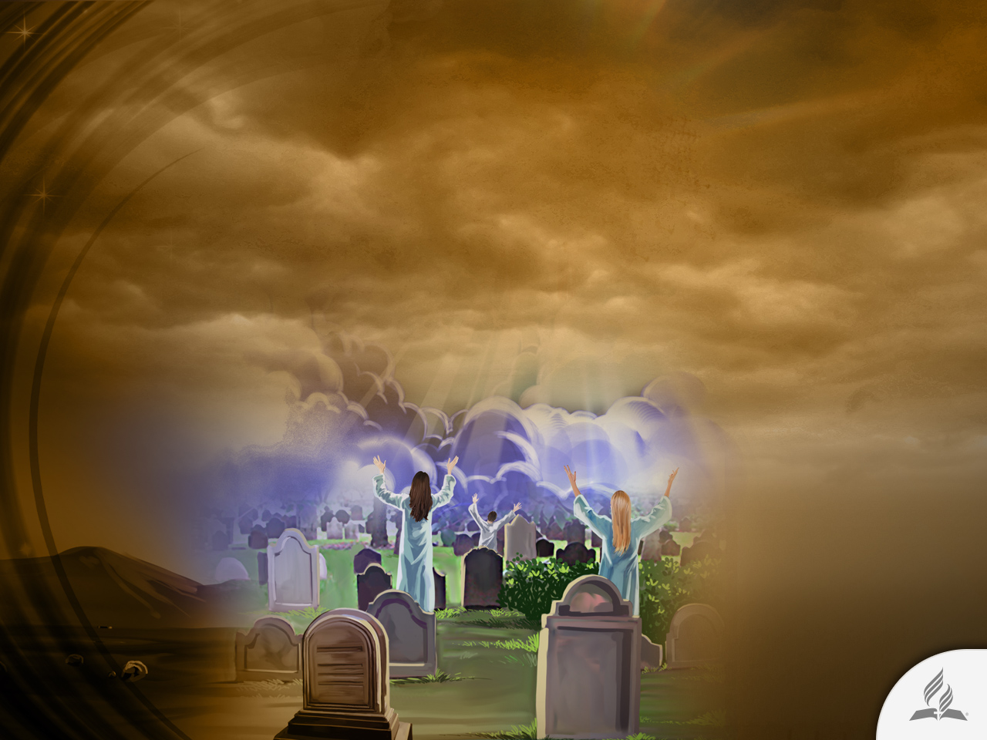
The Coming of Christ
Jesus returns to the Earth and take His children with Him (Rev. 19:11-21).
The first resurrection (Rev. 20:6).
The wicked are dead (Matt. 24:37-39).
Earth is left desolated (Jer. 4:23).
Satan is bound by a chain of circumstances (Rev. 20.2, 3).

Slide 8
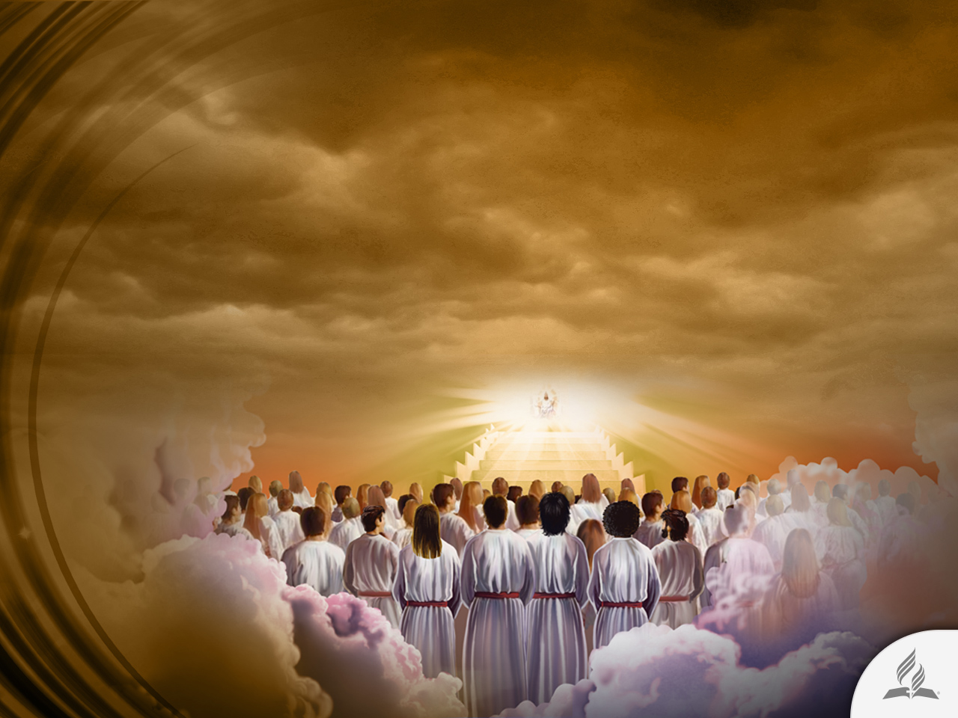
The Millennium, a Period of Restoration
Christ remains in Heaven with the saints (Rev. 15:3; John 14:2).
Saints reign with Christ (Rev. 2:26).
Judgment regarding the wicked is made (Rev. 20:4; 2 Pet. 2:4). This judgment does not decide the salvation of these people, but clears up any doubt concerning the doom of the wicked.

Slide 9
The Millennium, a Period of Restoration
The resurrected righteous, and those who remained alive until the Second Coming of Jesus, will go to heaven for a period of 1,000 years.
This period is known as the Millennium. The word “Millennium” does not appear in the Bible, but it does mention 1,000 years, during which the righteous will be in heaven with Jesus. During that time, the earth will remain completely desolate and Satan will be imprisoned (symbolically).
He will not have anyone to deceive. The godly will be in heaven, and the ungodly will have died from the splendor of Christ’s coming.

Slide 10
A Description of the Millennium Period
“I looked at the earth, and it was formless and empty; and at the heavens, and their light was gone. I looked at the mountains, and they were quaking; all the hills were swaying. I looked, and there were no people; every bird in the sky had flown away. I looked, and the fruitful land was a desert; all its towns lay in ruins before the Lord, before his fierce anger. This is what the Lord says: ‘The whole land will be ruined, though I will not destroy it completely’” (Jer. 4:23-27).

Slide 11
The End of the Millennium
The wicked are raised during the second resurrection (Rev. 20:5-7).
The Holy City descends with Jesus and the redeemed (Zach. 14:9; Rev. 20.5).
Satan’s captivity is finished
(Rev. 20:8).
The Holy City is attacked (Rev. 20:8, 9).
The execution of the judgment is fulfilled (Luke 13:28; Rom. 14:10).
Satan and the wicked are destroyed
(Rev. 20:9, 20; 20:10, 15; 2 Pet. 3:7; Is. 34:8; 28:21).

Slide 12
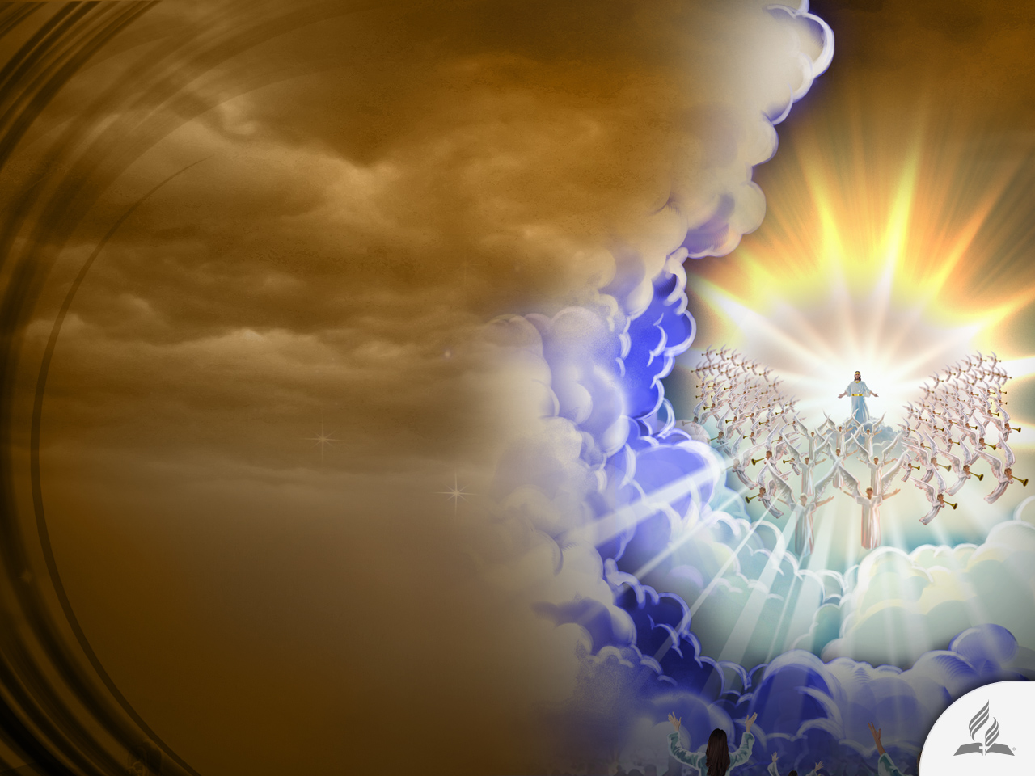
The First Resurrection
Only those who died in Christ participate in this resurrection.
Occurs at Christ’s coming.
The resurrected are transformed and taken to Heaven.
Do not experience death any more.
They receive immortality.

Slide 13
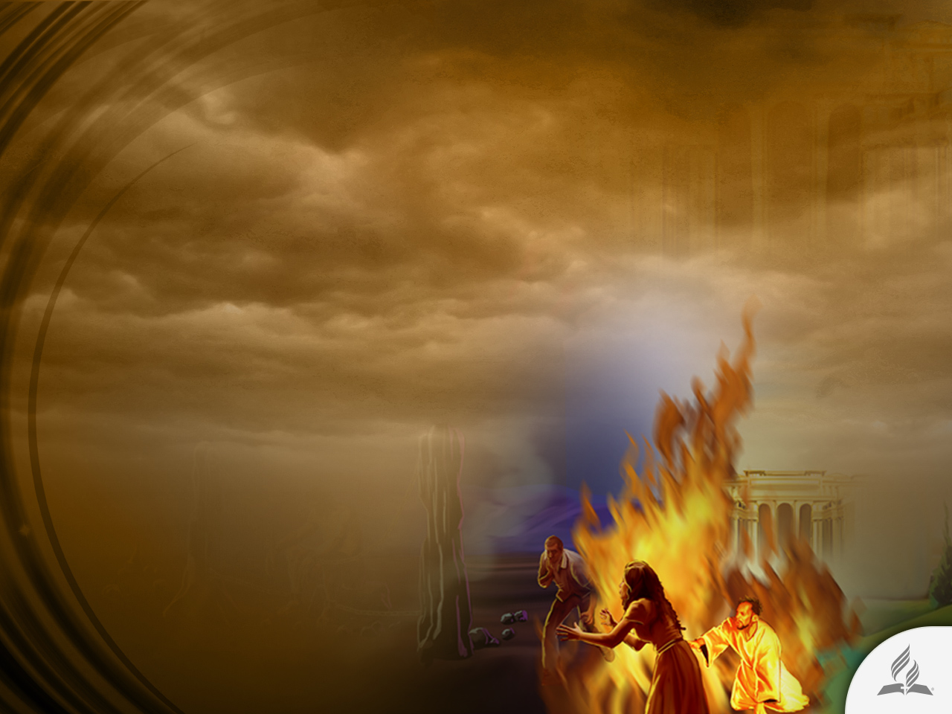
The Second Resurrection
All the lost participate in it.
Occurs at the end of the Millennium.
The lost ones are resurrected in order to be judged by God.
They are doomed to eternal death.
They are destroyed.

Slide 14

THE PROMISE OF A NEW EARTH

Slide 15
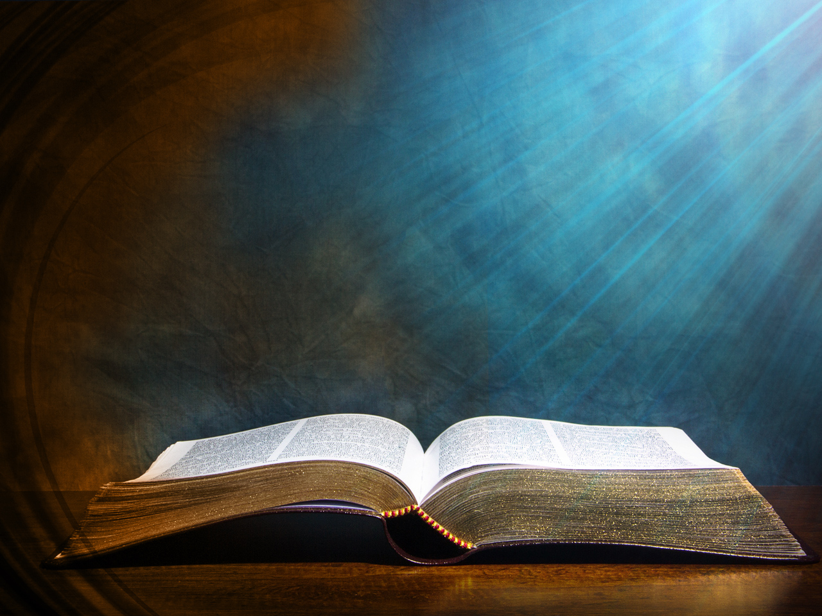
A Place Prepared for Us
“Do not let your hearts be troubled. You believe in God; believe also in me. My Father’s house has many rooms; if that were not so, would I have told you that I am going there to prepare a place for you? And if I go and prepare a place for you, I will come back and take you to be with me that you also may be where I am” (John 14:1-3).

Slide 16
We Will Be with Him
“For the Lord himself will come down from heaven, with a loud command, with the voice of the archangel and with the trumpet call of God, and the dead in Christ will rise first. After that, we who are still alive and are left will be caught up together with them in the clouds to meet the Lord in the air. And so we will be with the Lord forever” (1 Thess. 4:16, 17).

Slide 17
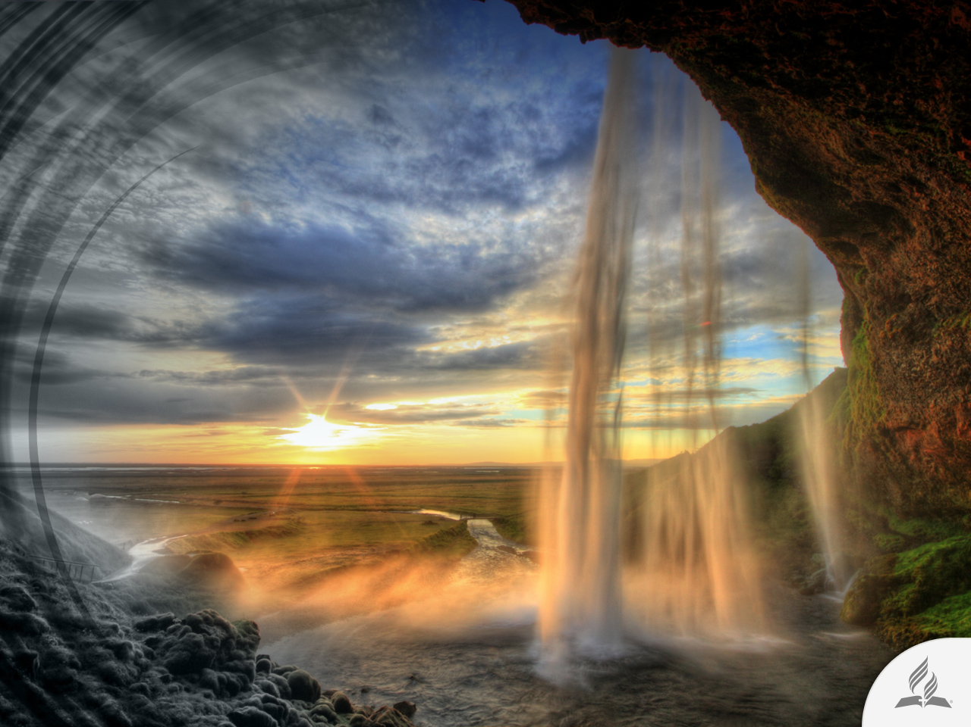
A Reality beyond Imagination
“What no eye has seen, what no ear has heard, and what no human mind has conceived—the things God has prepared for those who love him” (1 Cor. 2:9).

Slide 18
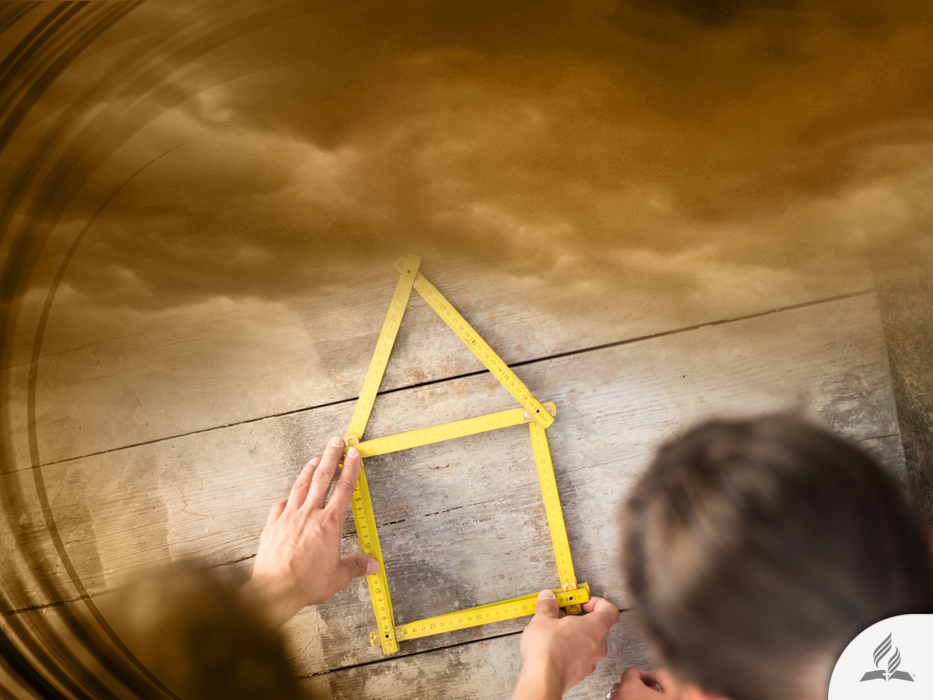
A Fair Society
“They will build houses and dwell in them; they will plant vineyards and eat their fruit. No longer will they build houses and others live in them, or plant and others eat. For as the days of a tree, so will be the days of my people; my chosen ones will long enjoy the work of their hands” (Is. 65:21, 22).

Slide 19
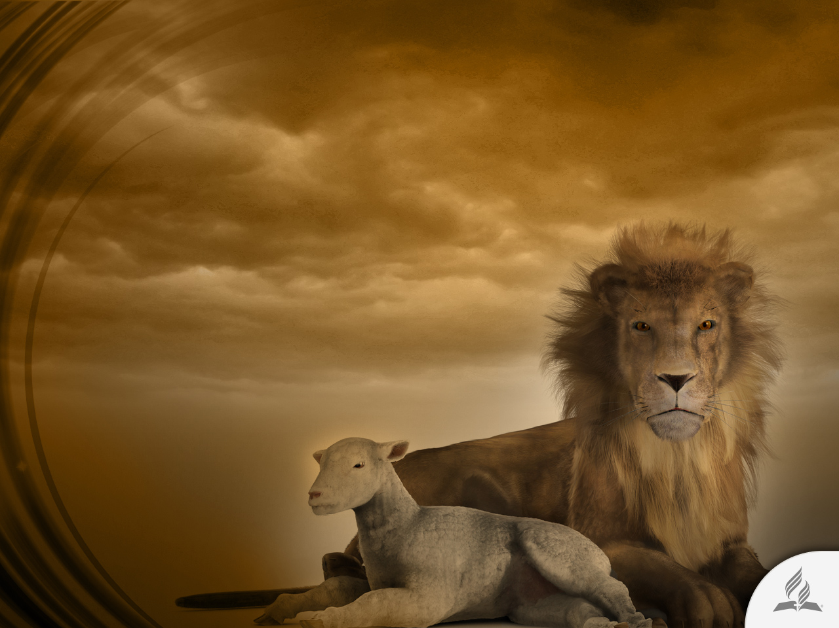
No More Destruction or Harm
“The wolf and the lamb will feed together, and the lion will eat straw like the ox, and dust will be the serpent’s food. They will neither harm nor destroy on all my holy mountain, says the Lord” (Is. 65:25).

Slide 20

No More Death, Pain, and Tears
“He will wipe every tear from their eyes. There will be no more death’ or mourning or crying or pain, for the old order of things has passed away” (Rev. 21:4).

Slide 21
No More Sin and Evil
“Nothing impure will ever enter it, nor will anyone who does what is shameful or deceitful, but only those whose names are written in the Lamb’s book of life” (Rev. 21:27).

Slide 22

Health Restoration
“Down the middle of the great street of the city. On each side of the river stood the tree of life, bearing twelve crops of fruit, yielding its fruit every month. And the leaves of the tree are for the healing of the nations” (Rev. 22:2).

Slide 23
Who will be there?

Slide 24
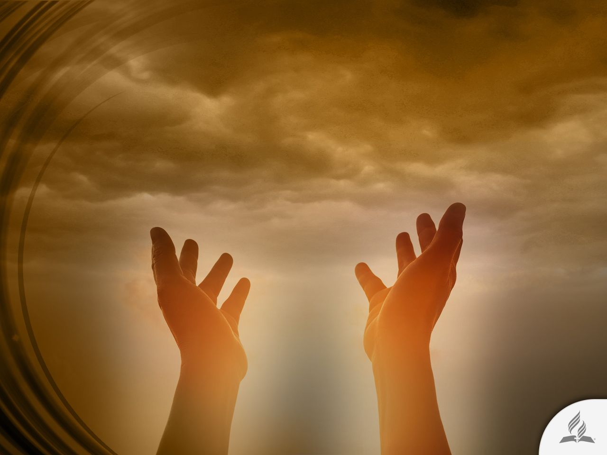
Salvation Is a Gift of God
“For the wages of sin is death, but the gift of God is eternal life in Christ Jesus our Lord” (Rom. 6:23).
Nobody “wins” salvation. It is not possible to get it by our own efforts.

Slide 25
How Can We Get Salvation?
“If you declare with your mouth, ‘Jesus is Lord,’ and believe in your heart that God raised him from the dead, you will be saved. For it is with your heart that you believe and are justified, and it is with your mouth that you profess your faith and are saved” (Rom. 10:9,10).

Slide 26

Obedience Is a Gift of God
“For it is God who works in you to will and to act in order to fulfill his good purpose” (Phil. 2:13).

Slide 27
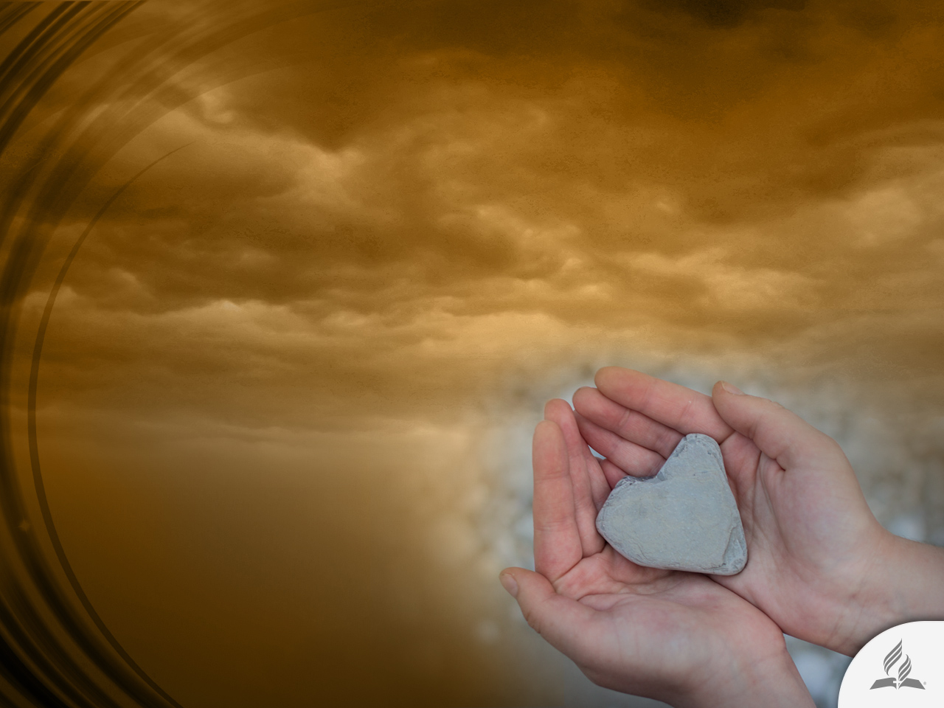
Obedience Is a Gift of God
“I will sprinkle clean water on you, and you will be clean; I will cleanse you from all your impurities and from all your idols. I will give you a new heart and put a new spirit in you; I will remove from you your heart of stone and give you a heart of flesh. And I will put my Spirit in you and move you to follow my decrees and be careful to keep my laws” (Ezek. 36:25-27).

Slide 28
Which Is the Result of the Transforming Work of God in Our Hearts
“Lord, who may dwell in your sacred tent? Who may live on your holy mountain? The one whose walk is blameless, who does what is righteous, who speaks the truth from their heart; whose tongue utters no slander, who does no wrong to a neighbor, and casts no slur on others; who despises a vile person but honors those who fear the Lord; who keeps an oath even when it hurts, and does not change their mind; who lends money to the poor without interest; who does not accept a bribe against the innocent. Whoever does these things will never be shaken” (Ps. 15:1-5).

Slide 29
Summary
The Bible teaches that death does not mark the end of existence, but merely a new chapter. According to the Scripture, there will be a New Earth, where we will live eternally with our God.
The second coming of Christ begins with a series of events that will finish with the destruction of Satan and the wicked.
The New Earth is a reality beyond imagination. It will inaugurate a new life for all the redeemed.
We can access the New Earth through the salvation Jesus offers us today.
Jesus wants to transform our lives in order to prepare us to live in the heavenly environment.

Slide 30
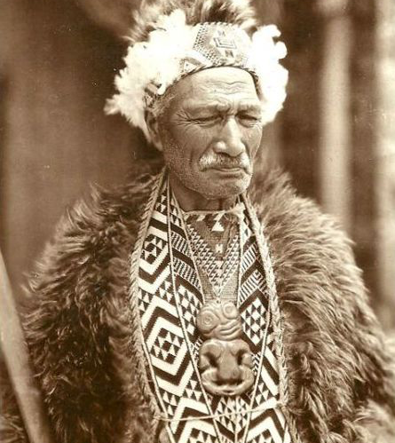
My Father’s House
A New Zealand chief, Tamahana, who visited England a few years ago, was known for his deep spirituality and his constant delight in the word of God. One day he was taken to see a beautiful mansion—one of the show places near London.

Slide 31
My Father’s House
The gentleman who took him expected to see him greatly astonished at the building. However, the chief showed little excitement and no admiration.
Wondering how this could be possible, the gentleman began to point out its grandeur, the beauty of its expensive furniture brought from all over the world, the view from its windows…

Slide 32
My Father’s House
Tamahana listened silently; then, looking around upon the walls, he replied: “Ah, my Father’s house is finer than this.” “Your father’s house!” thought the gentleman, who knew his father’s house was but a poor mud cottage.
But Tamahana went on: “My Father’s house is finer than this,” and began to speak in his own expressive, touching strain, of the house above—the house of “many mansions”—the eternal home of the Redeemer.

Slide 33
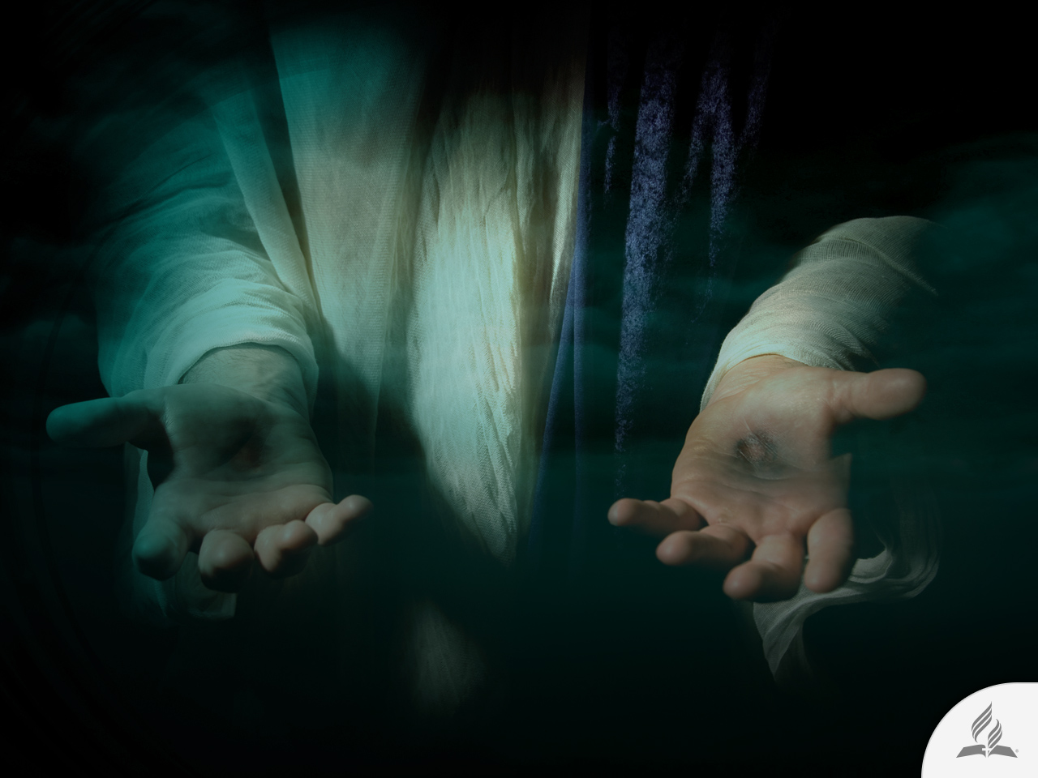
My Decision
Jesus said: “Look, I am coming soon! My reward is with me, and I will give to each person according to what they have done” (Rev. 22:12).
Are you willing to accept the promise Jesus offers you?

