Slide 1


Slide 2




Our Greatest Need
Topic 1

Slide 3
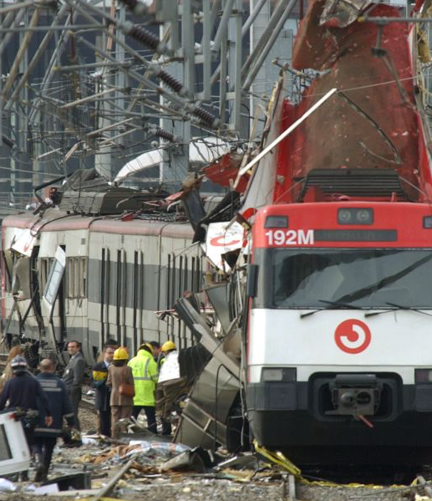
Tragedy in Madrid
On March 11th, 2004, three bombs exploded at the Atocha Railway Station, one of the largest in Madrid.
The explosion ended the lives of several passengers, who did not even have time to become aware of what happened to them.
Two minutes later, at El Pozo Station, two other bombs exploded; at Santa Eugenia, one more exploded; and at a fourth train station, near Tellez, another four bombs went off.

Slide 4
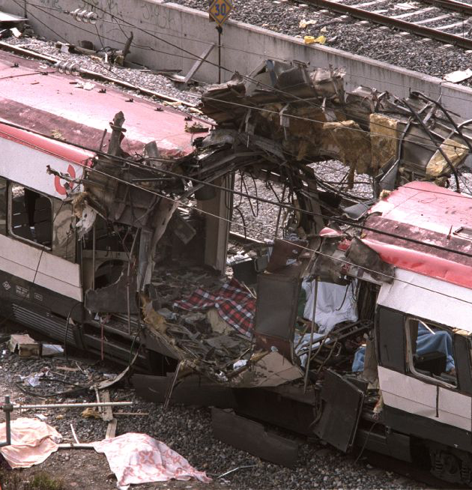
Tragedy in Madrid
In a short time, the aftermath of the tragedy was known: 191 dead and more than 1,500 injured people.
Spain mourned her dead. Several parents held the lifeless and bloodied bodies of their children, women cried over the premature loss of their husbands, and scores of children lost their parents.

Slide 5
Elements That Promote the Development of Terrorism
Lack of values such as tolerance, respect for differences of opinion, religious freedom, among others.
Religious or ideological extremism, which justifies the use of violence for spiritual or political objectives.
Radical nationalism strengthened by the feeling that the aggrieved have been or are even now victims of great injustices.

Slide 6
Elements That Promote the Development of Terrorism
Social and economic inequality between rich and poor is a breeding ground for resentment and hate. The greater the economic gap, the greater the possibility of bolstering or nurturing all kinds of conflicts, such as terrorism.
Authoritarian leaders who do not permit the development of democracy.
Lack of political parties or social organizations representing different sectors of society.
Acceptance of violence as one of the main means to resolve societal problems.

Slide 7
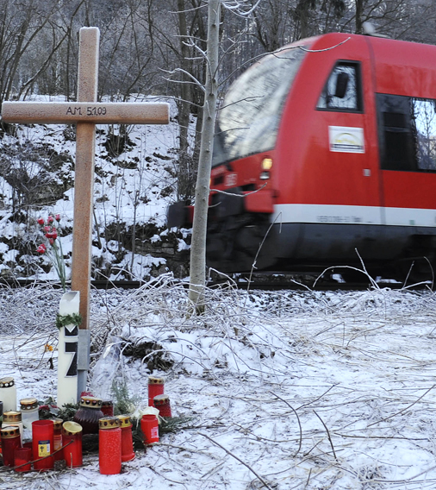
A False Door
On January 5, 2009, in Blaubeuren, Germany, magnate Adolf Merckle committed suicide.
For him, it represented the end of his problems.
However, this is not an appropriate solution that a balanced person should find to life’s problems.

Slide 8
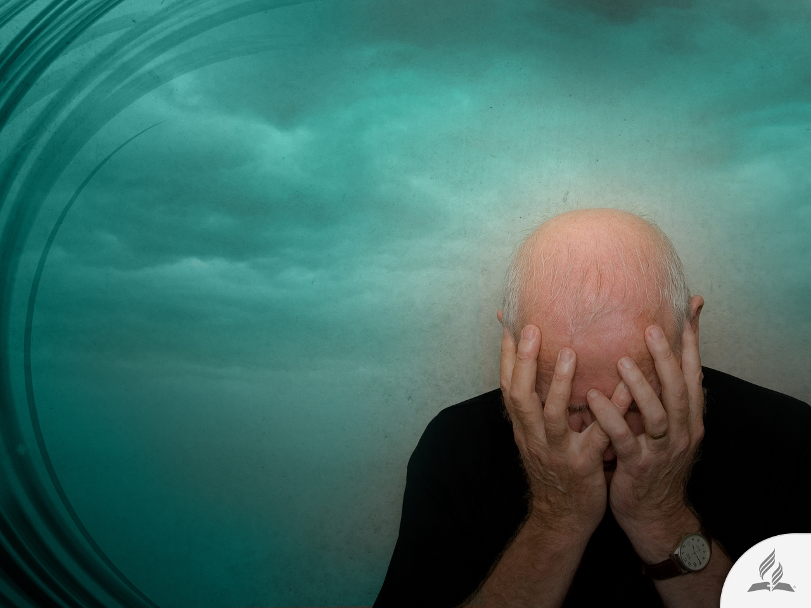
Why so much suffering?
A hard question through the ages

Slide 9
Why We Suffer?
Have you ever wondered why we suffer?
Without an in-depth analysis, we would instinctively say that we suffer because something is wrong. And perhaps it is.
How can something that makes us suffer be good? In fact, suffering is no more than tasting evil’s gall of bitterness.
It arrives in our lives against our will. Our decisions often have no control over it.
None of us yearn for pain and suffering, at least not those of us in full use of our mental faculties.
Whenever suffering knocks on the door of our hearts, we ask: “Why this?” “Why me?”
We then look for answers.

Slide 10
Living in a World of Pain
Of course, there are also those who are indifferent or, at least, those who prefer not to think; those who remain in doubt and do not question themselves.
Unfortunately, these people are swept away by the turbulent waters of the absence of meaning to their existence.
They immerse themselves in the immediacy of their senses; they forget about the value of the spirit; they allow themselves to be driven by the inertia of contemporary trends and remain bound to chains of mediocrity.
They produce idols such as money, ostentation, magnificence, and appearance, ignoring their own conscience and burying themselves in the transience of consumerism, thereby entering an endless downward spiral.

Slide 11
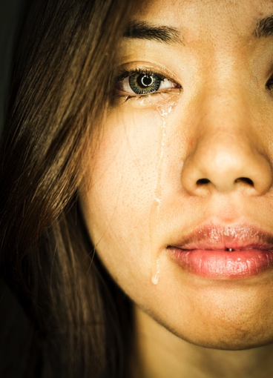
No One Is Exempt from Suffering
We will all someday feel the earth tremble beneath our feet.
Disease, sudden death, an accident, a broken heart, or economic loss threatens our lives, and causes us to become depressed, taking away the desire to live and the strength to go on.

Slide 12
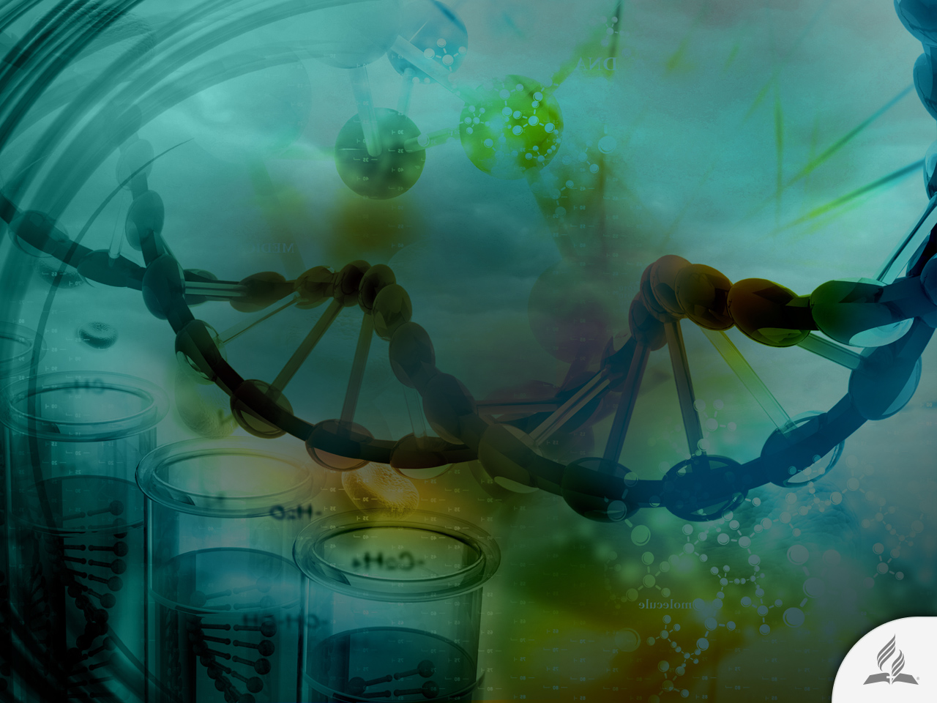
Who Has the Answer?
Science, philosophy or religion?
Science cannot prove the origin of suffering, or discover its remedy.
Philosophy becomes lost in a maze of words and concepts that daze us but do not diminish our suffering.

Slide 13
What about Religion?
If there is a God, why do evil and suffering exist?
Is pain part of human destiny?
If so, why do we flee from suffering? We do not run away from hunger, thirst, or sleep. We accept them because they are part of our nature. So why not accept pain also?
Sooner or later, pain touches us all. However, managing suffering not only consists of resisting pain by accepting it as something inevitable; more precisely, it is necessary to know the reason of its existence.
Suffering is the carrier of a message that one must understand, and only through comprehension of this message can a solution be found.

Slide 14

There is an answer!
The Bible reveals important realities about suffering

Slide 15

A Psalm about Suffering (Ps. 73)
God is not the bad character of the movie (v. 1).
Sometimes is hard to understand the apparent prosperity of the wicked (v. 4-9).
Christians also suffer (v. 12-14).
Suffering is not easy to understand (v. 15-16).
Pain is better assimilated when we see it through a spiritual focus (v. 17).
We must not concentrate on the temporary realities of this world. The wicked have no future (v. 28-20).
If we focus on negative implications of suffering we will fill our lives with bitterness and foolishness (v. 21-22).

Slide 16
A Better Way (Ps. 73)
God invites us to be near to Him (v. 23).
He guides and counsels us (v. 24).
He can strengthen us when we fail (v. 26).
We must trust Him (v. 28).
We can share with others this great truth (v. 28).

Slide 17

The Best Way
The Bible says that, more than in a particular religion, the answer for all problems, pain, and suffering of this world can be found in one person: Jesus.

Slide 18

What Does Jesus Give me?
LOVE
STRENGTH
CERTAINTY
HELP
REST
“For God so loved the world that he gave his one and only Son, that whoever believes in him shall not perish but have eternal life” (John 3:16).
“I can do all this through him who gives me strength” (Phil. 4:13).
“I am the way and the truth and the life. No one comes to the Father except through me” (John 14:6).
“Come to me, all you who are weary and burdened, and I will give you rest” (Matt. 11:28).
“And surely I am with you always, to the very end of the age” (Matt. 28:20).

Slide 19
The Great Work of Jesus (1 Tim. 3:16)
He suffered in this world
“He appeared in the flesh…
Faced sin
was vindicated by the Spirit...
Testified to all the universe
was seen by angels…
For all human beings
was preached among the nations…
Shared a Gospel
was believed on in the world
And now He is interceding for us
was taken up in glory”

Slide 20
Summary
The World is filled with tragedies, suffering, injustice, terrorism and all sorts of problems.
Science, philosophy, and even a religion are not the solution for our problems.
You can face suffering from a positive perspective by looking it as a carrier of a message that you must understand.
Psalm 73 says that suffering is not easy to understand, because if we focus on the negative implications of suffering, we will fill our lives with bitterness and foolishness.
Jesus can give love, strength, certainty, rest, and help to face suffering. Because He has suffered, too, He can understand you and give you hope in life.

Slide 21
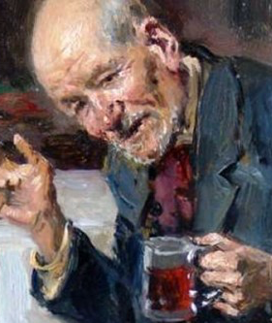
Lord, If It’s Not Too Late
Years ago a unique character was converted in the Water Street Mission in New York. It was “the Old Colonel.” Through drink he had sunk very low.
At the time of his conversion he was sixty years old. He looked as if he were one hundred. He looked more like an animal than like a human being. He was clothed in rags. The overcoat he wore was fastened with a nail.
“Old Bill” was a caricature of the man he had been—a college graduate and a brilliant law student in the office of E. M. Stanton, Lincoln’s Secretary of War.

Slide 22

Lord, If It’s Not Too Late
On the night of his conversion, he cried, “O Lord, if it is not too late, forgive and save this poor old sinner!” God heard the cry of his heart.
He was gloriously saved. God restored his intellect. That which had been his greatest love and had almost ruined his life—strong drink—became his greatest hate.
He became an honored and beloved Christian gentleman!

Slide 23
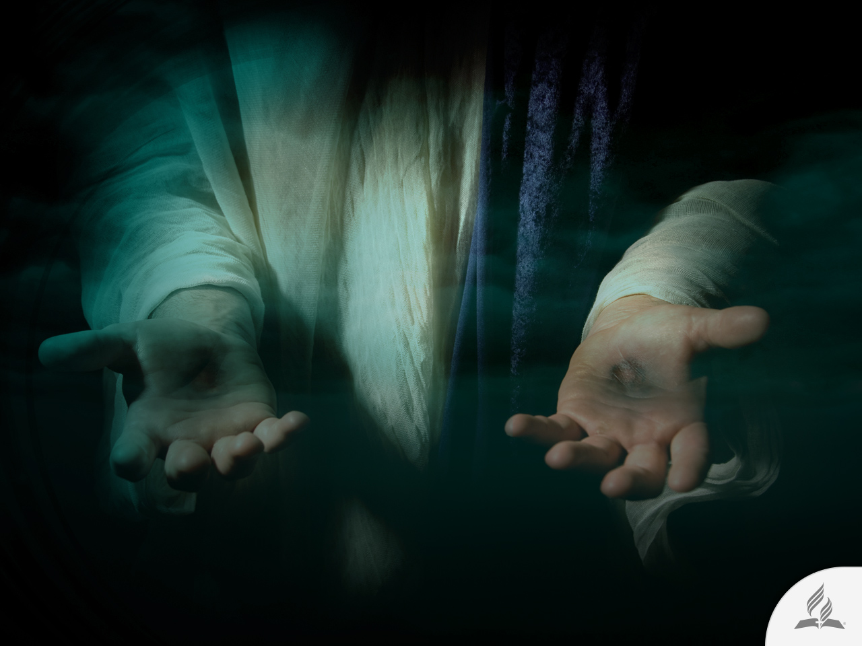
My Decision
You will experience suffering, pain, and problems; they are part of life in this world of sin.
Jesus Christ is the only one who can understand your pain and suffering and who can also care for your greatest needs.
Are you willing to accept Him and to get to know Him better?

Slide 24
Next Topic:
IS IT POSSIBLE TO BELIEVE IN GOD?
What is the purpose of life and suffering?
What are the biblical arguments of
the existence of God?
Can the Bible be trusted?
The Bible and Science.
There Is an Answer!

