Slide 1
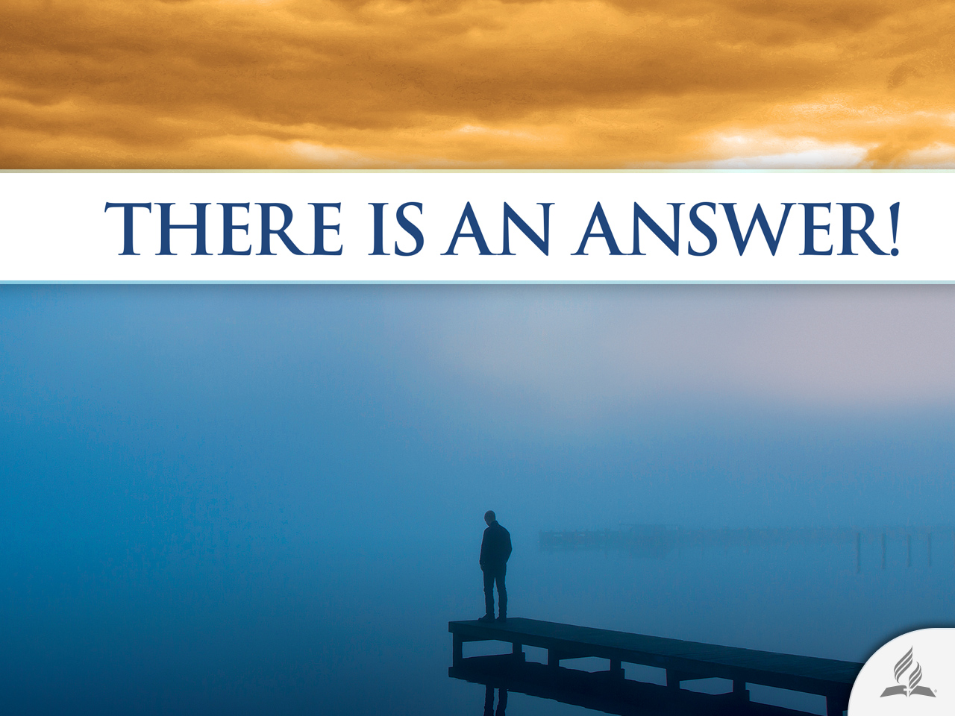

Slide 2

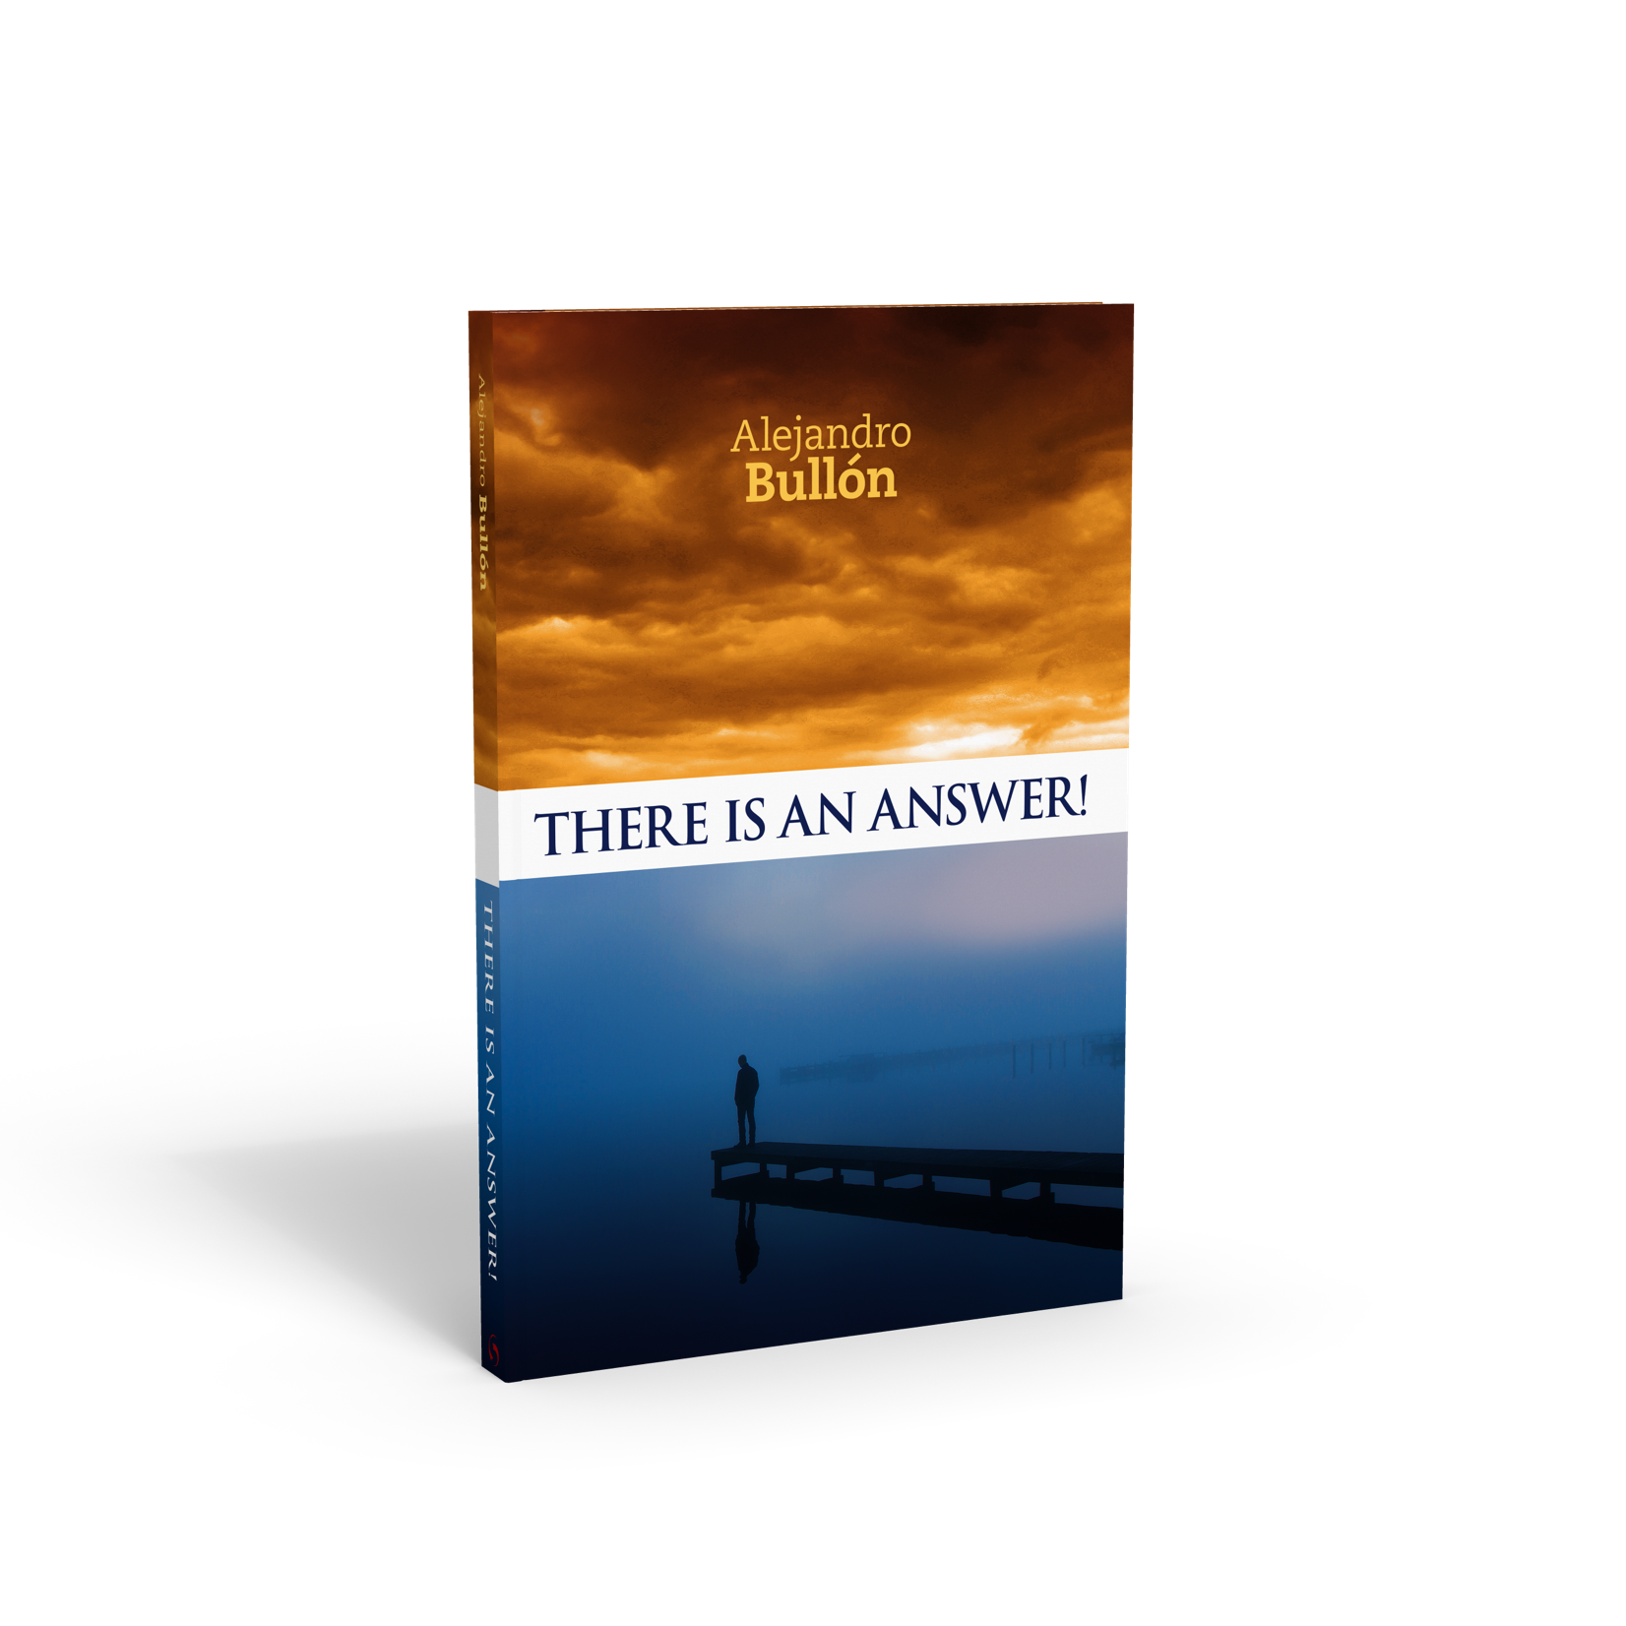


Is It Possible to Believe in God?
Topic 2

Slide 3
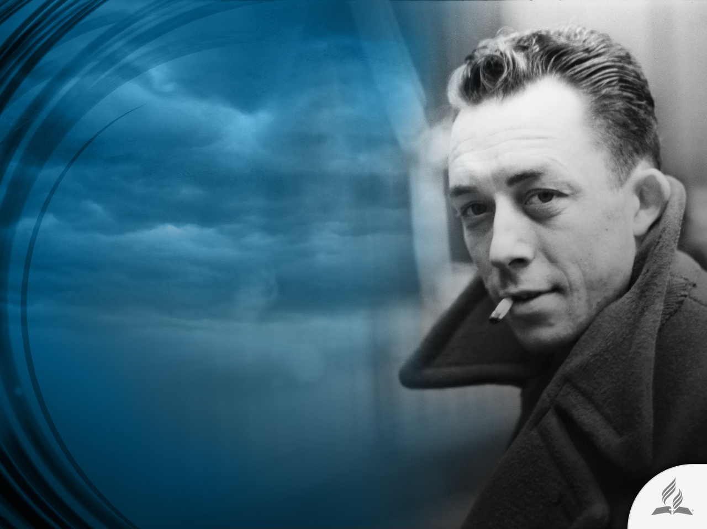
What is the purpose of life and suffering?
Albert Camus, French philosopher, wrote that humanity is born, lives, and finally dies tormented by one question: What is the purpose of life and of suffering?
Camus’ answer to this question is the theory of the absurd: everything in life and in the universe is meaningless.

Slide 4
No Meaning To Life
According to Camus, humanity exists in a universe without meaning. Someone trying to find any purpose enters a futile conflict with the universe.
The French philosopher’s conclusion is logical. For without God, whom Camus refused to accept, there is no human explanation for the mystery of pain, suffering, and death.
Despite how incoherent the theory of the absurd may seem, throughout the decades Camus influenced various generations that, in one form or another, face life with that view. In the minds of those who embrace this position, there is no place for God.

Slide 5
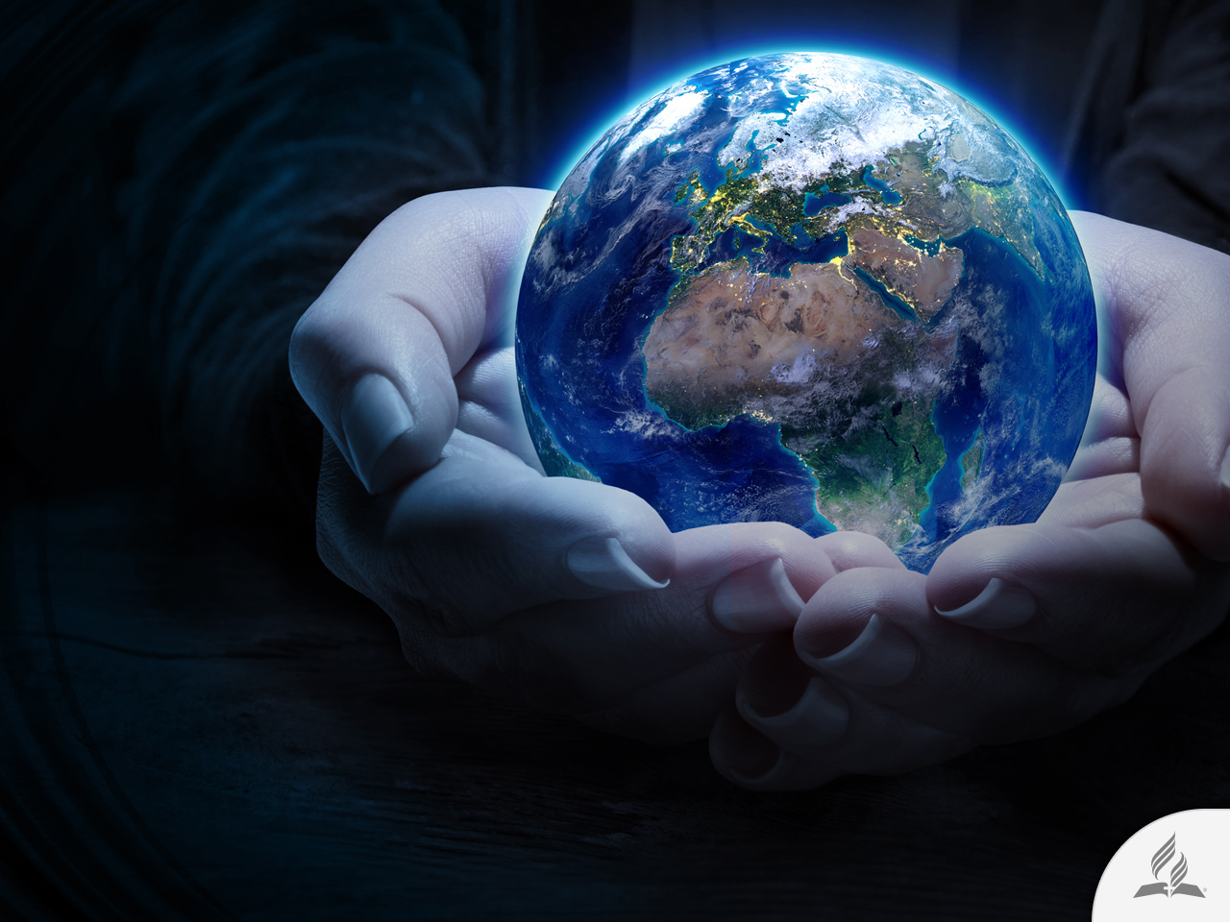
Does God Exist?
A question that every human being has considered

Slide 6
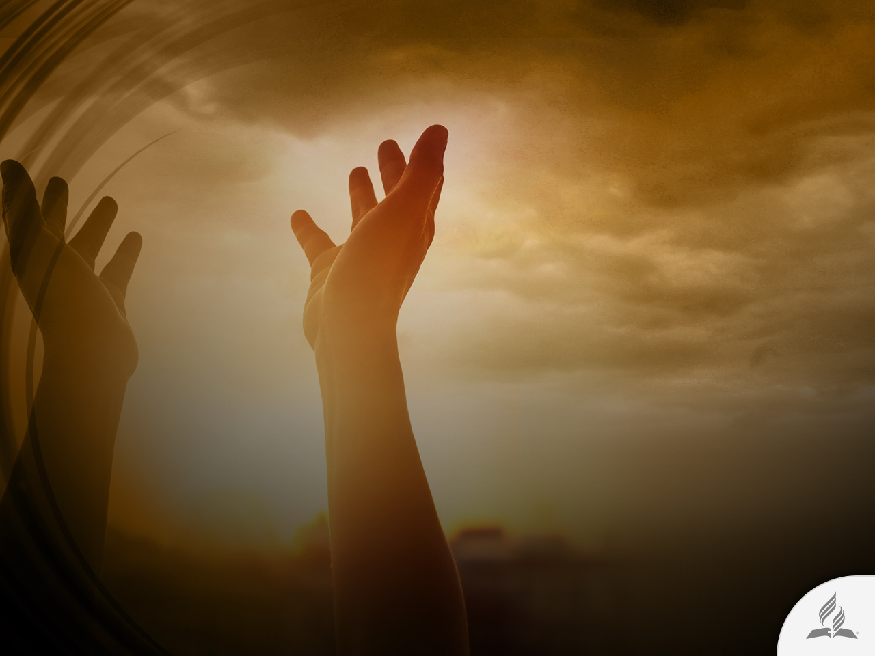
A Natural Human Element
Believing in God is a characteristic element of human nature, since the latter has been constituted to have an intuition about a divine existence and presence.
His existence, character, and the trustworthiness in his Word involve elements that are decipherable to human logic.

Slide 7

Cosmological Argument
(Ps. 139:13-18)
Nothing exists without a cause. God is the origin of everything that exists, the first cause.

Slide 8

Teleological Argument
(Ps. 19:1-6; Is. 40:26)
Order, harmony, and perfection exist in that which is infinitely large and significantly small. Everything occurs as if a supreme artist had both conceived and expressed it in an extraordinary work.

Slide 9
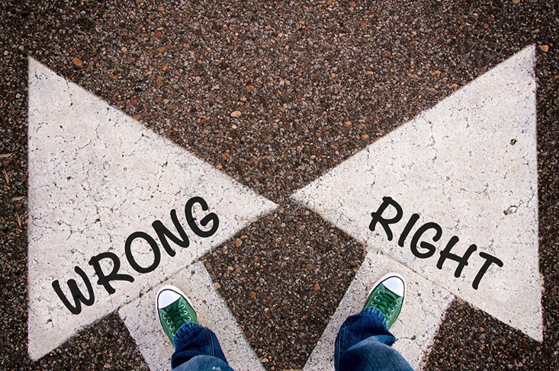
Moral Argument
(Rom. 2:14, 15)
Human beings have aspirations that would be inexplicable if God did not exist. The function of conscience would lack any meaning if there were no eternal justice and a supreme Legislator.

Slide 10

Argument from History (Deut. 32:8)
Whether the history of the universe, of humanity, of a particular people, or that of an individual is contemplated, it is perceived that there is always a plan, a providence, a sovereign thought that presides over everything and guides it toward the ultimate goal.

Slide 11

Argument from
Supernatural Events
(Is. 44:6, 7)
Revelation, miracles, and prophecies, among others, are manifestations through which God reveals His existence and His interest for His children.

Slide 12

The Mark of God Is Everywhere
The things that surround us on earth, sea, and sky indicate order, beauty, precision, and ingenious planning.
A logical analysis reveals that none of the wondrous things in existence around us could exist by mere coincidence.
There must be an intelligent mind behind it all.

Slide 13
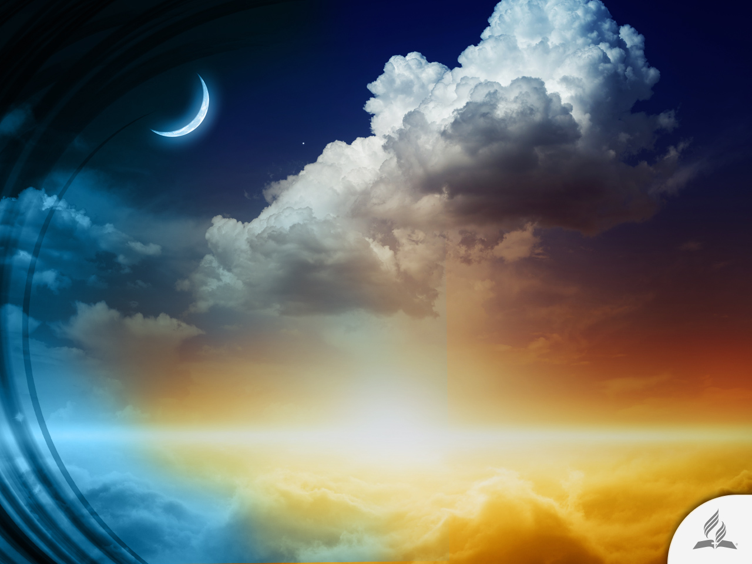
Heavens Declare the Glory of God
King David said: “The heavens declare the glory of God, the skies proclaim the work of his hands” (Ps. 19:1).
Raise your eyes to the sky. Over there, where your eyes get lost in the infinite, the same evidence of order, beauty, precision, and purpose exists as on earth.

Slide 14
Heavens Declare the Glory of God
“Lift up your eyes and look to the heavens: Who created all these? He who brings out the starry host one by one and calls forth each of them by name. Because of his great power and mighty strength not one of them is missing. Why do you complain, Jacob? Why do you say, Israel, ‘My way is hidden from the Lord; my cause is disregarded by my God?’ Do you not know? Have you not heard? The Lord is the everlasting God, the Creator of the ends of the earth. He will not grow tired or weary, and his understanding no one can fathom” (Is. 40:26-28).

Slide 15
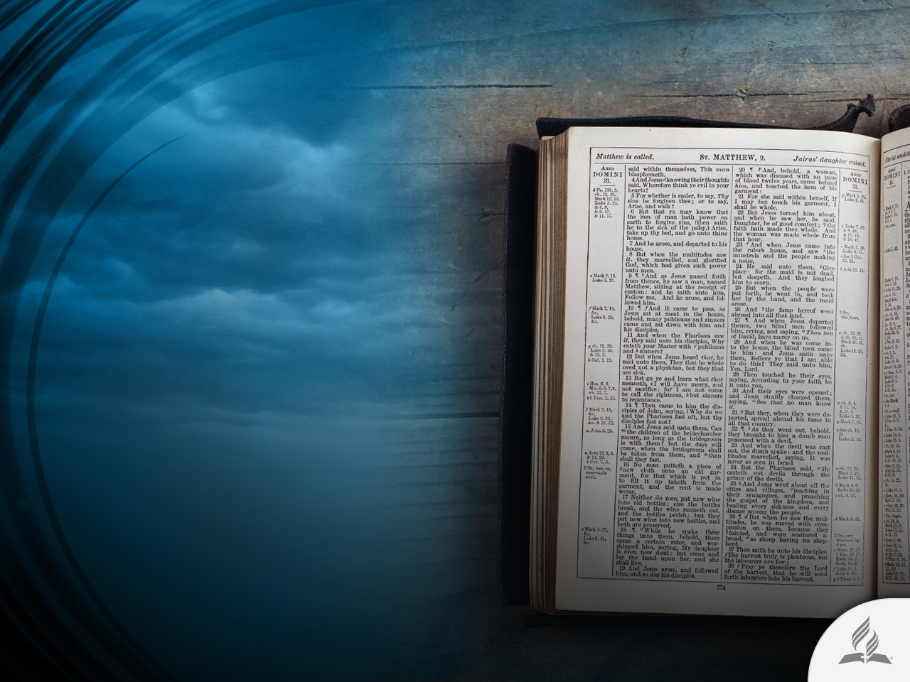
CAN THE BIBLE
BE TRUSTED?
What reasons do I have for believing that the Bible is the Word of God?

Slide 16
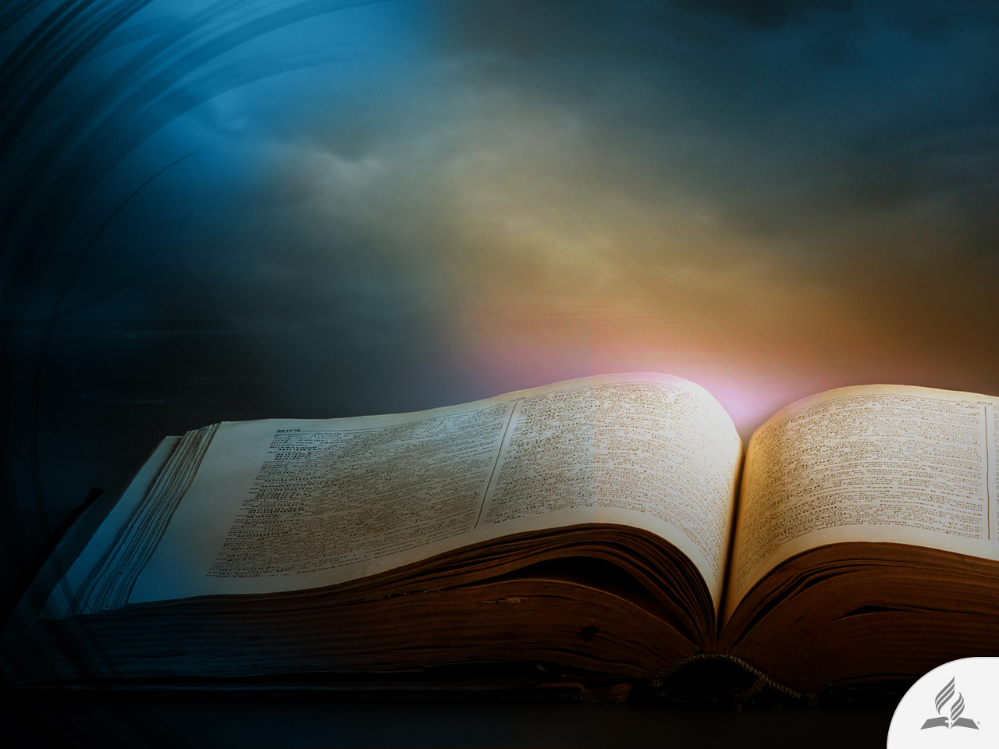
The Bible Has Divine Authority
“All Scripture is God-breathed and is useful for teaching, rebuking, correcting and training in righteousness” (2 Tim. 3:16).

Slide 17
The Bible Has a Wonderful Unity
This book was written by 40 different authors during a period of almost 1,600 years in three distinct languages. Most of the writers never met each other in person.
However, to read the Bible from start to finish is to discover its unity of thought and content; the impression of 40 different authors being gathered one day to reconcile the text they would write about.
This is further evidence that they were the human means of transmission inspired by the Holy Spirit, who is the true Author of the Bible.

Slide 18
The Fulfillment of the
Biblical Prophecies
“Remember the former things, those of long ago; I am God, and there is no other; I am God, and there is none like me. I make known the end from the beginning, from ancient times, what is still to come. I say, ‘My purpose will stand, and I will do all that I please’” (Is. 46:9, 10).
The Bible contains at least 1,000 prophecies, some completely fulfilled; others in the process of being carried out; and others yet to come to fruition. Approximately one-third of the Bible is comprised of prophecies, whose certainty can be confirmed today with astonishing exactness.
There Is an Answer!

Slide 19

Prophecies from the Old Testament Regarding the Messiah
Prophecy | Prophet/Author | Fulfillment
Would be born in Bethlehem | Micah (5:2) | Matthew 2:5, 6; Luke 2:4-6
Would be born from a virgin | Isaiah (7:14) | Matthew 1:22, 23
Would be called Immanuel | Isaiah (7:14) | Matthew 1:23
His place of birth would mourn the death of many children | Jeremiah (31:15) | Matthew 2:17-18
Would make a victorious entrance into Jerusalem riding a donkey | Zechariah (9:9) | Matthew 21:4-5
Would use parables in preaching | Isaiah (6:9, 10) | Matthew 13:10-15
Would heal many people | Isaiah (53:5) | Matthew 8:16, 17
Would be rejected by His own people | Isaiah (53:3) | John 1:11
Would be crucified alongside two thieves | Isaiah (53:12) | Matthew 27:38; Mark 15:27
Would be given vinegar to drink | David (Ps. 69:21) | Matthew 27:34; John 19:28-30
His clothes would be distributed by casting lots | David (Ps. 22:18) | Luke 23:34
Would be assigned a grave with the godless, but would be buried with the rich | Isaiah (53:9) | Matthew 27:57-60

Slide 20
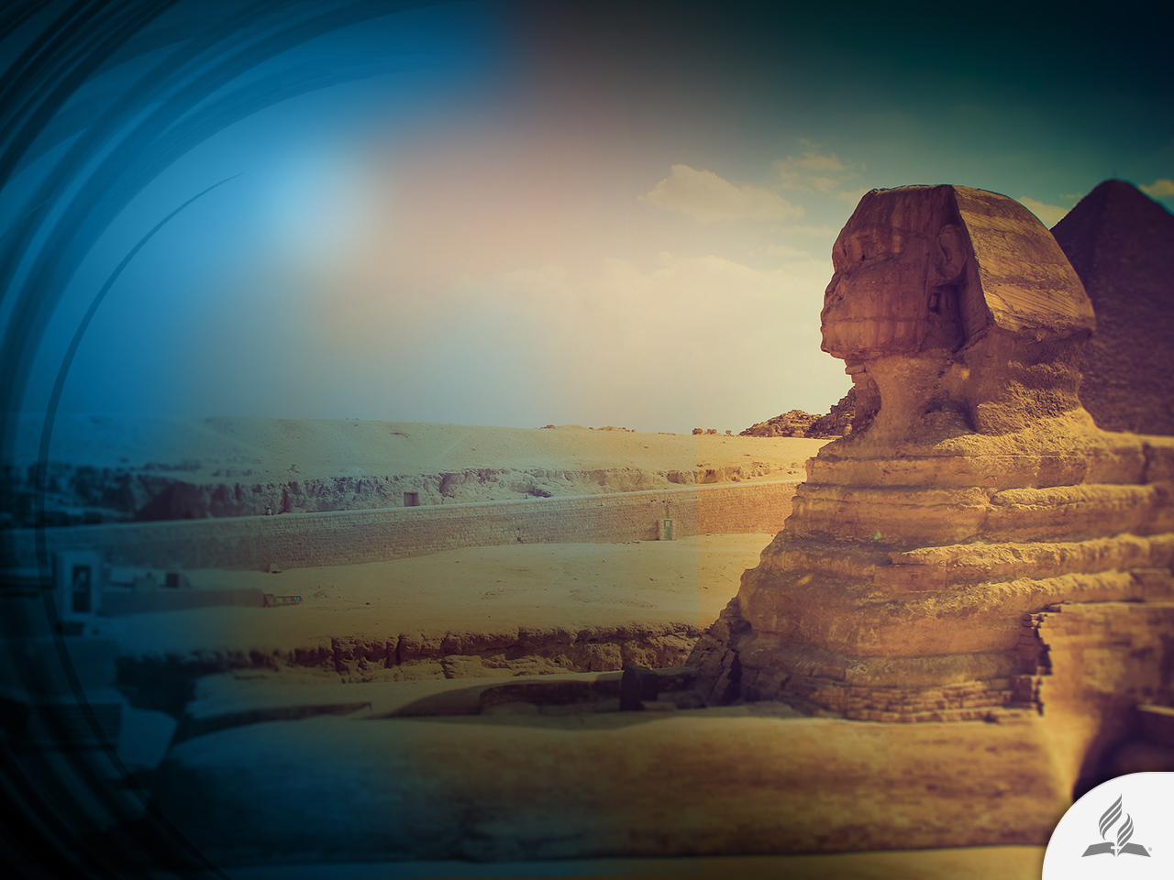
Bible Prophecies against Some Places
Tyre (Ezek. 26:7-14).
Egypt (Ezek. 29:14, 15).
Petra (Edom) (Jer. 49:17, 18; Is. 34:11-13).
Babylon (Jer. 51:36, 37; Is. 13:20, 21).

Slide 21
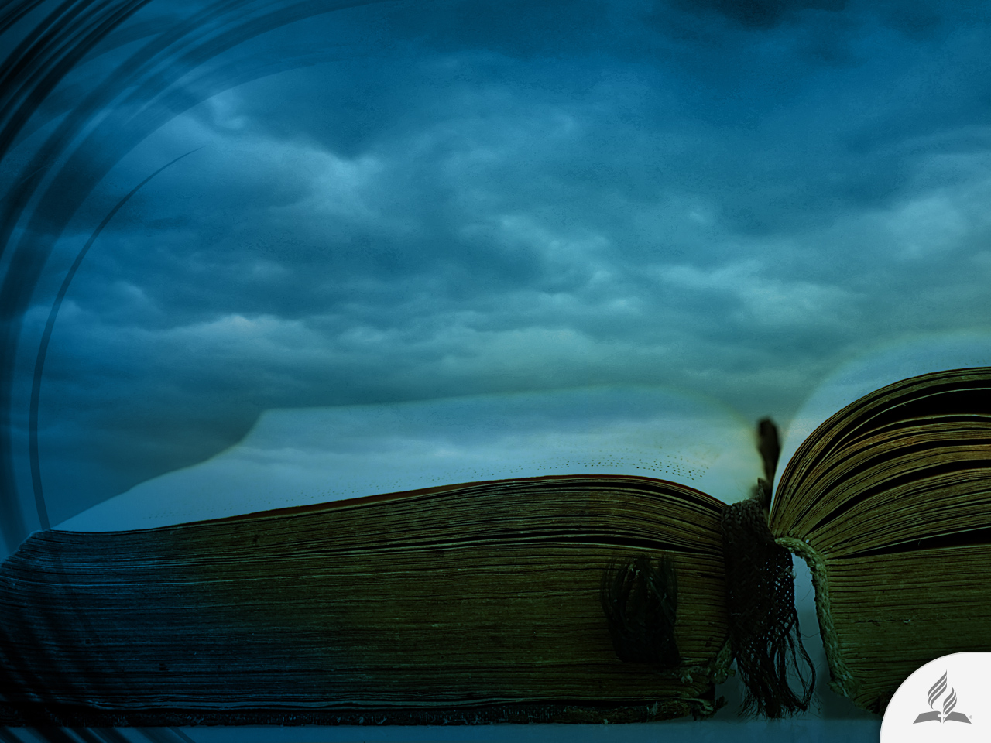
Benefits of reading the bible
Yields a prosperous life (Ps. 1:1-3).
Helps to overcome sin (Ps. 119:11).
Provides wisdom (Ps. 119:98).
Fills the heart with joy (Ps. 119:111).
Brings happiness to life (Jer. 15:16).
Develops love for God (John 14:21).
There Is an Answer!

Slide 22
Benefits of reading the bible
Shows salvation (2 Tim. 3:14, 15).
Offers happiness (James 1:25, 27).
Increases faith (Rom. 10:17).
Helps defeat the enemy (Eph. 6:16, 17).
Guides and protects (Ps. 119:105).
Fosters a better life (1 Pet. 1:23-25; 2:1).
There Is an Answer!

Slide 23
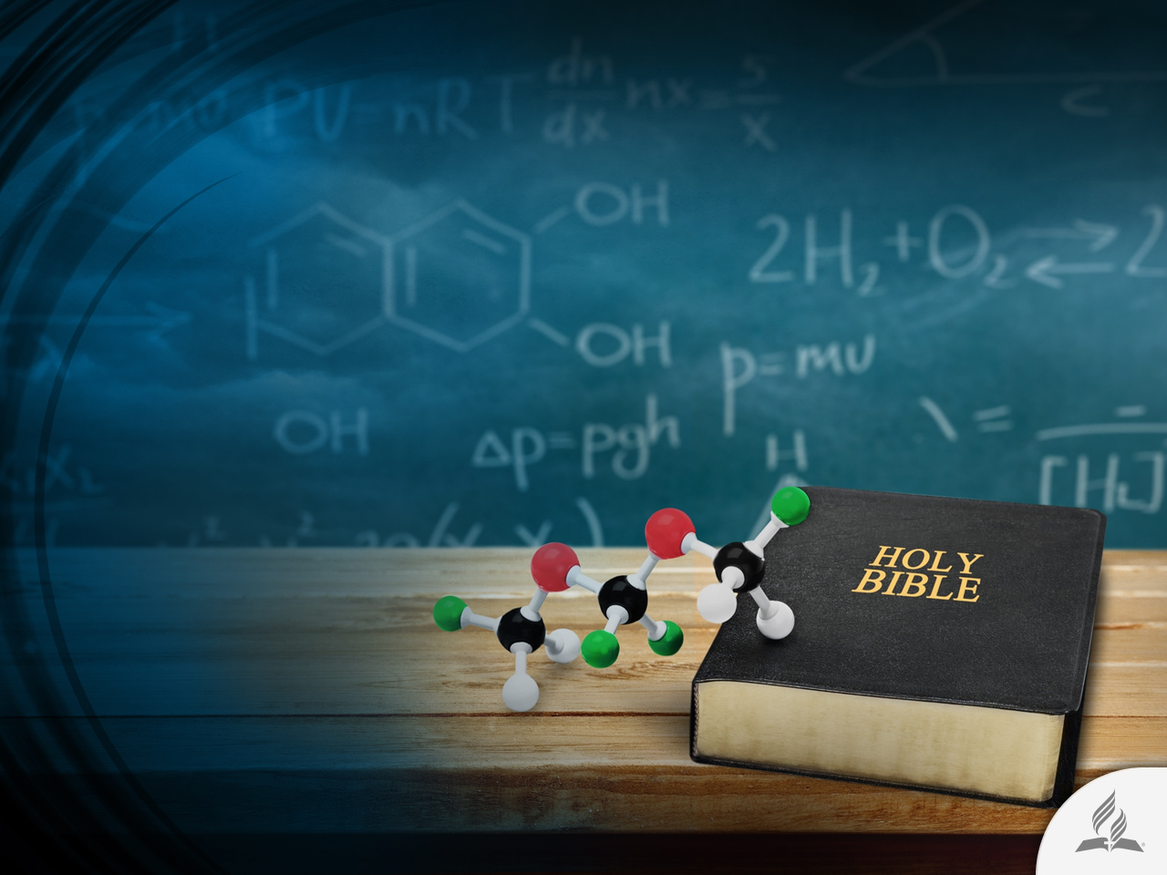
THE BIBLE
AND SCIENCE

Slide 24
The Circle of the Earth
Throughout time, science and its discoveries have proven that the Bible is right in its declarations. Let us analyze, for example, this text from Isaiah: “He sits enthroned above the circle of the earth” (Is. 40:22).
The Hebrew word Isaiah used for “circle” is khug, which means “round sphere.”
The American Standard Version of the Bible states: “It is he that sitteth above the circle of the earth.” Greek science, contemporary to Isaiah, taught that the Earth was flat, square, or rectangular.
How did Isaiah know that the Earth was round rather than flat, as popular opinion asserted? Without doubt, the prophet wrote with something more than human understanding.

Slide 25
The Orbit of the Sun
Speaking about the sun, the psalmist wrote: “It rises at one end of the heavens and makes its circuit to the other; nothing is deprived of its warmth” (Ps. 19:6).
For many years, scientists lectured about geocentrism, i.e., that the sun revolves around earth. But it was later discovered that the sun is not stationary in one place, as was once believed.
Rather, it actually moves through space. Its traveling speed is estimated at 965,580 kilometers per hour, in such a large orbit that it takes 200 million years to complete one rotation.
How did the psalmist know that the sun has one “circuit” or orbit?

Slide 26
The Number of the Stars
Moses wrote almost 6,000 years ago: “He took [Abram] outside and said: ‘Look up at the sky and count the stars—if indeed you can count them.’ Then he said to him, ‘So shall your offspring be’” (Gen.15:5).
Today, astronomers agree that it is practically impossible to calculate the number of stars. How did Moses and Jeremiah know that well before telescopes and satellites were invented?

Slide 27
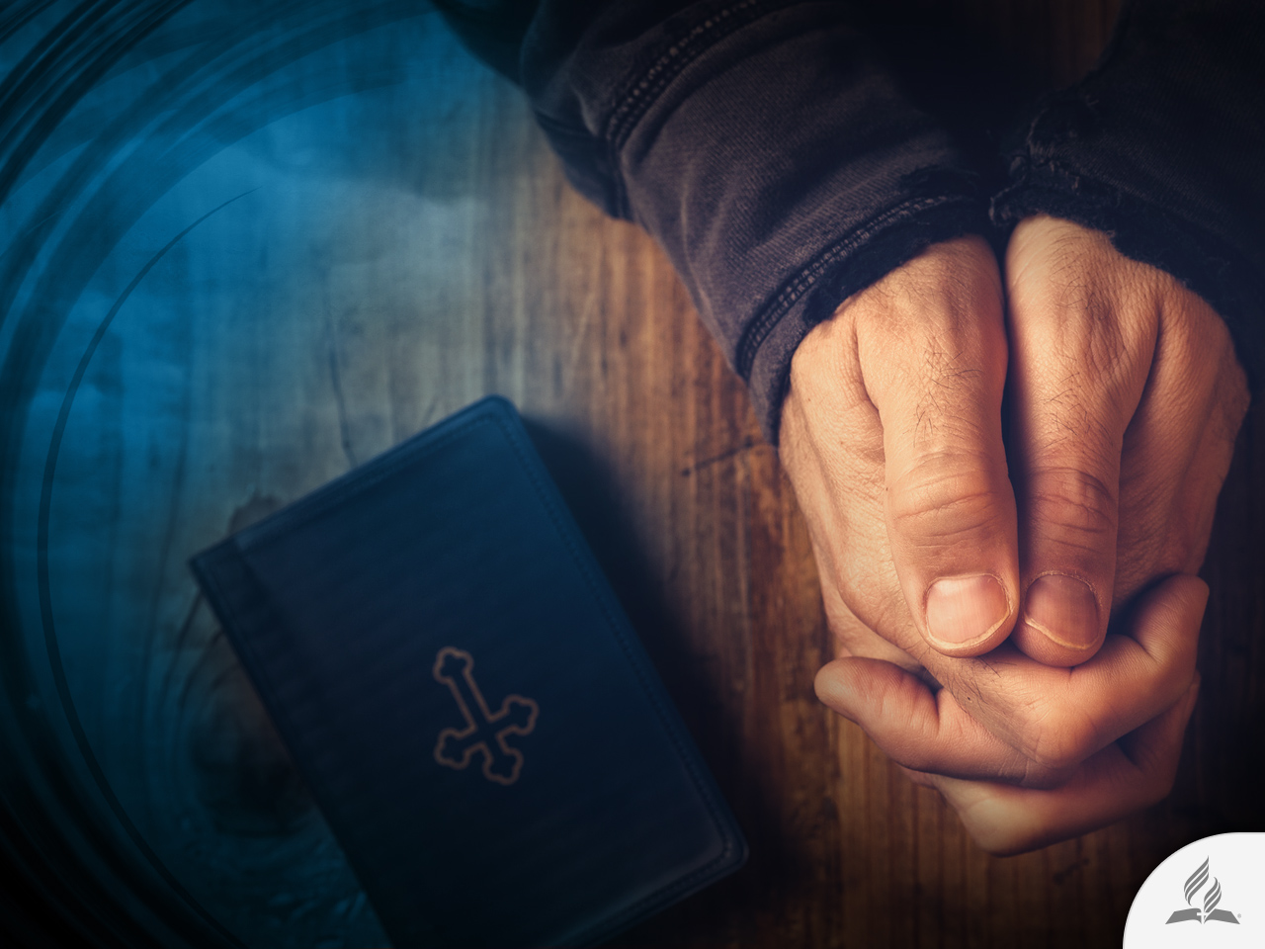
The Transforming Power of the Bible
The Word of God won’t return to Him empty (Is. 55:11).
Criminals go on to lead honest lives, unsuccessful people pick themselves up, slaves to certain vices react and defeat harmful habits that were destroying their lives.

Slide 28
Summary
Every human being has a purpose to his or her life.
Believing in God is a characteristic element of human nature.
Cosmological, teleological, moral, historical, and supernatural arguments help us understand the work of God.
The things that surround us on earth, sea, and sky indicate order, beauty, precision, and ingenious planning.
The authority and unity of the Bible, just like the fulfillment of its prophecies, help us trust the Scriptures.
The transforming power of the Bible reveals that it has a non-human origin.

Slide 29
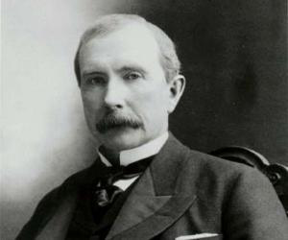
What Is the Purpose of Your Life?
John D. Rockefeller, Sr. was strong and husky when young.
He determined early on to earn money and drove himself to the limit. At age 33, he earned his first million dollars.
At age 43, he controlled the biggest company in the world. At age 53, he was the richest man on earth and the world’s only billionaire.

Slide 30
What Is the Purpose of Your Life?
Then he developed a sickness called “alopecia,” where the hair of his head dropped off, his eyelashes and eyebrows disappeared, and he was shrunken like a mummy.
His weekly income was one million dollars, but he digested only milk and crackers.
He was so hated in Pennsylvania that he had to have bodyguards day and night.
He could not sleep, stopped smiling long ago, and enjoyed nothing in life.
The doctors predicted he would not live over one year.

Slide 31
What Is the Purpose of Your Life?
The newspaper had gleefully written his obituary in advance—for convenience to have when he died. Those sleepless nights set him thinking.
He realized with a new light that he “could not take one dime into the next world.” Money was not everything.

Slide 32
What Is the Purpose of Your Life?
The next morning found him a new man. He began to help churches with his amassed wealth; the poor and needy were not overlooked. He established the Rockefeller Foundation, whose funding of medical research led to the discovery of penicillin and other wonder drugs. John D. began to sleep well, eat and enjoy life.
The doctors had predicted he would not live over age 54. He lived up to 98.

Slide 33
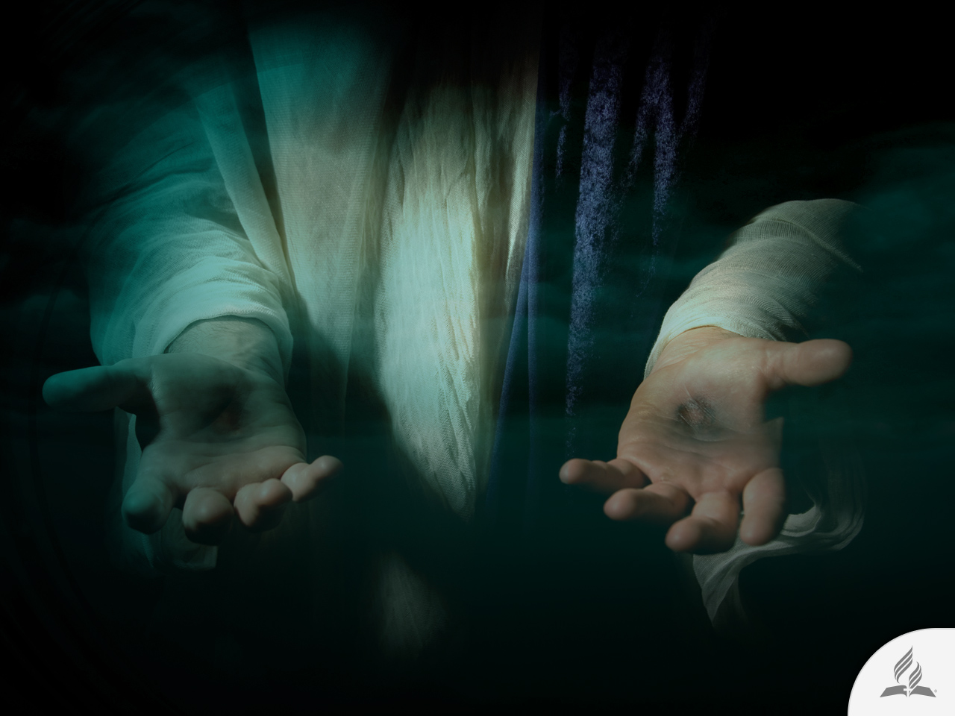
My Decision
The Bible says: “I will instruct you and teach you in the way you should go; I will counsel you with my loving eye on you” (Ps. 32:8).
Are you willing to accept Jesus and let Him show you the purpose of your life?

Slide 34
Next Topic:
WHERE DO WE COME FROM, AND WHERE ARE WE GOING?
Scientific Evidence in Favor of God.
The Biblical Account of Creation.
A Book of Faith with Pedagogical Language.
Beyond Human Grasp.
A Matter of Faith.

