Slide 1


Slide 2




Where Do We Come from, and Where Are We Going?
Topic 3

Slide 3

The Song of Brazilian
Singer Leonardo
I don’t know where I am going,
I may never arrive at something,
My life follows the sun,
In the vast horizon,
I don’t even know who I am…

Slide 4

Great Questions about Life
Many men and women on this planet ask themselves the same question: What am I doing here? Where do I come from? Where am I going? Is there life beyond this one?

Slide 5
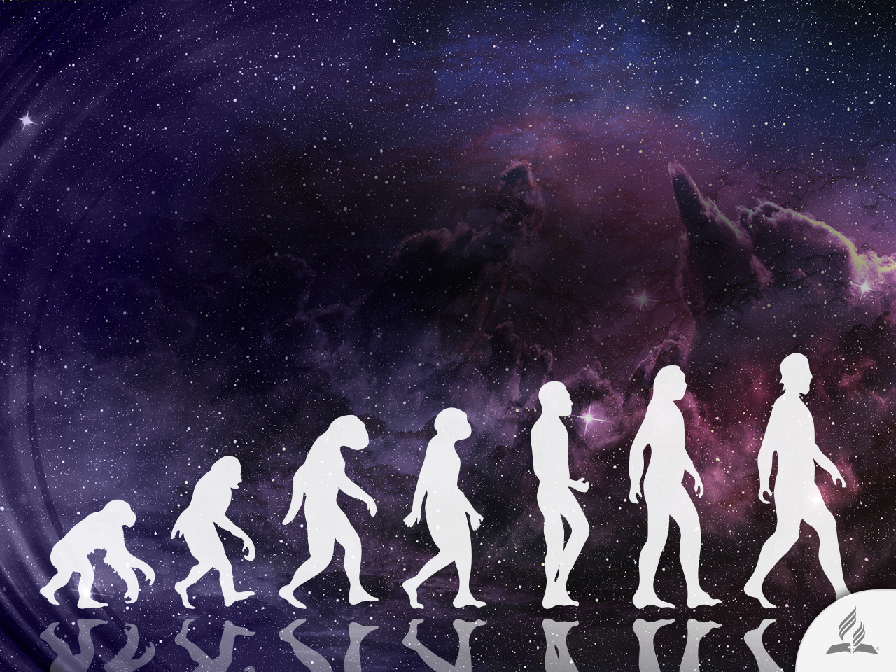
Great Questions about Life
And before these existential questions, philosophers, writers, and thinkers have tried in vain to reply to the instinctive clamor of the human heart.
Many of them see in the theory of evolution a good option for understanding life.

Slide 6

The prolonged search for an evolutionary mechanism
CLASSIFICATION AND PERIOD | PRINCIPLE EXPONENTS | CHARACTERISTICS
Lamarckism 1809-1859 | Lamarck | Use causes the development of new characteristics that are passed on in the form of inheritance.
Darwinism 1859-1894 | Darwin, Wallace | Minor changes, under the control of natural selection, lead to survival of the fittest. Heredity is imparted through gemmules.
Mutations 1894-1922 | Morgan, de Vries | Emphasis on major mutational changes. Natural selection is not as important.
Modern Synthesis (Neo Darwinism) 1922-1968 | Chetverikov, Dobzhansky, Fisher, Haldane, Huxley, Mayr, Simpson, Wright | Unified approach. Changes in populations are important. Minor mutations under the control of natural selection. Relationship with traditional classification.
Divergence 1968 to present | Eldredge, Gould, Grassé, Henning, Kauffman, Kimura, Lewontin, Patterson, Platnick | Multiplicity of contradictory ideas. Dissatisfied with modern synthesis. Emphasis on cladistics. Search of a cause for complexity.

Slide 7
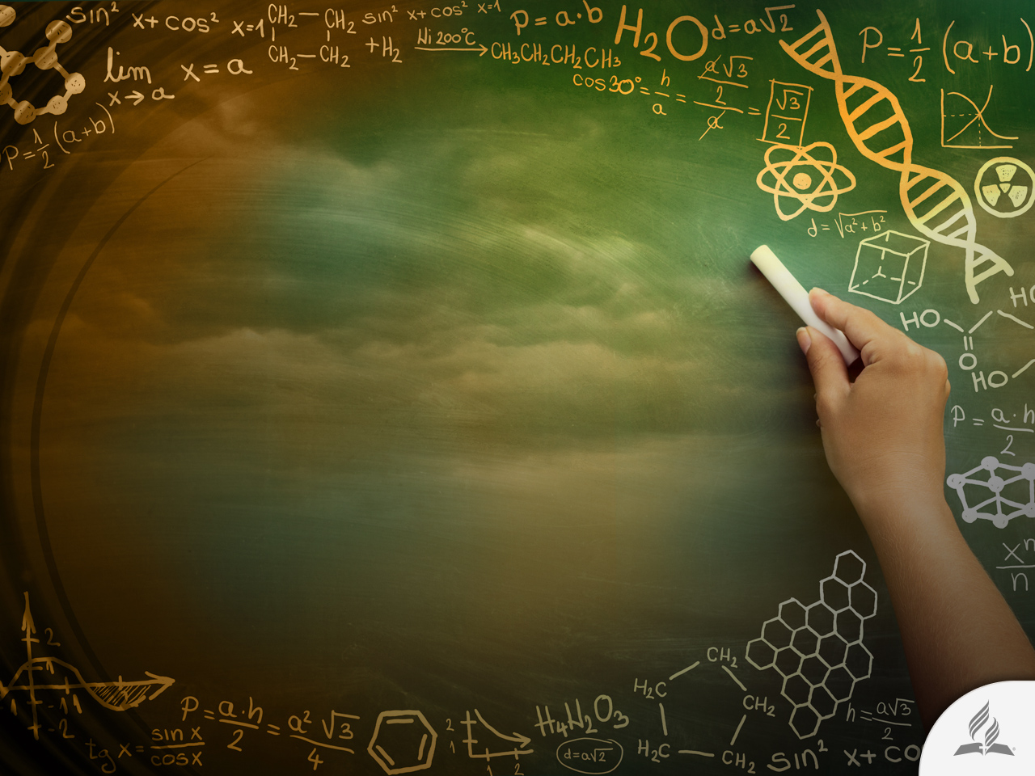
SCIENTIFIC EVIDENCE IN FAVOR OF GOD

Slide 8
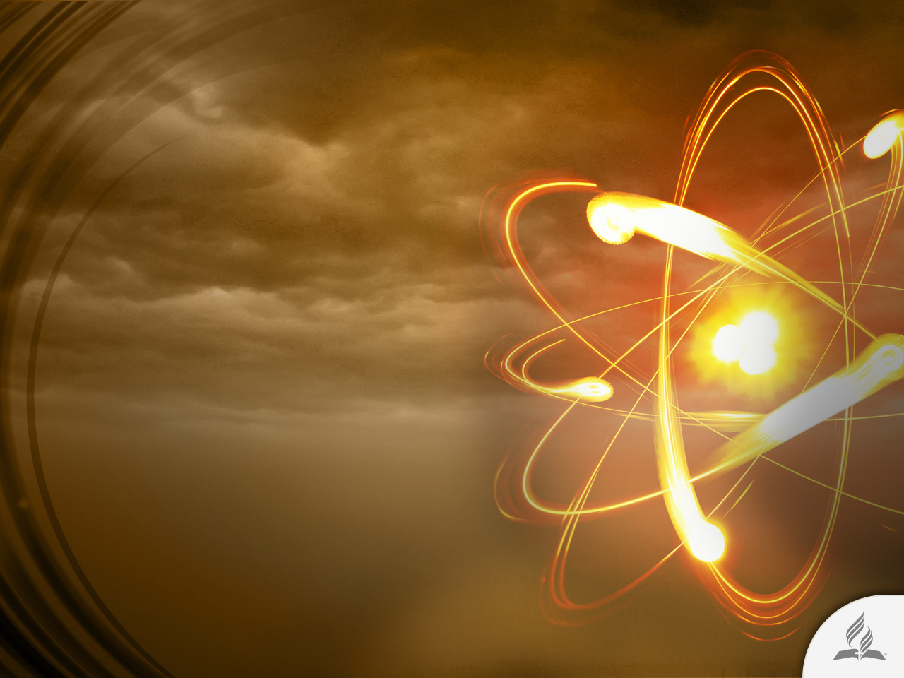
1. Matter
Why is matter arranged into subatomic particles following laws that permit them to form more than 100 elements that constitute the matter of the universe, such as atoms, molecules, and chemical changes necessary for life?
In addition, this matter produces light in order to allow sight. Matter could simply be chaotic, without laws. These laws suggest intelligent planning.
Why must the mass of these subatomic particles be exactly 1:1000 in order to exist?

Slide 9
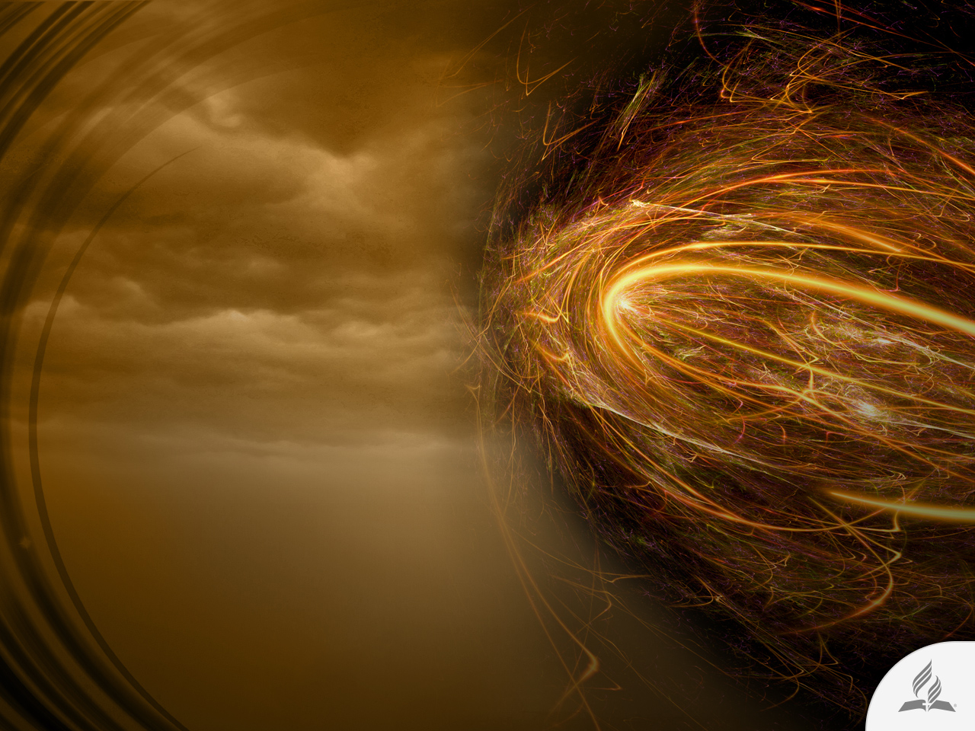
2. Forces
The extremely precise value and the field of action of the four fundamental forces of physics are exactly those required to allow the existence of a universe that is adequate for life to exist. The relationship between the two nuclear forces and gravity and electromagnetism must be extremely precise or the sun would not regularly provide the earth with the precise amount of heat we need.

Slide 10
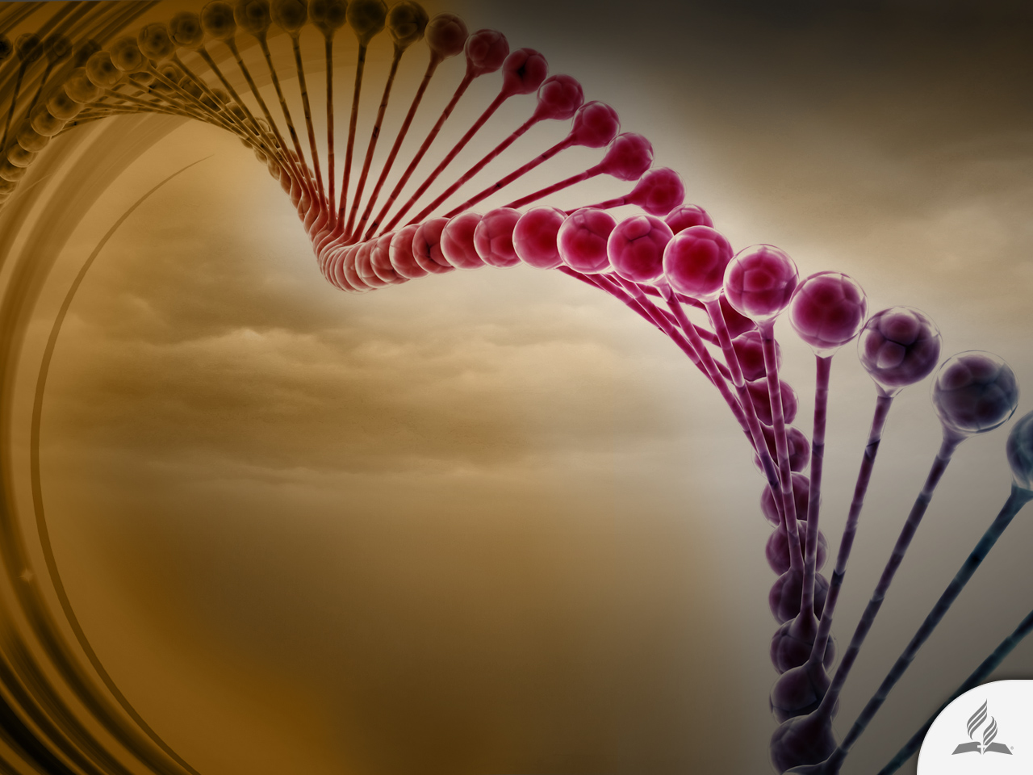
3. Life
The most unsophisticated living organisms are so intricate and complex that it seems impossible they could have originated without intelligent planning.
The complexities include DNA, proteins, ribosomes, metabolic pathways, genetic code, and the ability to reproduce, including a verification and correction system when DNA is duplicated.

Slide 11

4. Organisms
Systems of irreducible complexity are evident in all organisms. They have interdependent parts that cannot function until all necessary parts are present. Examples include the automatic mechanism of focus and exposure of the eye, as well as our intricate brains, etc. The individual parts of these systems, useless on their own, lack an inherent value of evolutionary survival; hence, they required the planning of a Designer.

Slide 12

5. Time
The long eras proposed for the earth and the universe are way too brief to accommodate the improbable events imagined by evolution. Calculations indicate that the age of 5 billion years attributed to the earth is billions of times too brief to randomly produce even one unique, specific protein molecule. God seems to be absolutely necessary.

Slide 13
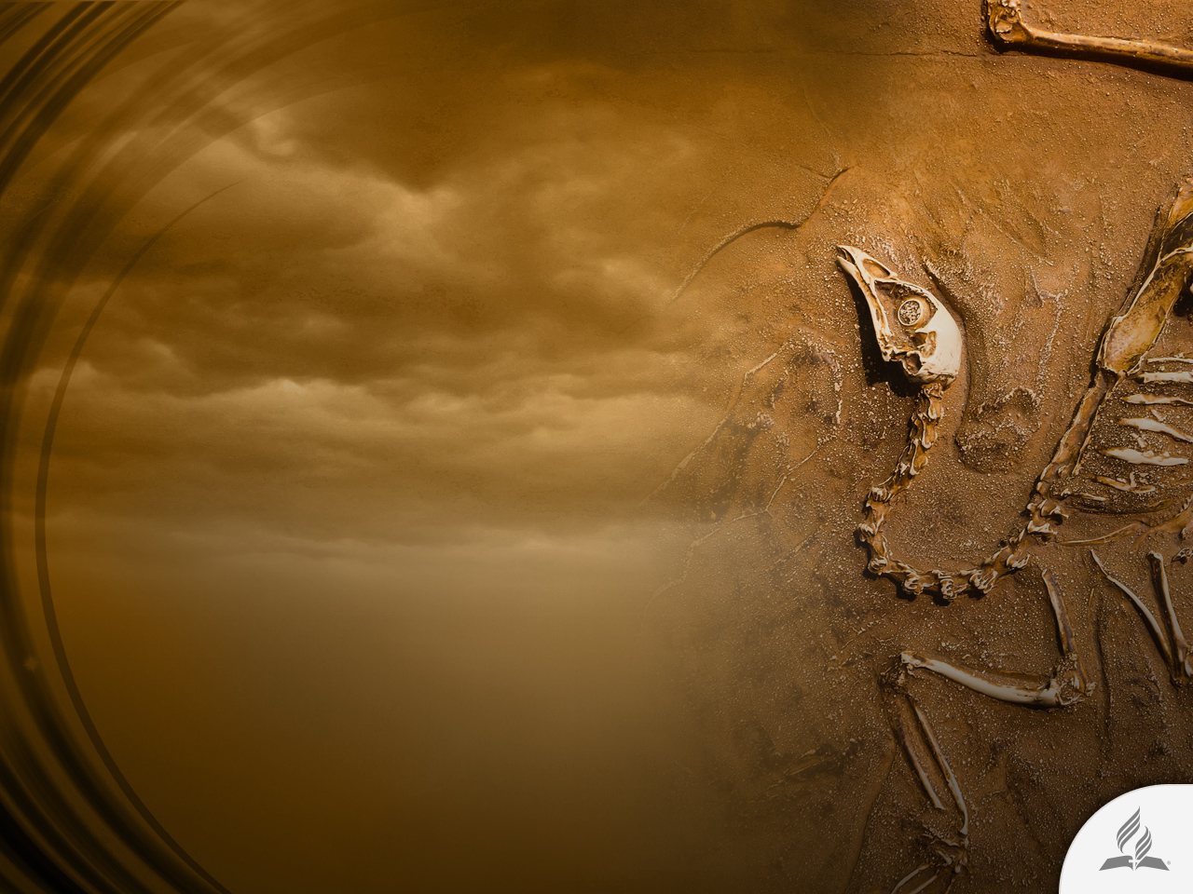
6. Fossils
During the greater part of the evolutionary period almost no evolution at all took place. Suddenly, toward the end, and for less than 2% of the evolutionary period, most of the fossil animal phyla appear in what is known as the Cambrian explosion.
Furthermore, no significant ancestors of the phyla are apparent immediately before such an event. Many other important groups also appear, as if they had been instantly created. Evolutionists propose intermediate forms. However, if evolution had taken place, the fossil record should be full of many types of intermediate forms attempting to evolve, which it isn’t.

Slide 14

7. Mind
The mind possesses characteristics whose analysis presents great difficulties for science. For that reason, such characteristics indicate a reality that transcends the naturalistic sphere and points to a transcendent God. Our free will, to be truly free (according to a majority consensus), prevails over the normal principles of cause and effect known to science.
Other factors include our consciousness (the sense that we exist) and our perception that reality has meaning. We also have a sense of morality, as well as a sense of love and concern for others. Such high characteristics of the mind are not found in ordinary matter.

Slide 15

The Biblical
Account of Creation
What does the Bible say about the origin of life and the planet?

Slide 16

In the Beginning
The Bible begins with an assertive declaration: “In the beginning God created the heavens and the earth” (Gen. 1:1).
The biblical author is not concerned with proving that creation is real.
He simply presents the creative God and accurately describes His creative work.

Slide 17

What Is Seen Was Made out of
What Was Not Seen
“By faith we understand that the universe was formed at God’s command, so that what is seen was not made out of what was visible” (Heb. 11:3).
There was nothing before God created the universe; He is the beginning of everything. Before God nothing existed; He created everything from nothing.

Slide 18
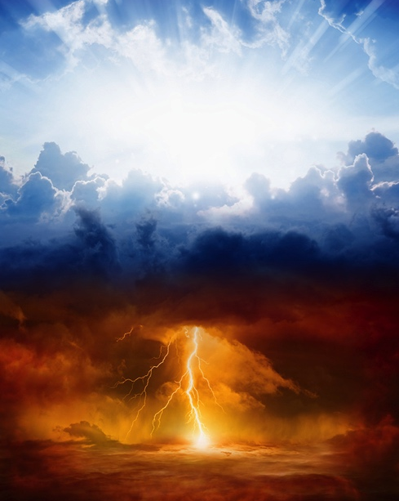
Heavens Are Silent Witnesses of the Power of God
“The heavens declare the glory of God; the skies proclaim the work of his hands. Day after day they pour forth speech; night after night they reveal knowledge. They have no speech, they use no words; no sound is heard from them” (Ps. 19:1-3).
No words, philosophy, or arguments are necessary. We have to look only skyward and be honest with reason itself. There must be a Creator behind something so grand, beautiful, and designed with such perfection.

Slide 19
How Did God Make the Universe?
“It is he who made the earth by his power, who established the world by his wisdom, and by his understanding stretched out the heavens. When he utters his voice there is a tumult of waters in the heavens, and he makes the mist rise from the ends of the earth. He makes lightning for the rain, and he brings forth the wind from his storehouses” (Jer. 51:15, 16, ESV).

Slide 20

THE WORD BECAME FLESH

Slide 21
Beyond Human Grasp
“In the beginning was the Word, and the Word was with God, and the Word was God. He was with God in the beginning. Through him all things were made; without him nothing was made that has been made. . . The Word became flesh and made his dwelling among us. We have seen his glory, the glory of the one and only Son, who came from the Father, full of grace and truth” (John 1:1-3, 14).
John affirms that Jesus is the Word of God, and that He was with the Father at the beginning of creation.

Slide 22

All Came through Jesus
“For him all things were created: things in heaven and on earth, visible and invisible, whether thrones or powers or rulers or authorities; all things have been created through him and for him” (Col. 1:16).

Slide 23
Jesus Is God
Indirect statements
  He is eternal (Is. 9:6; John 1:1; Heb. 13:8; Mic. 5:2)
  He is omnipresent (Matt. 18:20; 28:20)
  He is omniscient (Col. 2:3; John 2:24; 16:30)
  He is omnipotent (John 5:19; Heb. 1:3)
Direct statements
  “The fullness of the Deity” (Col. 2:8-10)
  “God over all” (Rom. 9:5)
  “Your throne, oh God” (Heb. 1:7-8)
  “The true God” (1 John 5:20)
  “Our great God” (Tit. 2:13)

Slide 24
Is Jesus Jehovah?
NAME | JEHOVAH | JESUS
The First and the Last | Is. 44:6 | Rev. 1:17
The Searcher | Jer. 17:10 | Rev. 2:18,22
The Good Shepherd | Ezek. 34:15-16 | John 10:14-15
The Redeemer | Ps. 19:14; Is. 47:4 | Col. 1:14; Rom. 3:24
The Truth | Jer. 10:10 | John 14:6

Slide 25
A Divine-Human Being: Phil. 2:5-8
“In your relationships with one another, have the same mindset as Christ Jesus: Who, being in very nature God, did not consider equality with God something to be used to his own advantage; rather, he made himself nothing by taking the very nature of a servant, being made in human likeness. And being found in appearance as a man, he humbled himself by becoming obedient to death— even death on a cross!”

Slide 26
His Word Has Power
“By the word of the Lord the heavens were made, their starry host by the breath of his mouth. He gathers the waters of the sea into jars; he puts the deep into storehouses” (Ps. 33:6, 7).
Here the question arises: If, when nothing existed, everything came into existence by the power of the word of God, how could He not restore the life of those who think there is no remedy for death?

Slide 27

You Can Be the Next New Creation
“Therefore, if anyone is in Christ, the new creation has come: The old has gone, the new is here!” (2 Cor. 5:17).

Slide 28
Summary
Many men and women on this planet ask themselves the same question: What am I doing here? Where do I come from? Where am I going? Is there life beyond this one?
Many of them see in the theory of evolution a good option for understanding life.
Matter, forces, life, organisms, time, fossils, and mind are important evidence in favor of God’s Creation.
The Bible says that God created the world.
The great Creator has come to this world in the person of Jesus Christ.
Our powerful Lord had power for creating the world, and also has the power to change your life.

Slide 29

From Atheism to Christianity
He was atheist when studied at Cambridge University, but found the Lord through science.
“Atheism, I began to realize, rested on a less-than-satisfactory evidential basis. The arguments that had once seemed bold, decisive, and conclusive increasingly turned out to be circular, tentative, and uncertain.”

Slide 30
From Atheism to Christianity
“The opportunity to talk with Christians about their faith revealed to me that I understood relatively little about their religion, which I had come to know chiefly through not-always-accurate descriptions by its leading critics, including British logician Bertrand Russell and German social philosopher Karl Marx.
I also began to realize that my assumption of the automatic and inexorable link between the natural sciences and atheism was rather naïve and uninformed. One of the most important things I had to sort out, after my conversion to Christianity, was the systematic uncoupling of this bond. Instead, I would see the natural sciences from a Christian perspective-and I would try to understand why others did not share this perspective.”

Slide 31
From Atheism to Christianity
He has three earned doctorates from Oxford University: a DPhil in molecular biophysics (1978) for his research on biological membranes; a DD from the Faculty of Theology (2001) for his work in historical and systematic theology; and a DLitt from the Division of Humanities (2013) for his research in the history of ideas, especially relating to science and religion.
He is also a Fellow of the Royal Society for the Encouragement of Arts, Manufactures & Commerce (FRSA).
“Spiritually, God is the oxygen of my existence; I would find it very difficult to thrive without a belief in God”.

Slide 32
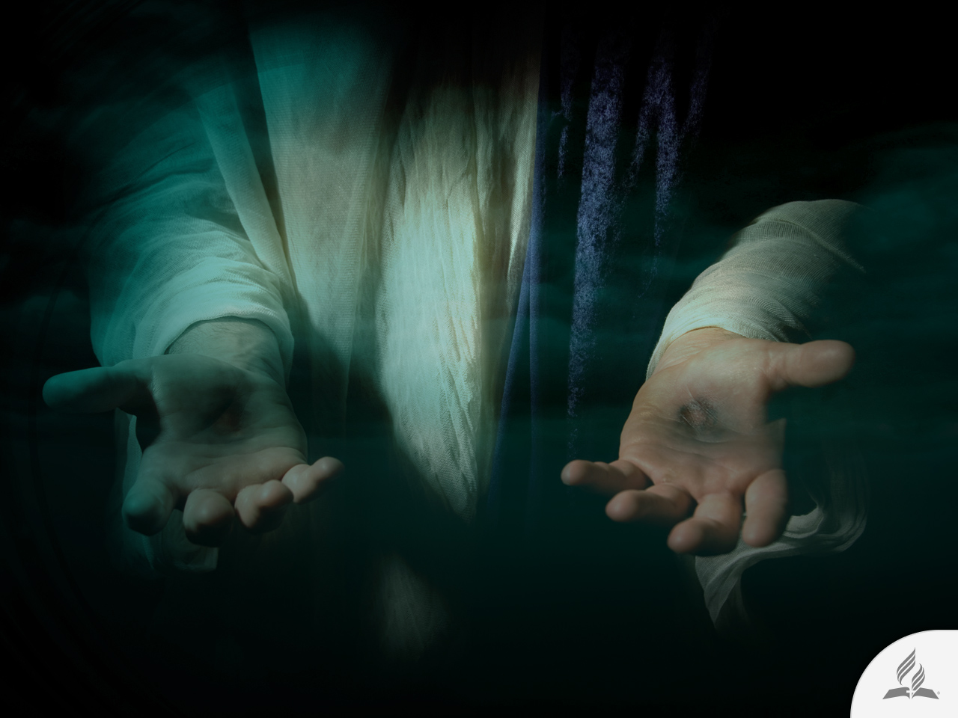
My Decision
The Bible says: “My son, give me your heart and let your eyes delight in my ways” (Prov. 23:26).
Are you willing to give Jesus your heart and let His power change you?

Slide 33
Next Topic:
WHY PAIN, SUFFERING, AND DEATH?
Back to Genesis.
Did God Create an Evil Being?
Result of Disobedience.
Death’s Footprint.
The Only Way.

