Slide 1
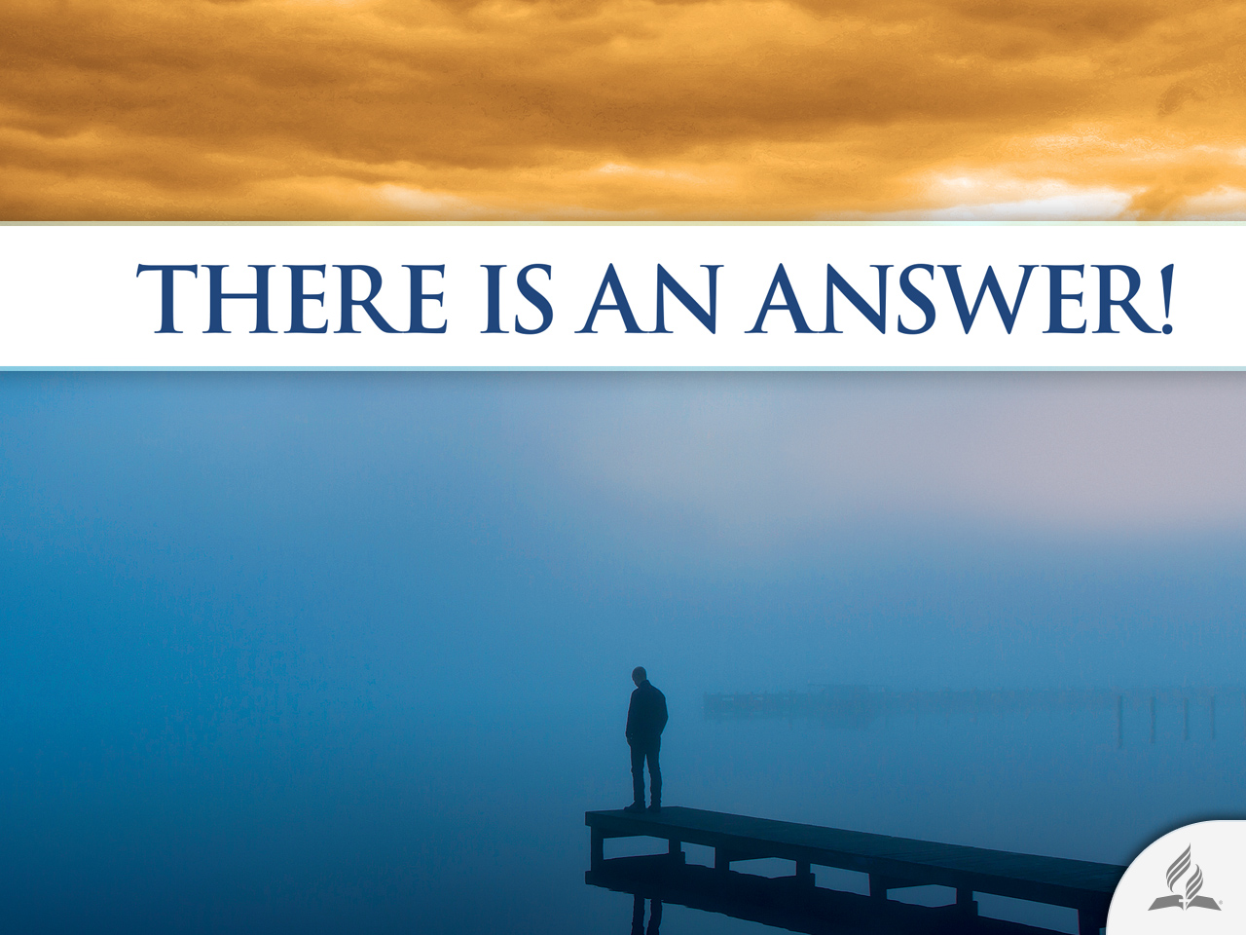

Slide 2




Can God Change My Life?
Topic 5

Slide 3
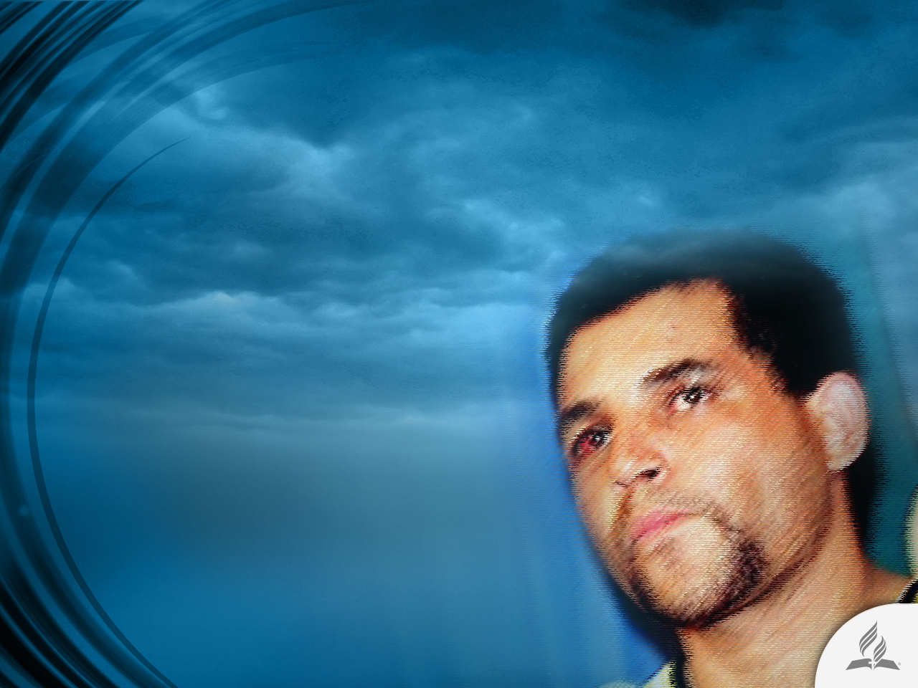
“I Have a Killer Beast inside Me”
Francisco de Assis Pereira murdered 11 women after raping them in a park on the outskirts of Sao Paulo (Brazil).
His strategy was the same in every case. He would find his victims in supermarkets and at bus stops and introduce himself as a talent scout who discovers beautiful women for a modeling agency.
Then, under the pretense of taking their photographs, he would take them to the park where he would rape them, and then strangle them with a rope.

Slide 4
“I Have a Killer Beast inside Me”
The search for Pereira lasted 23 days until he was arrested at the border between Brazil and Argentina, 1,500 kilometers away from Sao Paulo.
After he crossed the Uruguay River, the boundary between both countries, Francisco asked a local fisherman for lodging. The fisherman had seen the news on television and called the police.
During the trial, defense attorneys insisted that Francisco was a psychopath. Francisco himself said to the judge: “I never told anyone this. I have a killer beast inside me. It is an ugly, wicked beast I cannot control. There are days when I do not leave home because I know the beast will awaken. I go to bed, cover my head with the blanket, and pray so that I may be able to control myself. But I cannot.”

Slide 5
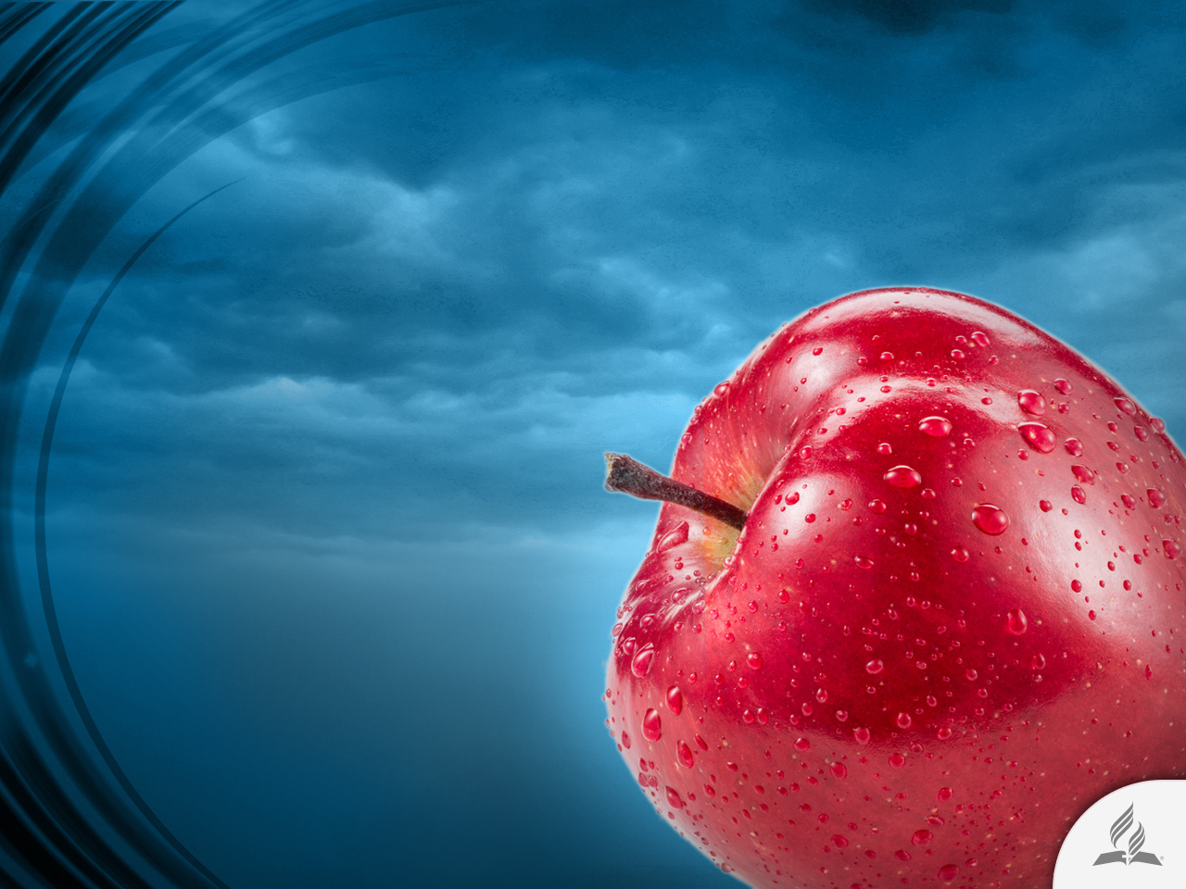
WHAT IS SIN?
Biblical concepts about it

Slide 6

What Is Sin?
The Bible uses various terms to refer to the concept of sin.
In reality, in the Bible, the concept of sin is very broad.
That is why it is important to know its different meanings.

Slide 7

Biblical Terms for “Sin” in the Old Testament (Hebrew)
WORD | MEANING | REFERENCE
Hattat | “To miss the mark,” “to miss the target.” The idea is that God’s rules are not followed. | Judges 20:16; Job 5:24; Leviticus 5:5, 16; Psalm 51:4
‘Awôn | Connotes a wrong intention, “wickedness” before God. Carries the notion of twisting. Additionally, it refers to falsehood, deception, and vanity. | Genesis 4:13; 15:16; Lamentations 3:9; Psalm 36:3; Proverbs 22:8
Peša‘ | To break the law or a rule in a deliberate, premeditated and desired manner. To refuse to be subject to a legal authority. | Isaiah 1:2; Jeremiah 3:13; Hosea 7:13
Reša‘ | Turmoil, wickedness, being out of control, hostility against God and His people. | Isaiah 57:20; Exodus 9:7

Slide 8
Biblical Terms for “Sin” in the New Testament (Greek)
WORD | MEANING | REFERENCE
Hamartia | “To miss the mark,” a deliberate error by a person seeking the will of God. Human decision to be hostile to the Lord. | Matthew 1:21; Romans 5:12; John 9:41; 19:11
Parakoé | “To fail to hear” or “to give up to hear,” translated “disobedience” and “disloyalty.” | Romans 5:19; 2 Corinthians 10:16; Hebrews 2:2
Parabasis | To deliberately break the law, to violate a command, to advance to a forbidden area, translated as “transgression” or “violation.” | Romans 4:15; Galatians 3:19; Hebrews 2:2
Paraptoma | A slip-up or fall, translated as “offense,” “crime,” and “fall.” | Matthew 6:14, 15; Romans 4:25; 5:15; 11:11, 12
Anomia | Infraction of the law, translated as “evilness” or “lawlessness.” | Matthew 7:23; 13:41; Romans 4:7; 1 John 3:4
Adikia | Absence of justice, translated as “ungodliness” and “wickedness.” | Romans 1:18, 19; 2 Peter 2:15; 1 John 5:7

Slide 9
Rebellion
against
God
Carelessness
of duties
A broken relationship
Contamination
and guilt
A
condition
SIN
An enslaving power
A specific kind of evil
Selfishness
and pride
Miss the mark
Transgression

Slide 10

Returning to Eden
Eve opted to believe the word of the serpent rather than the Word of God.
She tried to be happy in her own way. She did not eat from the tree intending to die. Her ambition was to be equal to God.
However, together with Adam, she ended up bringing death to herself and to humanity.

Slide 11
Wanting to Be Like God
Eve ate the fruit wanting to be like God, and she ended up bringing tragedy to the world.
Sin always works that way. It makes us believe that we do not need God, and that we can be happy without His help. Instead, we turn out to be irascible, disturbed, and grief-stricken.
We miss the target. We desire one thing and end up obtaining something completely different.
Sin produces fear, anxiety, pride, dissatisfaction, addictions, etc.

Slide 12

A SINFUL NATURE
A battle inside us

Slide 13
A Tendency toward Evil
“I do not understand what I do. For what I want to do I do not do, but what I hate I do. And if I do what I do not want to do, I agree that the law is good. As it is, it is no longer I myself who do it, but it is sin living in me. For I know that good itself does not dwell in me, that is, in my sinful nature. For I have the desire to do what is good, but I cannot carry it out. For I do not do the good I want to do, but the evil I do not want to do – this I keep on doing. Now if I do what I do not want to do, it is no longer I who do it, but it is sin living in me that does it. So I find this law at work: Although I want to do good, evil is right there with me. For in my inner being I delight in God’s law; but I see another law at work in me, waging war against the law of my mind and making me a prisoner of the law of sin at work within me. What a wretched man I am! Who will rescue me from this body that is subject to death?” (Rom. 7:15-24).

Slide 14

A Sinful Nature (Ps. 51:5)
For humans, it is easier to sin than to obey God.
Obedience is hard for us.
But when Jesus comes to our lives He creates in us a new Christian nature (Eph. 4:20-24).
Then begins the conflict that Paul the Apostle mentions.

Slide 15
Jesus Creates a New Nature In Us
“Therefore, if anyone is in Christ, the new creation has come: The old has gone, the new is here!” (2 Cor. 5:17).
“And to put on the new self, created to be like God in true righteousness and holiness” (Eph. 4:24).
“For we know that our old self was crucified with him so that the body ruled by sin might be done away with, that we should no longer be slaves to sin” (Rom. 6:6).
“And have put on the new self, which is being renewed in knowledge in the image of its Creator” (Col. 3:10).
“Therefore we do not lose heart. Though outwardly we are wasting away, yet inwardly we are being renewed day by day” (2 Cor. 4:16).

Slide 16

The Battle Between Two Natures: How Are They Nourished?
SINFUL NATURE
NEW NATURE
Unsuitable media content: movies, TV programs, websites, etc.
Inappropriate friendships.
Non-edifying music.
Non-assistance to the Church.
Spiritual indifference.
Edifying media content: music, videos, movies, etc.
Prayer and Bible reading.
Assistance to the Church.
Mission activities.
Uplifting reading material.

Slide 17
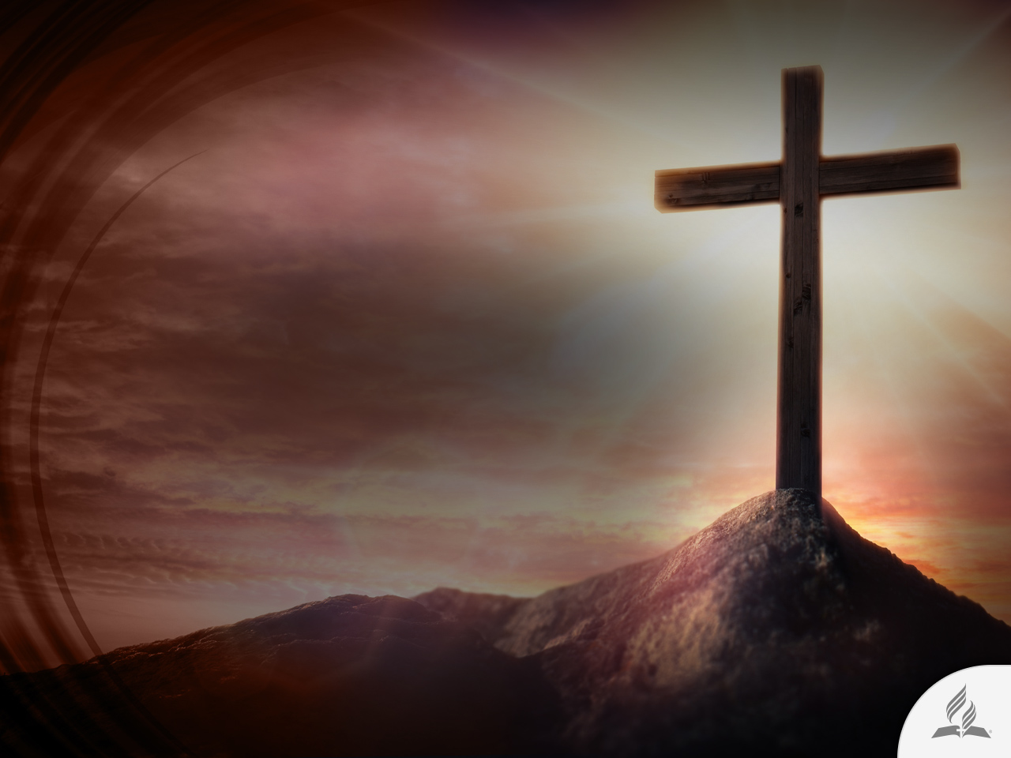
The Need of a Daily Devotional Life
“Then he said to them all: ‘Whoever wants to be my disciple must deny themselves and take up their cross daily and follow me’” (Luke 9:23).

Slide 18
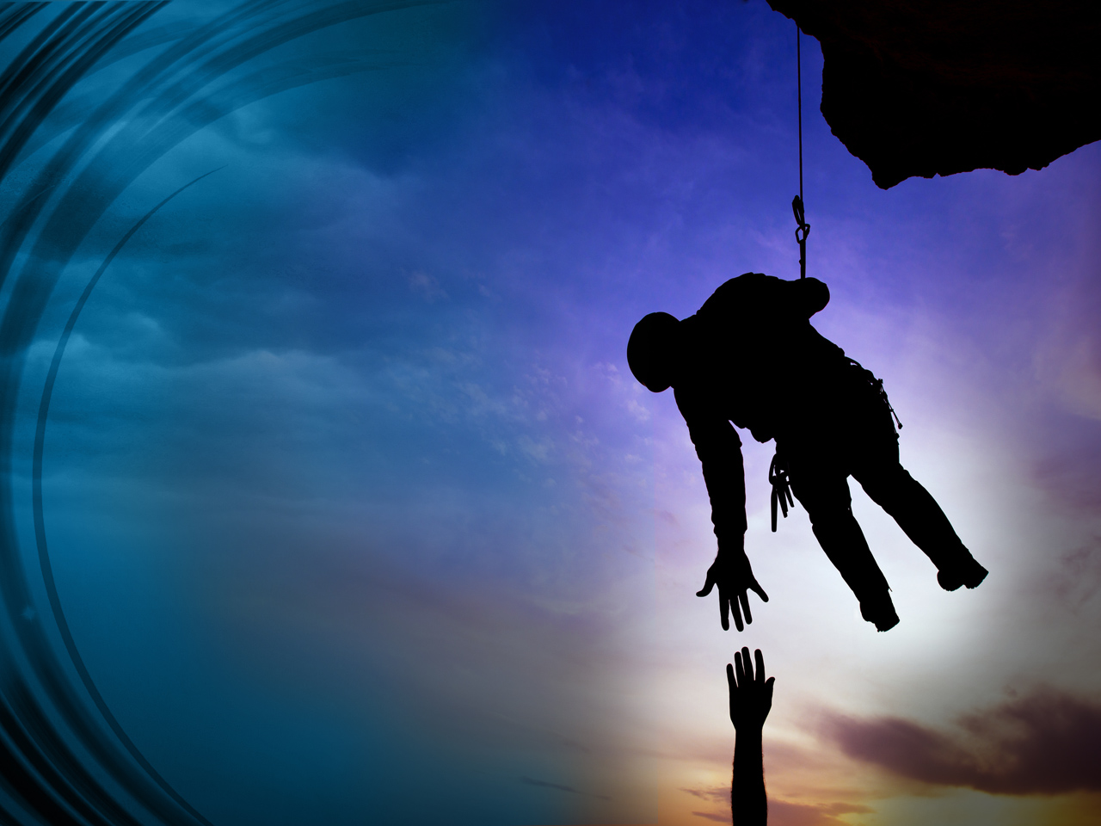
1. Deny Yourself
Crucify self (Gal. 2:20).
Recognize your human weakness.
Accept divine help.

Slide 19

2. Take up the Cross
Accept the inconveniences of being a Christian (critics, mockeries, rejections).
Submit to the will of God when it is contrary to our desires.

Slide 20

3. Follow Jesus
Be ready to do what He call us to do (Ps. 25:1-10).
Enjoy your obedience of His will.

Slide 21
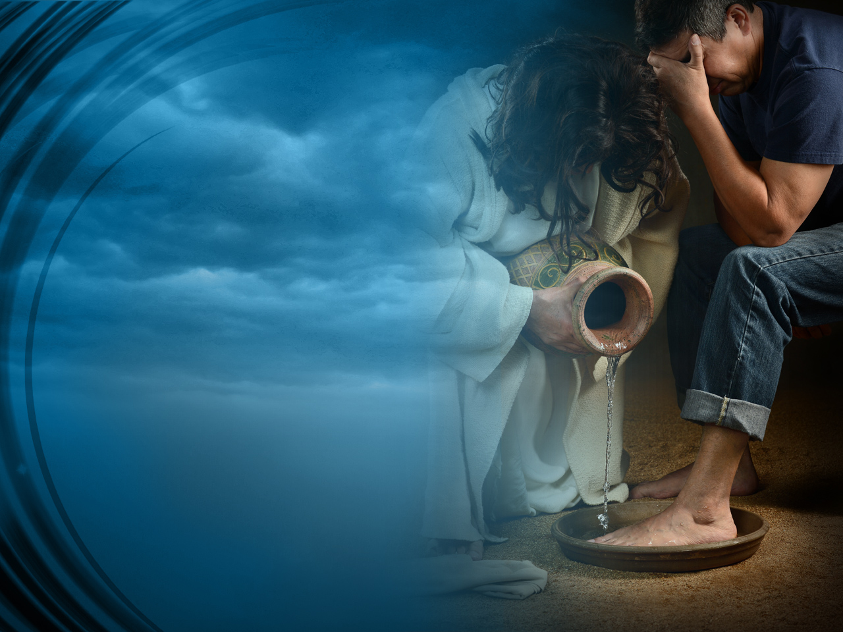
Three Attitudes toward Jesus

Slide 22
Three Types of Attitudes Today
Some harbor in their hearts a lack of faith and criticize everything related to Jesus and to religion.
Others acknowledge their sinful situation, repent, and accept Jesus as their personal Savior.
And there are those who remain indifferent, simply observing what will happen.

Slide 23
Three Types of Attitudes on the Cross (Luke 23:39-42)
Lack of Faith
The Bad Thief
Repentance
The Good Thief
Indifference
The People

Slide 24
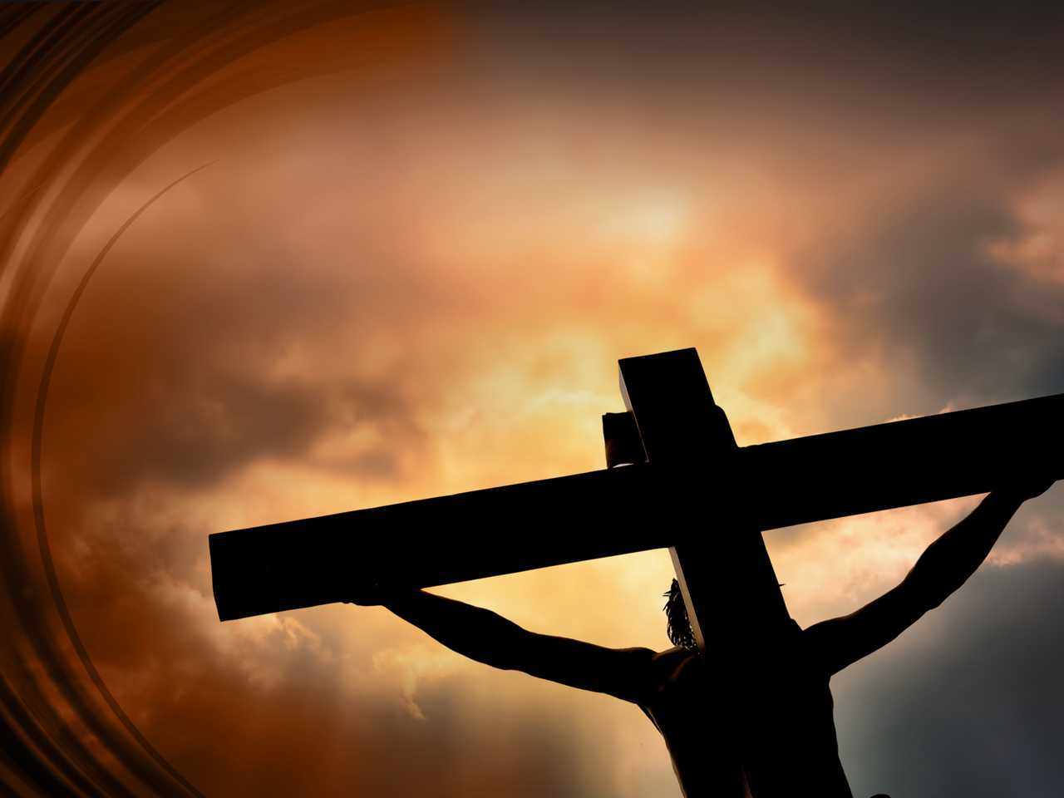
The Anger of the Bad Thief toward Jesus
Aren’t you the Messiah? Save yourself and us! (Luke 23:39).
What are you waiting to help me?
Release me from this cross!

Slide 25

The Testimony of the Good Thief
“‘Don’t you fear God,’ he said, ‘since you are under the same sentence? We are punished justly, for we are getting what our deeds deserve. But this man has done nothing wrong.’ Then he said, ‘Jesus, remember me when you come into your kingdom’” (Luke 23:40-42).

Slide 26
A Man with Spiritual Conviction
REPENTANCE
“‘Don’t you fear God,’ he said, ‘since you are under the same sentence?’”
CONFESSION
“We are punished justly, for we are getting what our deeds deserve.”
ACKNOWLEDGMENT OF DIVINE JUSTICE
“But this man has done nothing wrong.”
ACCEPTANCE OF JESUS AS PERSONAL SAVIOR
“Remember me.”
FAITH IN THE SECOND COMING OF JESUS
“When you come into your kingdom.”

Slide 27
Summary
Human beings have a sinful nature. For us, it is easier to disobey than to obey.
The Bible uses various terms to refer to the concept of sin.
When Jesus comes into our lives He creates in us a new nature.
We must nourish the new nature with a good lifestyle and a devotional life.
The story of the last moments of Jesus at the cross shows that there are three attitudes toward Christ: Lack of faith, repentance, and indifference.
If we follow the way of the Good Thief, we can be transformed by the Lord and be victorious Christians.

Slide 28
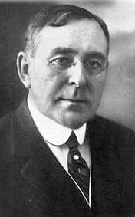
Label It “Sin”
The late Dr. J. Wilbur Chapman, a Presbyterian evangelist in the late 19th century, used to tell of a Methodist preacher who often spoke on the subject of sin. He minced no words, but defined sin as “that abominable thing that God hates.”
A leader in his congregation came to him on one occasion and urged him to cease using the ugly word. He said: “Dr. Blank, we wish you would not speak so plainly about sin. Our young people, hearing you, will be more likely to indulge in sin. Call it something else, as “inhibition,” or “error” or a “mistake,” or even “a twist in our nature.”

Slide 29
Label It “Sin”
“I understand what you mean,” the preacher remarked and going to his desk brought out a little bottle.
“This bottle,” he said, “contains strychnine. You will see that the red label here reads ‘Poison.’ Would you suggest that I change the label, and paste one on that says, ‘Wintergreen?’ The more harmless the name the more dangerous the dose will be.”

Slide 30
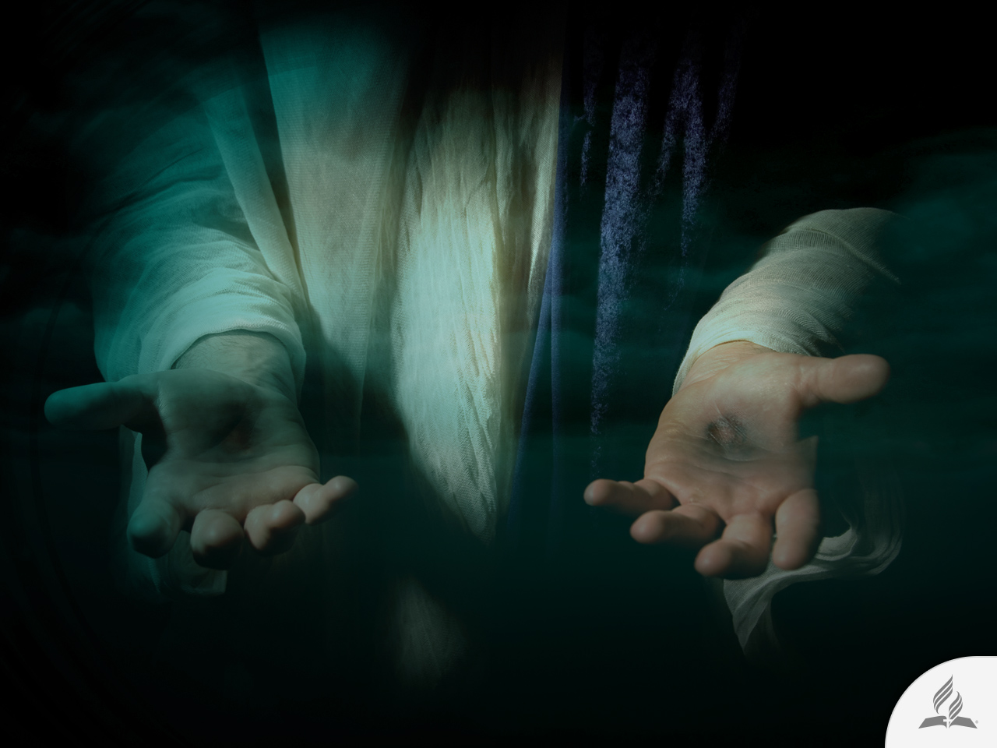
My Decision
The Bible says: “I will sprinkle clean water on you, and you will be clean; I will cleanse you from all your impurities and from all your idols. I will give you a new heart and put a new spirit in you; I will remove from you your heart of stone and give you a heart of flesh. And I will put my Spirit in you and move you to follow my decrees and be careful to keep my laws” (Ezek. 36:25-27).
Are you willing to accept the help Jesus wants to give you today?

Slide 31
Next Topic:
IS IT POSSIBLE TO BE HAPPY?
The Search for Happiness.
Frustrating Selfishness.
On the Wrong Path.
From Decision to Action.

