Slide 1
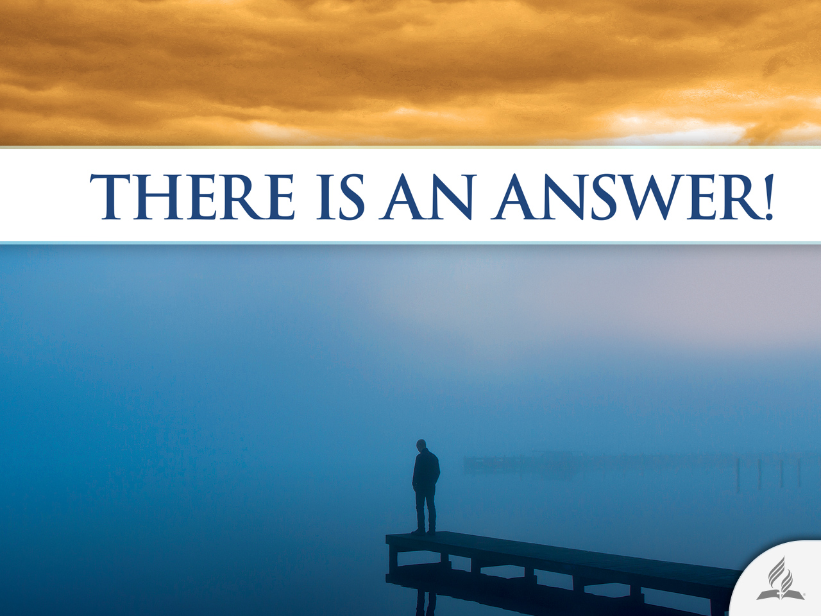

Slide 2




Is It Possible To Be Happy?
Topic 6

Slide 3

He Had Everything to Be Happy
Michael Hutchence, lead singer of the band INSX, felt fulfilled at the height of his professional career when, suddenly, on November 22, 1997, the world was stunned by the news of the suicide of the Australian star.
An autopsy revealed that Hutchence, before hanging himself, had consumed large amounts of alcohol, cocaine, and antidepressants. Police found his naked, lifeless body in a hotel room with a belt around his neck that was tethered to the self-locking mechanism of the door.

Slide 4
He Had Everything to Be Happy
The band’s press advisor, Shawn Deacon, commented that great artists generally have a dark side.
Hutchence’s agent, Martha Troup, asserted that “Michael was a happy man, or at least, he had everything in order to be happy.”
The statements by Deacon and Troup are shocking. The former speaks about “a dark side” in the life of the artist. The latter said “he had everything to be happy.”
Perhaps a man who “had everything to be happy” carried in him “a dark side” that drove him to suicide?

Slide 5

The Search for Happiness

Slide 6
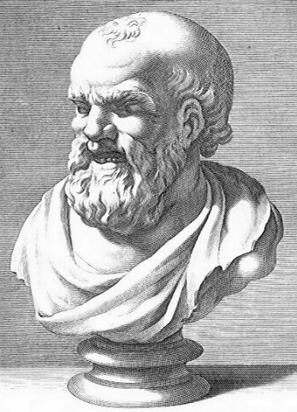
What Is Happiness?
Throughout history, philosophers, writers, psychologists, and theologians have tried to define happiness.
Democritus, who lived in the fourth century, BC, said that happiness and unhappiness are within the soul.
Epictetus taught that happiness and desire cannot coexist.
He referred to happiness as something impossible to attain.

Slide 7
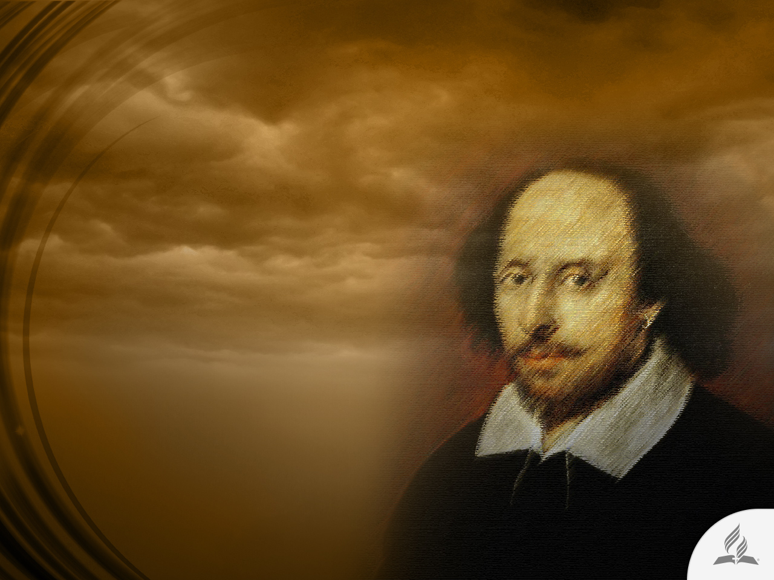
Can We Reach Happiness?
William Shakespeare said that it is very harsh to picture happiness through the eyes of another person.
Like Epictetus, he believed that happiness exists inside oneself.

Slide 8
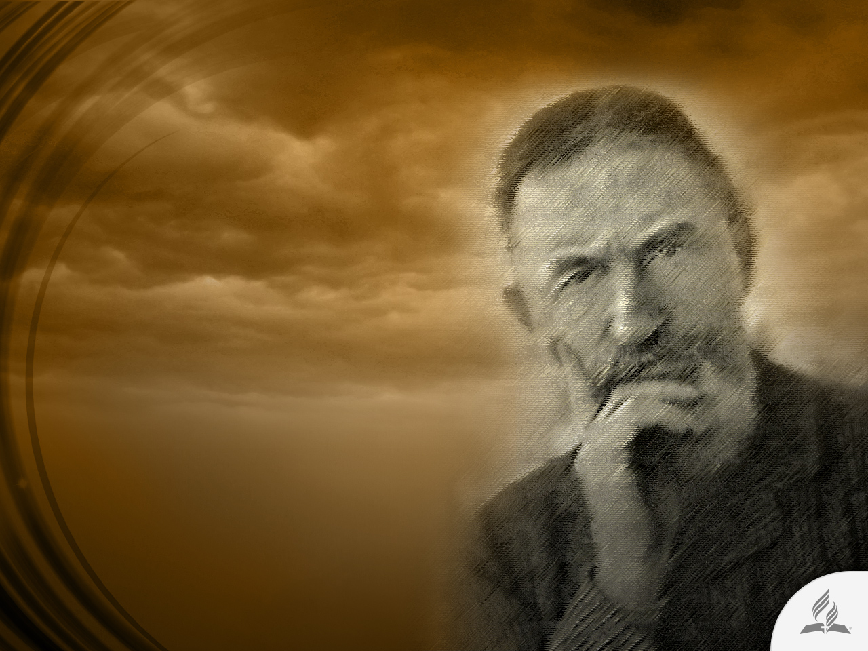
Is Happiness a Simple Utopia?
George Bernard Shaw argued that no one could endure a life of total happiness because it would be hell on earth.
He also considered happiness as a simple utopia.

Slide 9
All Yearn for Happiness
After all, what is happiness? How can we recognize it when it passes by our side? How can we achieve it? Can we provide happiness to our loved ones?
But in one way or another, the truth is that we all yearn for happiness. Everything human beings do, they instinctively do with the desire to be happy.
No one unites in marriage to be unhappy. Does anyone seek employment because they want to be unhappy? No one attends college because they are eager for misfortune.

Slide 10

EIGHT SECRETS
TO A FULFILLED LIFE

Slide 11

Happiness Is a Personal Decision
In recent years, psychologists and personal self-help and self-improvement therapists have written extensively about happiness.
Almost all agree that happiness is not something found outside of us.

Slide 12

1. Be strong and do not let anything destroy you.

Slide 13

2. Accept that you are more than the possessions around you, and the capacity in which you find yourself or in which you desire to be.

Slide 14

3. Learn from setbacks in life.

Slide 15

4. Be slightly better each day.

Slide 16

5. Enjoy every moment as if it were the last.

Slide 17

6. Employ calm and reason in every decision.

Slide 18

7. Think it through before carrying out any action. Own up to everything you do.

Slide 19

8. Enjoy life and take responsibility for it.

Slide 20

The way to happiness
Psalm 1

Slide 21
Secrets to Reach Happiness
“Blessed is the one who does not walk in step with the wicked or stand in the way that sinners take or sit in the company of mockers, but whose delight is in the law of the Lord, and who meditates on his law day and night. That person is like a tree planted by streams of water, which yields its fruit in season and whose leaf does not wither— whatever they do prospers” (Ps. 1:1-3).

Slide 22
Blessed Is the One Who Does Not…
Walk in step with the wicked
Inappropriate influences
Stand in the way that sinners take
Inappropriate decisions
Sit in the company of mockers
Inappropriate attitudes

Slide 23

The Word of God as Center of Life
“But whose delight is in the law of the Lord, and who meditates on his law day and night” (Ps. 1:2).

Slide 24
Benefits of Reading the Bible
The Word of God awakens and strengthens faith (Rom. 10:17).
Through hearing the Word, God supplies the Holy Spirit (John 3:6-8; 6:36, 44, 65).
The Bible leads to life (John 6:63; 20:31).
Gives hope to our life (Rom. 15:4).
Leads us to freedom (Rom. 8:32).
The Word of God is the key to answered prayer (John 15:7).
The Bible is the source of wisdom (2 Tim. 3:15-17).
The Scriptures give us crucial warnings (Deut. 30:15-20).
The Holy Scriptures enable us to defeat the devil (James 4:7).
The Word of God is the source of great and lasting joy (John 15:11).

Slide 25
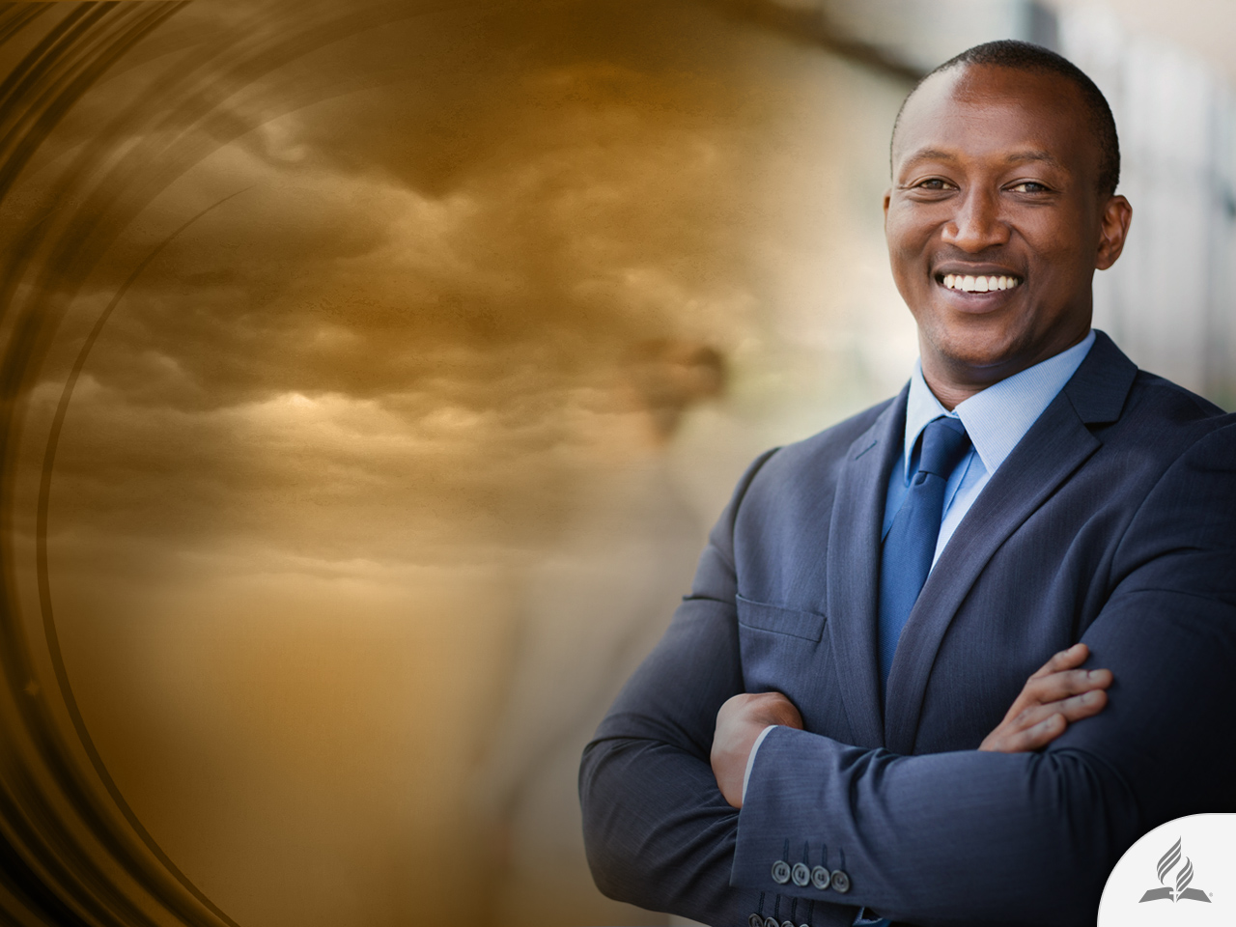
A Productive Person
“That person is like a tree planted by streams of water, which yields its fruit in season and whose leaf does not wither—whatever they do prospers” (Ps. 1:3).

Slide 26
Three Ways to Enjoy Life According to Psalm 1
Live according
to the Law
Stand in the way of the Law
Be consolidated in the Law
Meditate on the Bible every day
Delight in the Bible and live according to its principles
Live a life of prosperity

Slide 27
Summary
Throughout history many people have tried to define happiness.
In recent years, psychologists and personal self-help and self-improvement therapists consider that happiness is not something found outside of us.
Happiness is a personal decision.
Psalm 1 reminds us that we must avoid inappropriate influences, decisions, and attitudes in order to be happy.
The reading of the Bible gives us great benefits that enable us to enjoy life and make us prosperous.

Slide 28
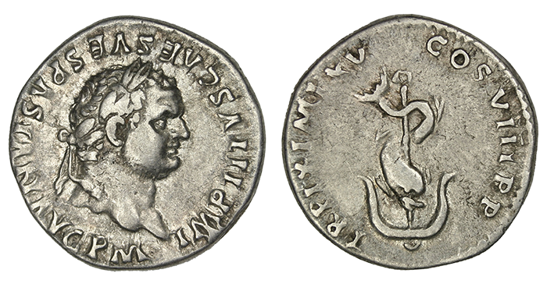
A Symbol of Happiness
A famous historic symbol to express moderation is the device of a dolphin wound around an anchor.
Titus, the Emperor of Rome, had the symbol inscribed on his coins and it was meant to express that golden mean between hurry and delay—the failure that comes from rushing into something and the failure that results from hesitation or undue caution.
The anchor is thus the symbol of delay, as it is also of firmness and security, while the dolphin is regarded as the swiftest and most mercurial of fish.

Slide 29
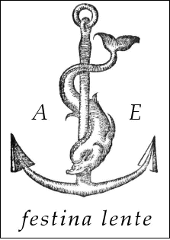
A Symbol of Happiness
Frequently the dolphin and anchor are used as a family crest, with the explanatory motto, Festina lente, “Hasten slowly.”
The symbol, therefore, fitly expresses the idea of moderation, of that just balance between two opposing forces.
It also represents that maturity in business, the medium between too great haste and too great hesitation.

Slide 30
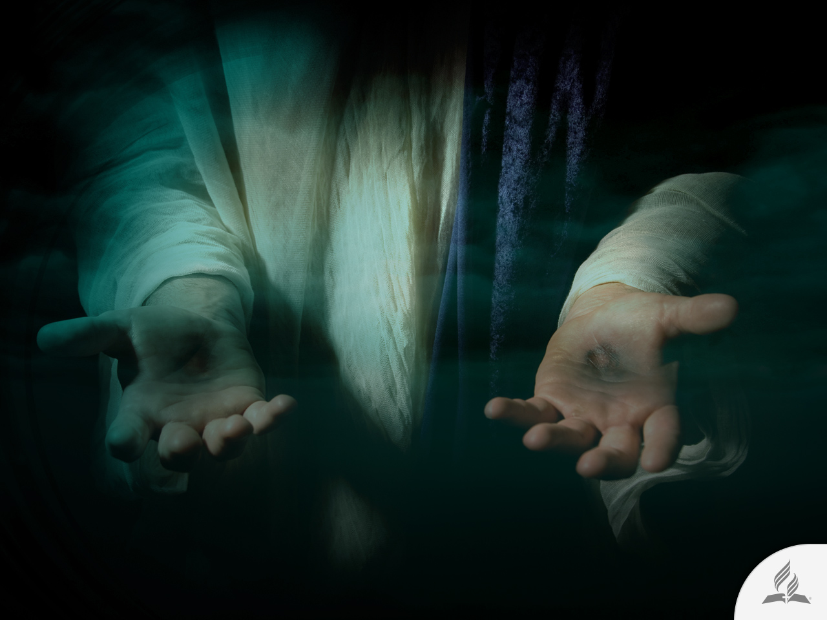
My Decision
The Bible says: “Peace I leave with you; my peace I give you. I do not give to you as the world gives. Do not let your hearts be troubled and do not be afraid” (John 14:27).
Are you willing to accept the peace Jesus wants to give you today?

Slide 31
Next Topic:
LIVING LONGER AND BETTER
Secrets to Longevity
Biblical Counsels on Health

