Slide 1


Slide 2




Living Longer and Better
Topic 7

Slide 3

Staying Young Forever
Staying young forever is a fantasy for many people.
The least fortunate people are content with nurturing the idea of finding the fountain of eternal youth.

Slide 4

Staying Young Forever
Mystics dream of discovering the elixir of life, and multimillionaires are willing to spend a fortune to freeze their bodies (cryogenics) after they die, hoping that in the future science will discover the secret of immortality.

Slide 5

SECRETS TO LONGEVITY

Slide 6
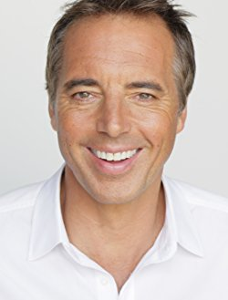
In Search of the Blue Zones
For seven years, a group of scientists and demographers directed by Dan Buettner conducted research for the National Geographic Magazine.
The purpose was to unravel the secrets of the so-called “blue zones,” regions of the planet inhabited by people who live for many years.

Slide 7
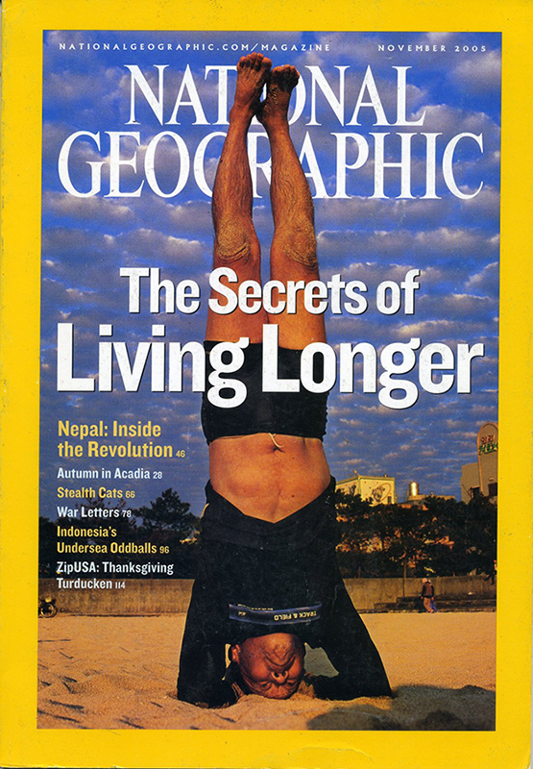
The Healthiest Community
The researchers found that members of the Seventh-day Adventist Church in Southern California (United States) are among the people who live longer than average.
What kind of lifestyle is necessary for enjoying good health?

Slide 8

1. Physical Exercise
Until a few decades ago, physical exercise was part of everyone’s daily routine.
However, today it has turned into an activity in itself because sedentary lifestyle has become part of the life of many people.

Slide 9
Benefits of Physical Exercise
Helps to tone muscles, which burns the fat that causes obesity.
Provides energy.
Reduces stress.
Reduces the risk of osteoporosis.
Better sleep. Less stress means more restorative sleep.
Practiced regularly and frequently, exercise stimulates the immune system, helping to prevent so-called lifestyle diseases, such as diabetes and cardiovascular diseases.
Causes the body to use oxygen and nutrients with greater efficiency for a healthier immune system.

Slide 10

2. Water
The second natural source of life and health is water.
Water is part of the world we live in. It is the most important component of all living beings.
In human beings it makes up nearly two-thirds of their body weight.
The body is equipped with a series of mechanisms that allow it to maintain a balance of the amount of water it needs.

Slide 11

3. Faith in God
Faith in God is not a simple assent or belief in an abstract theory.
Christian faith is a divine gift, accepted and experienced by Christians; it can be lead to a better life.
It cannot be measured or simply worn as an adornment. We must experience it in the heart, and, when we do so, it is like an atom: it carries a prodigious energy inside of it. Faith works wonders.

Slide 12

4. Rest
Rest is a state in which mental and physical activity are reduced.
It leads people to feel revitalized, rejuvenated, and ready to carry on with their daily activities.
It is essential to health and basic to the quality of life.

Slide 13

5. Clean Air
Pure air rich in oxygen is a source of health and wellbeing; it increases mental ability and feelings of happiness.
The quality of the air we breathe affects our way of being, the way we feel, and physical performance.

Slide 14

6. Temperance
It consists of abstaining from everything that is bad and moderate use of what is good.
Things such as alcohol, tobacco, and illicit drugs are definitely bad.
Temperance advises us to avoid them altogether.

Slide 15

7. A Balanced Diet
A balanced diet is one that, through food, provides nutrients in proportions needed by the body to function properly.
Today’s nutritionists confirm what the Bible has presented as a healthy diet: “And to all the beasts of the earth and all the bird in the sky and all the creatures that move along the ground—everything that has the breath of life in it—I give every green plant for food” (Gen. 1:30).

Slide 16

THE BIBLICAL MEANING OF
HUMAN BODY
1 Cor. 6:12-20

Slide 17
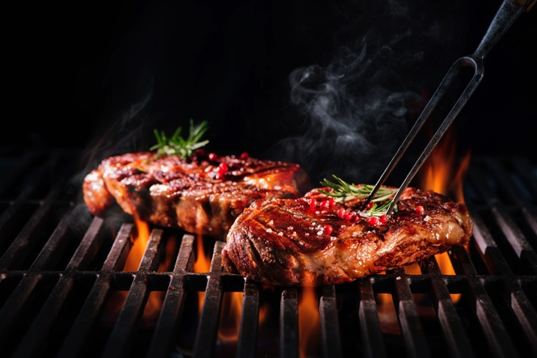
1. I Have Liberty, but Not Everything Is Good
“I have the right to do anything,” you say - but not everything is beneficial” (1 Cor. 6:12).

Slide 18

2. The Body Is Not for
Sexual Immorality
“The body, however, is not meant for sexual immorality but for the Lord, and the Lord for the body” (1 Cor. 6:13).
We must not use our bodies in a selfish way.

Slide 19

3. The Body Is for
Serving the Lord
“The body, however, is not meant for sexual immorality but for the Lord, and the Lord for the body” (1 Cor. 6:13).
The human body must be used in order to do God’s will.

Slide 20

4. The Body Is a Divine Instrument
“Do you not know that your bodies are members of Christ himself?” (1 Cor. 6:15).
It must be a useful tool in the service of our neighbors.

Slide 21

5. The Body Must Be United to Something
“Do you not know that he who unites himself with a prostitute is one with her in body? For it is said, ‘The two will become one flesh.’ But whoever is united with the Lord is one with him in spirit” (1 Cor. 6:16-17).

Slide 22
Sole Owners of the Human Body
God
Human Being
Spouse

Slide 23

6. The Body Is a Sacred Place
“Do you not know that your bodies are temples of the Holy Spirit, who is in you, whom you have received from God? You are not your own” (1 Cor. 6:19).

Slide 24

7. Jesus Paid for Our Bodies
“You were bought at a price. Therefore honor God with your bodies” (1 Cor. 6:20).

Slide 25
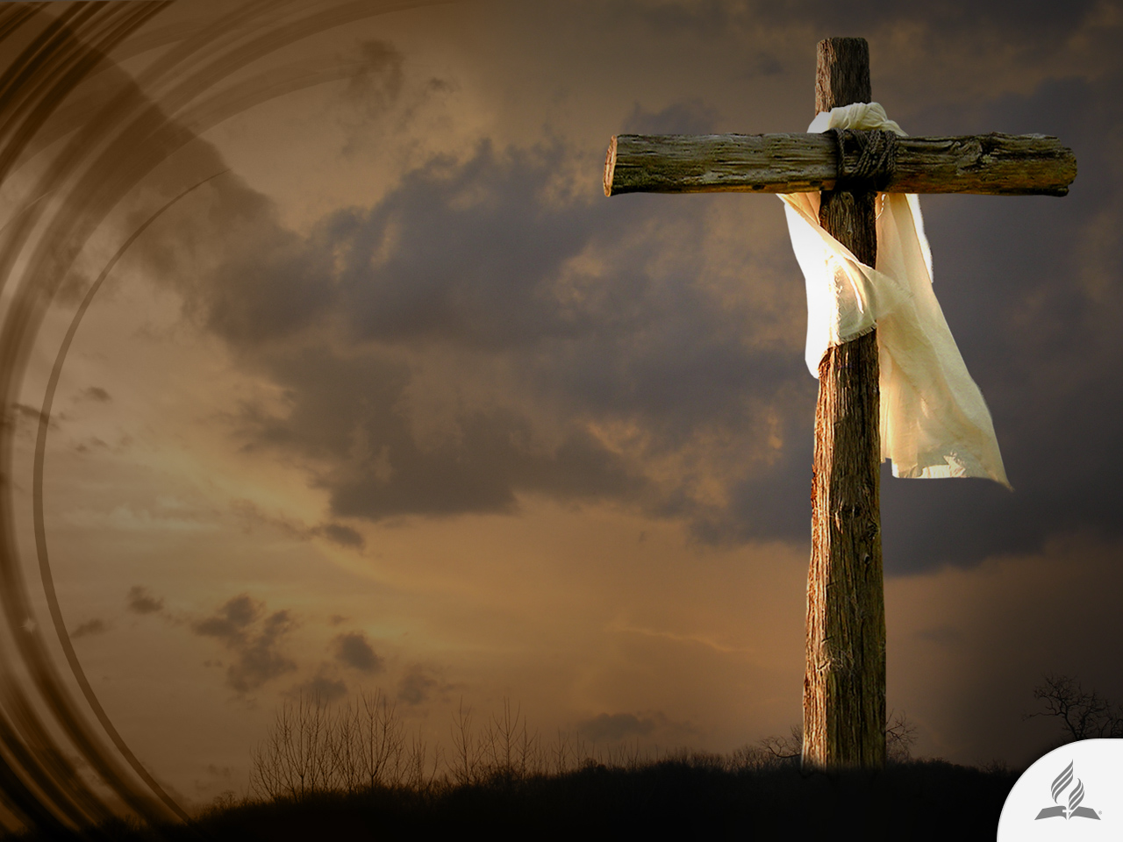
The Lord Gave His Life for Our Bodies
We must consult the true Owner any time we organize our life or make a decision about the use of our bodies.

Slide 26
HONOR GOD WITH YOUR BODY

Slide 27

The Secret of Eternal Life
“Therefore honor God with your bodies” (1 Cor. 6:20).

Slide 28
An Infallible Formula
From the Divine Doctor’s Office
Nutrition
Exercise
Water
Sunlight
Temperance
Air
Rest
Trust in God

Slide 29

Honest with Very Little
Whoever can be trusted with very little can also be trusted with much, and whoever is dishonest with very little will also be dishonest with much (Luke 16:10).
Good management of an earthly body reveals God an appropriate character ready to receive a heavenly body (1 Cor. 15:52-54).

Slide 30
Summary
A good lifestyle is the great secret for longevity.
It includes physical exercise, nutrition, exercise, water, sunlight, temperance, air, rest, and trust in God.
The Bible says that human body has an important role in our spiritual life; for that reason, Jesus gave His life so that we can enjoy an integral redemption.
We must honor God through our bodies.
The way we take care of our bodies reveals to God if we are able to manage a heavenly body.

Slide 31
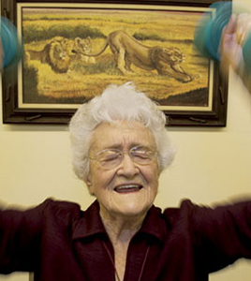
Blue Zone Report about
Loma Linda, California
This sunny Southern California town is home to about 9,000 Seventh-day Adventists.
Though the city wasn’t incorporated until 1970, Adventists have centuries-old roots in Loma Linda.
Formed in the 1840s, the church flourished through the 20th century – and so did its members.
That is because the Adventists built a culture focused on health.
www.bluezones.com

Slide 32
A Report of Blue Zones about
Loma Linda, California
The Adventist church advocates vegetarianism and regular exercise.
Members sip water instead of soda and snack on nuts rather than potato chips. They abstain from cigarettes and alcohol, and keep stress at bay by observing a 24-hour Sabbath every week.
Loma Linda’s centenarians also illuminate the importance of a ‘right tribe.’ In this tight-knit community, Adventists associate mainly with other Adventists so they feed off each other’s healthy habits.
Loma Linda University Medical Center has been studying Adventists for some fifty years. The result? Reams of evidence that lifestyle is the key to their exceptional longevity.
www.bluezones.com

Slide 33
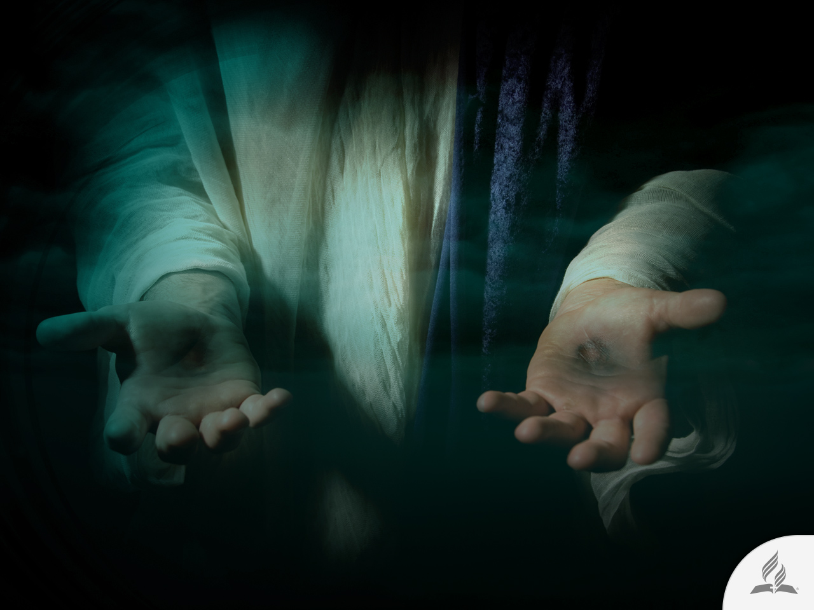
My Decision
The Bible says: “Dear friend, I pray that you may enjoy good health and that all may go well with you, even as your soul is getting along well” (3 John 2).
Are you willing to accept the lifestyle Jesus offers you in order to enjoy health?

Slide 34
Next Topic:
IS IT NECESSARY TO HAVE A FAMILY?
A Critical Time for the Family
The Original Plan

