Slide 1
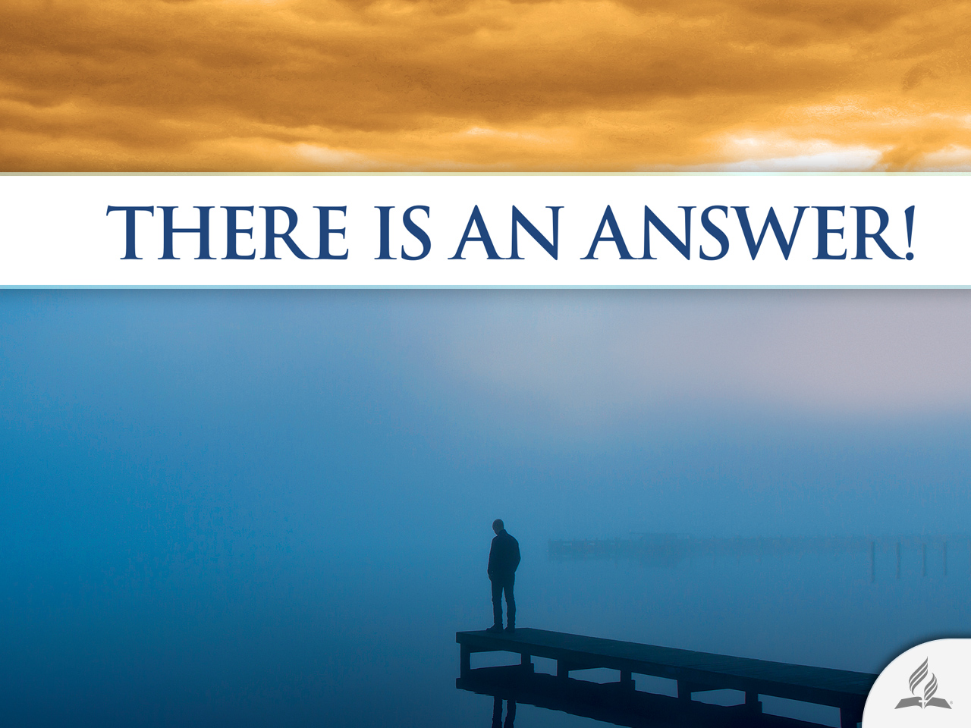

Slide 2




Is It Necessary to Have a Family?
Topic 8

Slide 3
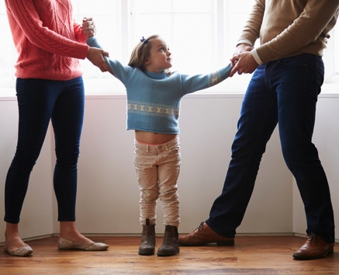
A Critical Time for the Family
Each year in the United States more than 1 million children suffer from the divorce of their parents; and half of those born to couples still married will witness their parents’ divorce before they turn 18.
Divorce has grown in an alarming way in the USA.

Slide 4
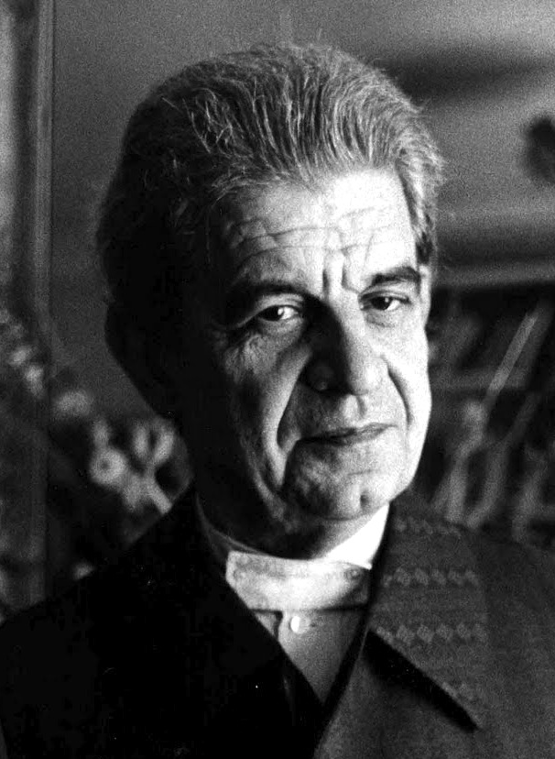
A Critical Time for the Family
Jacques Lacan said that the family was the “worst structure.”
Marriage is highly discredited at this time.
As time progresses, more and more people do not want to get married.

Slide 5
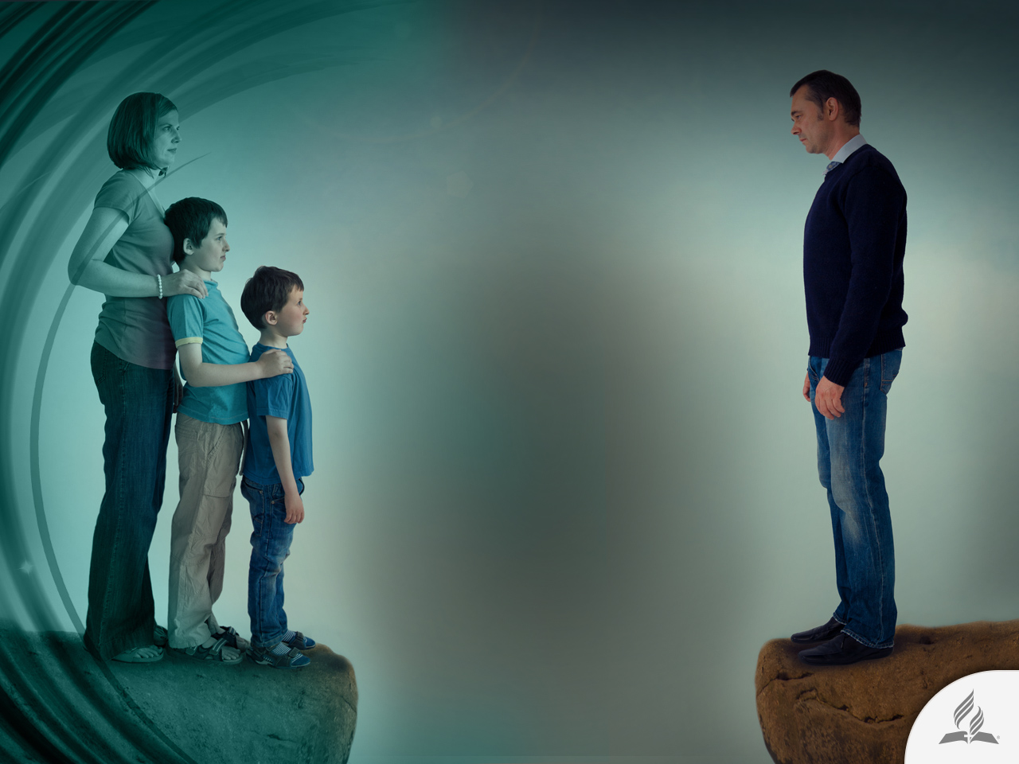
The Divorce Phantom
The deep scars left by divorce in family members affect all aspects of their lives, leading many to think of marriage as a failed or outdated institution.
Some even believe that commitment is the enemy of love, and that being in love would be better without the pressure of a signed document.

Slide 6

The HUMAN CONDITION

Slide 7
A Society in Decline
“But mark this: There will be terrible times in the last days. People will be lovers of themselves, lovers of money, boastful, proud, abusive, disobedient to their parents, ungrateful, unholy, without love, unforgiving, slanderous, without self-control, brutal, not lovers of the good, treacherous, rash, conceited, lovers of pleasure rather than lovers of God— having a form of godliness but denying its power. Have nothing to do with such people” (2 Tim. 3:1-5).

Slide 8
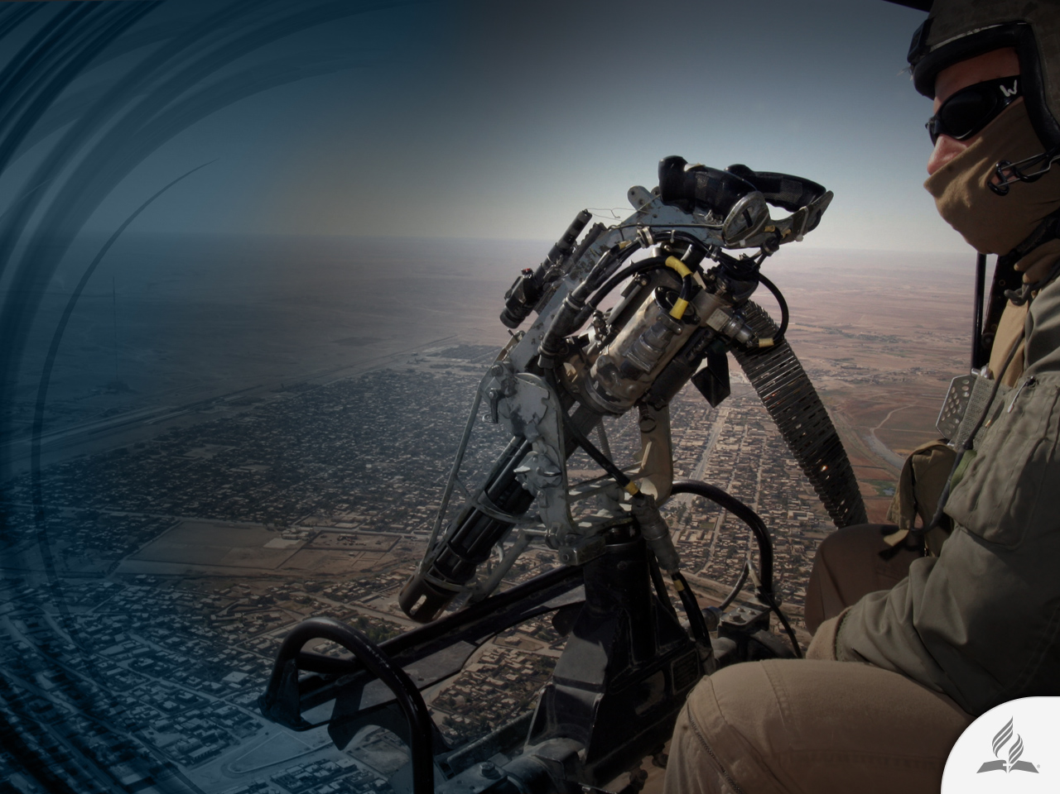
Terrible Times
Xalepós, “terrible times.”
Violence will be one of the main characteristics of society.

Slide 9
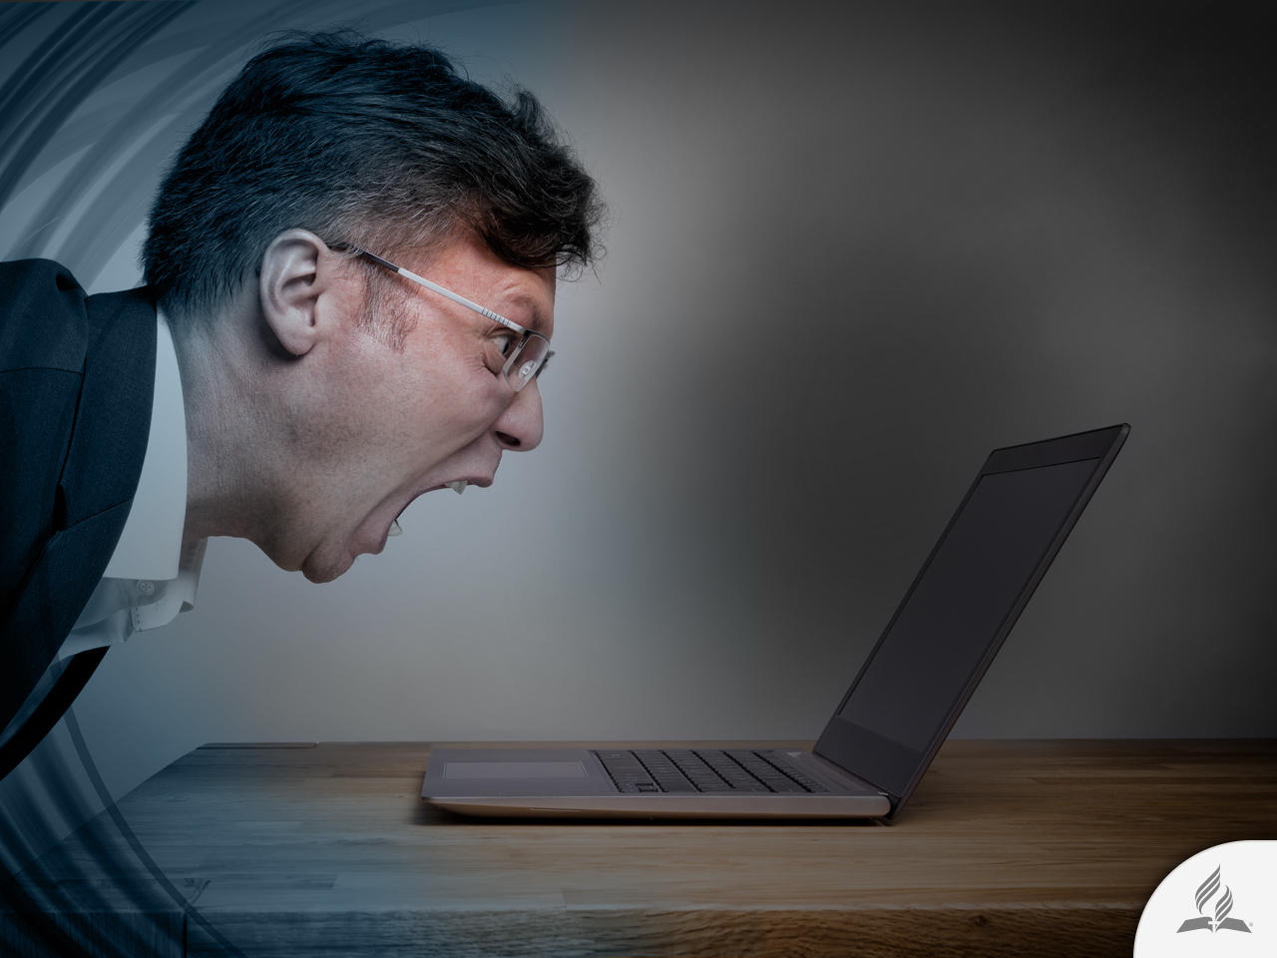
People Lovers of Themselves
Filáutoi, “lover of self.”
Life would be focused on oneself, and trying to satisfy its desires.
  Frustration
  Dissatisfaction
  Depression
Selfishness is one of the principal sins in human life.

Slide 10

Rise of Materialism
Filárguroi, “lovers of money.”
A lot of people consider making money as the main goal of their lives.
There is no place for moral values.

Slide 11
Bitterness as a Way of Life
Ajáristos, “ungrateful.”
Gratitude is a way to bring peace to heart.
Anósios, “unholy.”
Ungratefulness bring out evil in people.
Astorgos, “without love.”
The inability to love would be one of the principal characteristics of society before the coming of Christ to this world (Matt. 24:12).

Slide 12
The Way to Incredulity
Self-centered
Selfishness
Materialism
Appearing instead of being
Pride
Arrogance
Low tolerance to frustration
Aggressiveness
Disobedience

Slide 13
The Way to Incredulity
Frustration
Ingratitude
Impiety
Dehumanization
Insensibility
Lack of love
Destructiveness
Slanderers
Licentious
Brutal
Not lovers of the good

Slide 14

THE ORIGINAL PLAN

Slide 15
The First Couple
“The Lord God said, ‘It is not good for the man to be alone. I will make a helper suitable for him.’ … Then the Lord God made a woman from the rib he had taken out of the man, and he brought her to the man. The man said, ‘This is now bone of my bones and flesh of my flesh; she shall be called ‘woman,’ for she was taken out of man.’ That is why a man leaves his father and mother and is united to his wife, and they become one flesh. Adam and his wife were both naked, and they felt no shame” (Gen. 2:18, 22-25).

Slide 16
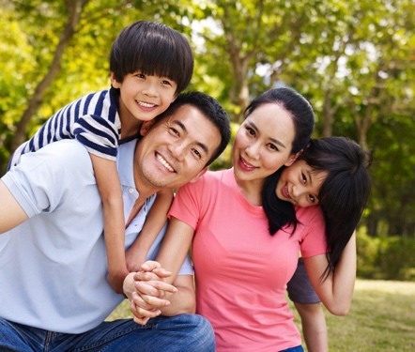
The Important Perceptions
God is the Founder and Giver of marriage.
Human beings have been designed for association and marriage.
Through marriage, men and women get the closest bond, closer than the relationship among fathers and sons.

Slide 17

Admiration
“This is now bone of my bones and flesh of my flesh.”
Admiration includes recognition, attendance, appreciation, and praise.

Slide 18
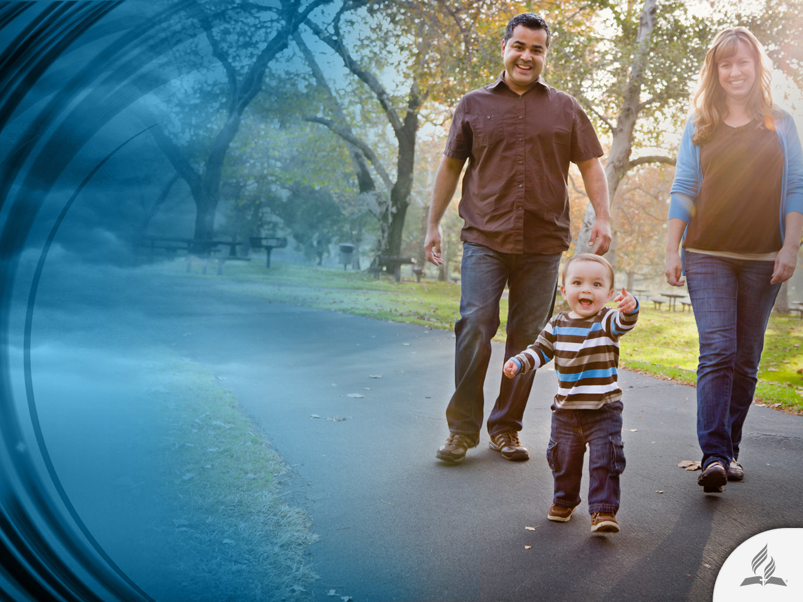
Admiration
All family members need recognition.
We need humility to recognize the virtues and achievements of our beloved.

Slide 19

Confidence
“And they become one flesh.”
Confidence is intimacy, security, hope, frankness, naturalness.

Slide 20
Confidence
Nobody should break the confidence among spouses, not even the relatives.
Marriages must resolve their problems alone (without relatives’ intervention).
Facing difficulties strengthens the relationship.
It is very important to protect the sacred circle of family, not letting anybody violate it.

Slide 21

Respect
“Adam and his wife were both naked, and they felt no shame.”

Slide 22
Respect
It is the feeling of admiring someone or something that is good, valuable, important, etc.
It consists of treating the other in the same way I would like to be treated.
It considers opinions, desires, and dignity of others.
It is to promote courtesy, good treatment, and harmony.
It is honoring, regarding, and understanding.

Slide 23
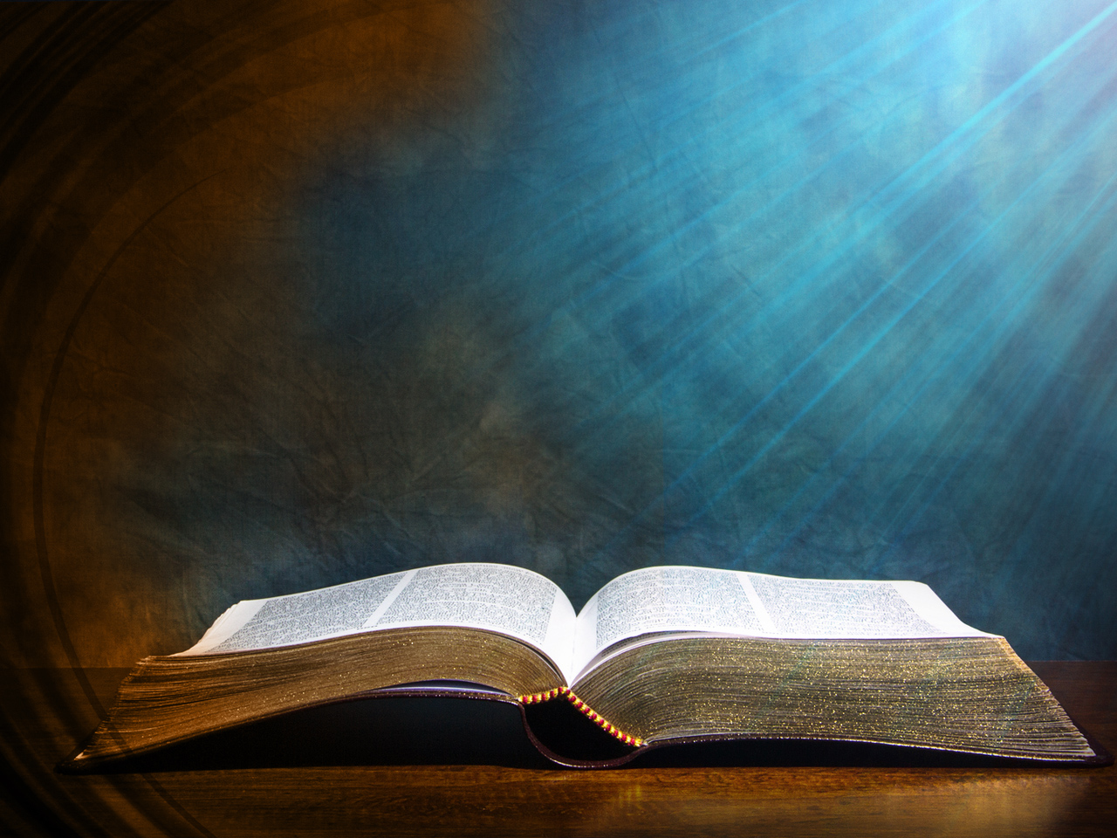
A very practical way
2 Peter 1:5-7

Slide 24

Peter’s Ladder for a
Better Marriage
“For this very reason, make every effort to add to your faith goodness; and to goodness, knowledge; and to knowledge, self-control; and to self-control, perseverance; and to perseverance, godliness; and to godliness, mutual affection; and to mutual affection, love” (2 Pet. 1:5-7).

Slide 25
Peter’s Ladder for a Better Marriage
LOVE
MUTUAL AFFECTION
GODLINESS
PERSEVERANCE
SELF-CONTROL
KNOWLEDGE
GOODNESS
FAITH

Slide 26

Don’t Forget the Five Love Languages
Words
Quality time
Gifts
Service acts
Physical contact

Slide 27
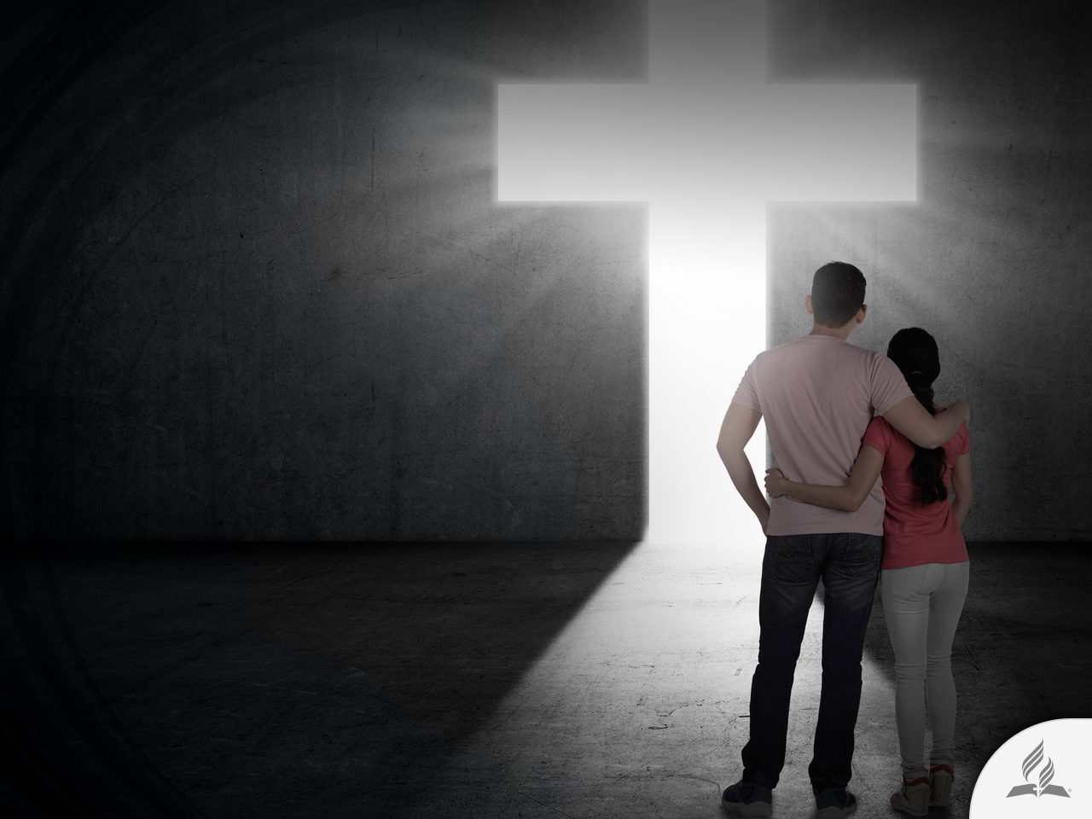
God Can Be the Builder of Your Home
“Unless the Lord builds the house, the builders labor in vain. Unless the Lord watches over the city, the guards stand watch in vain. In vain you rise early and stay up late, toiling for food to eat—for he grants sleep to those he loves” (Ps. 127:1-2).

Slide 28
Summary
Marriage is highly discredited these days. As time progresses, more and more people do not want to get married. Divorce is increasing around the world.
The Bible said that the previous times to Christ’s coming would be hard for family structure: selfishness, materialism, bitterness, and intemperance would be some of its main characteristics.
The original plan of God was the establishment of a family based on admiration, confidence, and respect.
We must use the five love languages and add them to our spiritual experience.
God can be the Builder of our Home.

Slide 29
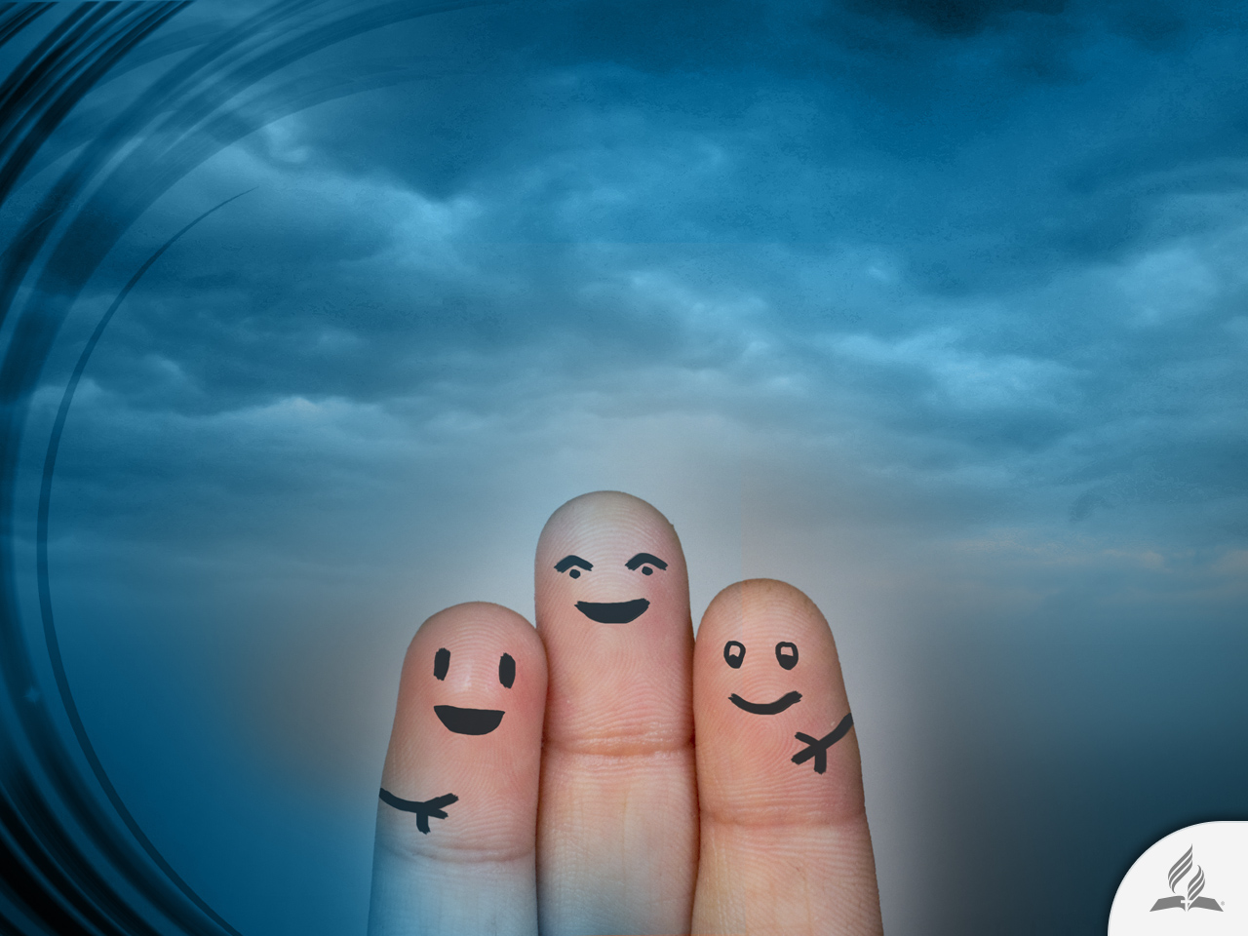
Humans Cannot Survive Alone
Dr. Leonard Cammer, a psychiatrist who has specialized in treating depressed persons for thirty years said, “The human being is the only species that can’t survive alone. The human being needs another human being—otherwise he’s dead!”

Slide 30
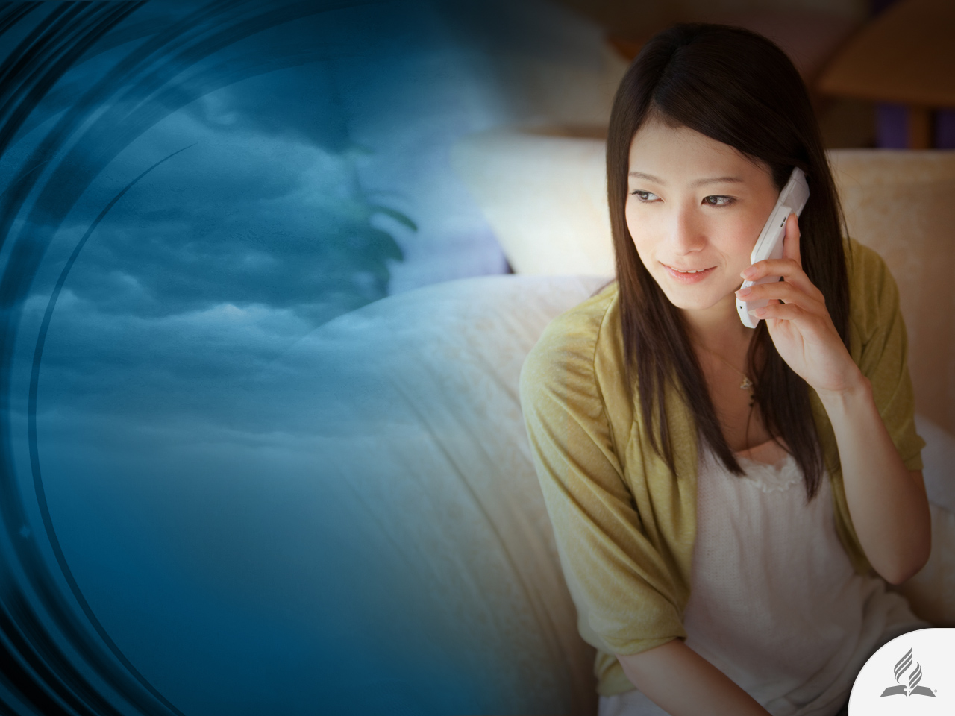
Humans Cannot Survive Alone
“A telephone call to a depressed person can save a life. An occasional word, a ten-minute visit, can be more effective than twenty-four hours of nursing care. You can buy nursing care. You can’t buy love.”
Tan, P. L. (1996). Encyclopedia of 7700 Illustrations: Signs of the Times (p. 754). Garland, TX: Bible Communications, Inc.

Slide 31
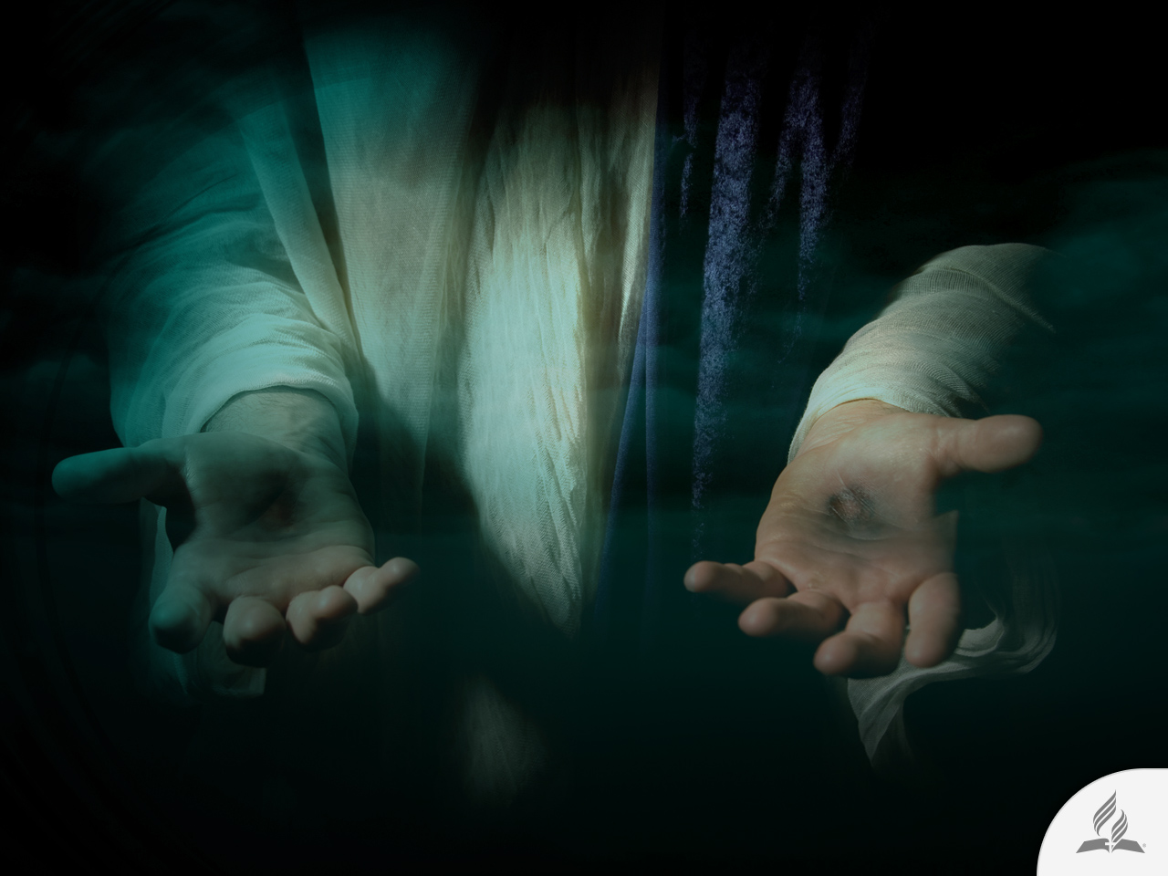
My Decision
The Bible says that marriage requires humility: “Do nothing out of selfish ambition or vain conceit. Rather, in humility value others above yourselves, not looking to your own interests but each of you to the interests of the others” (Phil. 2:3-4).
Are you willing to accept the help Jesus offers you in order to have a better marriage?

Slide 32
Next Topic:
WHAT HAPPENS AFTER DEATH?
An Inescapable Reality
What Is Death?
The Sleep of Death
Only Two Ways

