Slide 1


Slide 2




What Happens After Death?
Topic 9

Slide 3
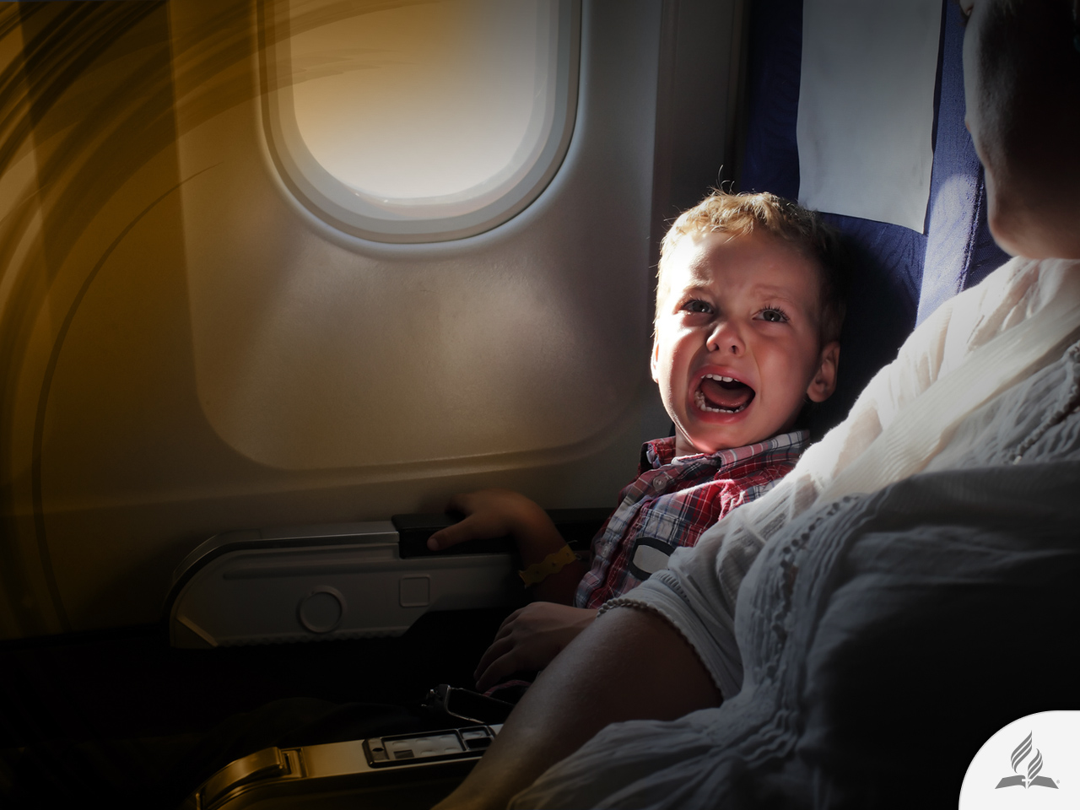
The Fear to Death
A child had no reason to be afraid, but he desperately yelled while he grabbed his mother’s dress and refused to enter the plane. “I don’t want to die! I don’t want to die!”

Slide 4
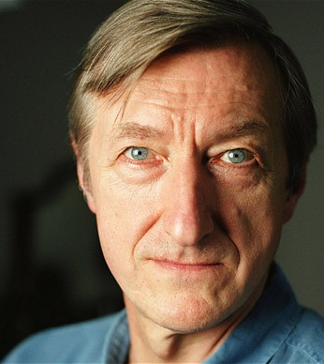
The Fear to Death
British novelist Julian Barnes is not a child anymore; he is a famous, mature man.
A few years ago he published a book titled Nothing to Be Frightened Of. It could be said that the book is the restrained sobbing of an adult before death.

Slide 5
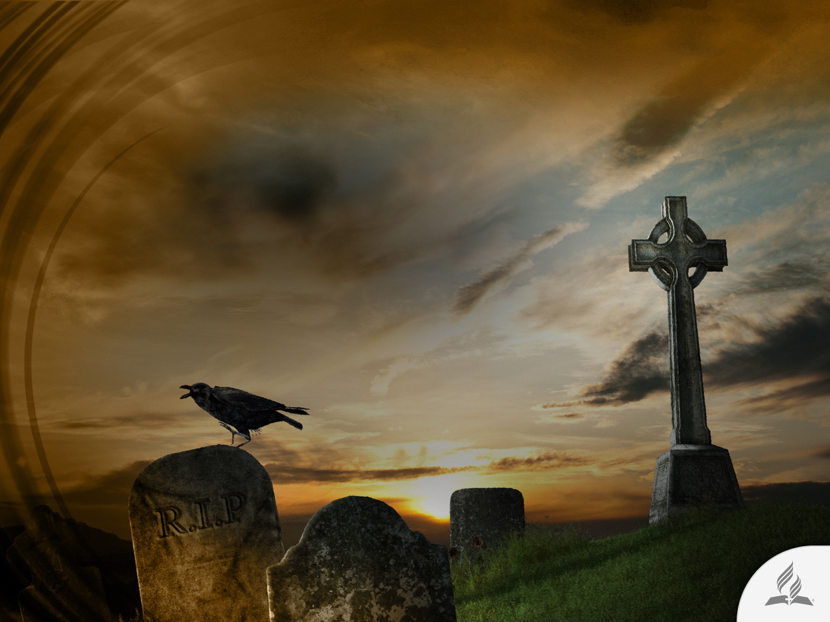
The Fear to Death
In his recent book, the author states that death is the disappearance of something we cling to, which in reality does not exist.
Therefore, a fear of death is senseless; it is a fear of nothing.
Nevertheless, he confesses his daily fear of death.
He imagines himself in situations in which he could die; for example, trapped in the jaws of a crocodile or in a shipwreck.

Slide 6

WHAT IS DEATH?

Slide 7
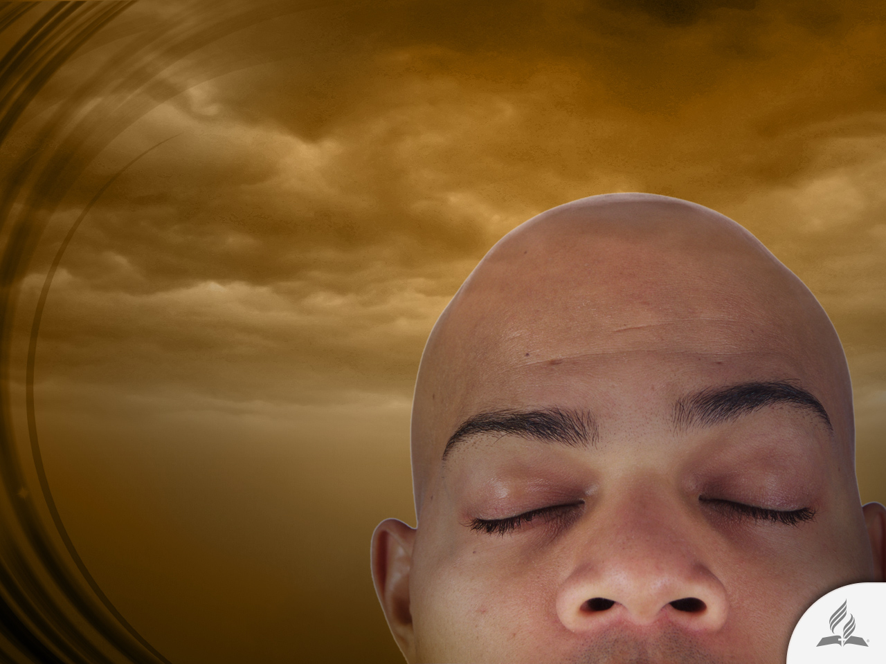
The Biblical Concept of Death
“Then the Lord God formed a man from the dust of the ground and breathed into his nostrils the breath of life, and the man became a living being” (Gen. 2:7).

Slide 8
The Biblical Concept of Death
DUST (body)
BREATH OF LIFE (spirit)
LIVING BEING

Slide 9
The Biblical Concept of Death
According to the Bible, the soul is an intrinsic part of a human being. The soul is a living being.
Beings have no soul; they are a soul.
The Hebrew word used for “person,” “soul,” “being,” and in a few instances for “life” (for example, Lev. 17:11, 14) is nephesh.
The translation for the word ruach is “spirit”, which comes from the same root words referring to breath or to breathe.
Nephesh characterizes what each living being is (the individualization of God’s breath); ruach is the breath of common life of each living being.
In Genesis 2:7, nephesh is used to describe the man created by God.

Slide 10
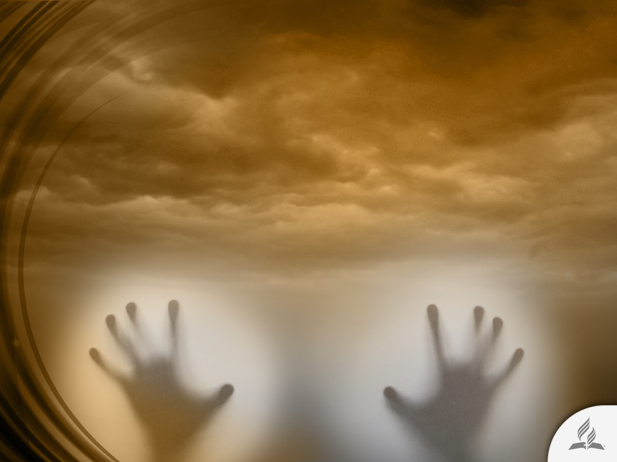
Can the Soul Die?
“Behold, all souls are Mine; the soul of the father as well as the soul of the son is mine. The soul who sins shall die” (Ezek. 18:4, NKJV).
When someone dies, the soul also dies, because the soul is the person.
Nowhere in the Bible is the assertion that the soul is something that inhabits the human body, or that is immortal.

Slide 11
Where Does Man Return to as a Result of Sin?
“By the sweat of your brow you will eat your food until you return to the ground, since from it you were taken; for dust you are and to dust you will return” (Gen. 3:19).
To whom would the breath of life (spirit) return? “And the dust returns to the ground it came from, and the spirit returns to God who gave it” (Eccl. 12:7).
When someone dies, the spirit (breath of life) returns to God, and the body (dust) returns to the ground. For that reason, the Bible says: “For the living know that they will die, but the dead know nothing; they have no further reward, and even their name is forgotten” (Eccl. 9:5).

Slide 12
The Biblical Concept of Death
DUST
(body)
BREATH OF LIFE (spirit)
DEAD PERSON

Slide 13
The Bible and Immortality
According to the Bible, only God is immortal: “God, the blessed and only Ruler, the King of kings and Lord of lords, who alone is immortal and who lives in unapproachable light, whom no one has seen or can see. To him be honor and might forever. Amen” (1 Tim. 6:15, 16).
When will human beings receive immortality? “Listen, I tell you a mystery: We will not all sleep, but we will all be changed – in a flash, in the twinkling of an eye, at the last trumpet. For the trumpet will sound, the dead will be raised imperishable, and we will be changed. For the perishable must clothe itself with the imperishable, and the mortal with immortality” (1 Cor. 15:51-53).
This promise will be carried out at the time of the Second Coming of Jesus.

Slide 14
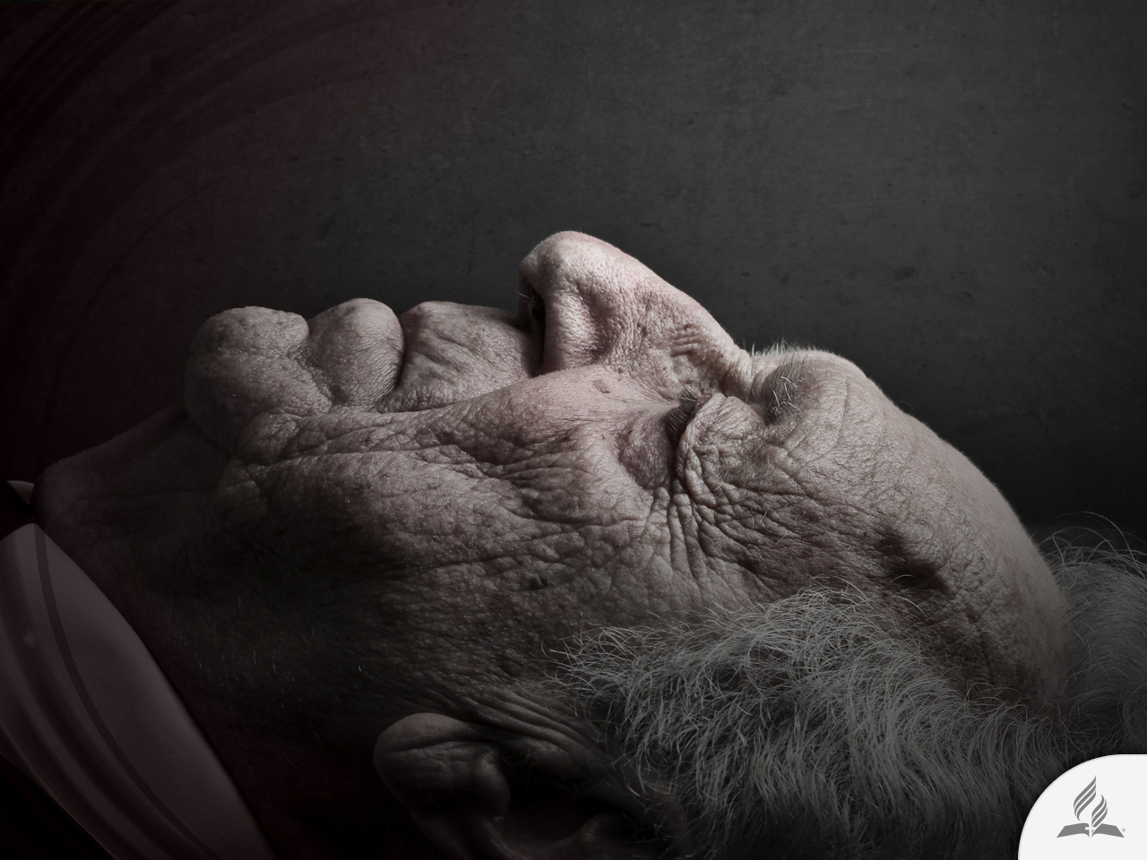
THE SLEEP OF DEATH

Slide 15

An Illustration of Death
Jesus compared death to a dream (John 11:11-14).

Slide 16
1. Those who sleep are unconscious (Eccl. 9:5)
Conscience is the part of the mind that makes you aware of your actions as being either morally right or wrong.
When somebody sleeps conscience is also absent.
For that reason, “dead know nothing.”

Slide 17
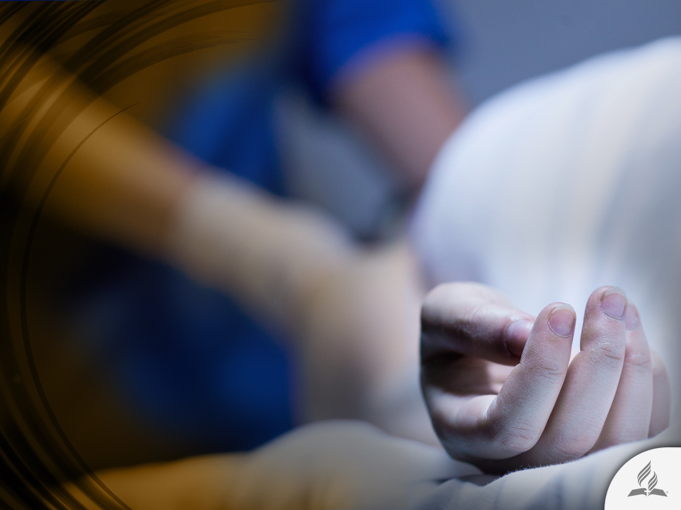
2. During sleep, conscious thoughts cease (Ps. 146:4)
The dead are not thinking, and they cannot influence the living.
Therefore, they cannot talk, hear or answer human cries.
There cannot be contact between the living and the dead.

Slide 18

3. Sleep finalizes daily activities (Eccl. 9:10)
The dead have finished their activities on this Earth.
They are not in a good place, serving God, or in a bad place, receiving a punishment.
They are just resting.

Slide 19

4. Sleep cuts us off from those who are awake, and from their activities (Eccl. 9:6).
The dead do not know if we are worshiping them or if we are trying to communicate with them.
They cannot help us resolve our problems.

Slide 20

5. Normal sleep renders conscious emotions inactive (Eccl. 9:6).
The dead do not suffer, neither complain nor are disturbed by our tears or claims.
For that reason, they cannot answer anybody.

Slide 21
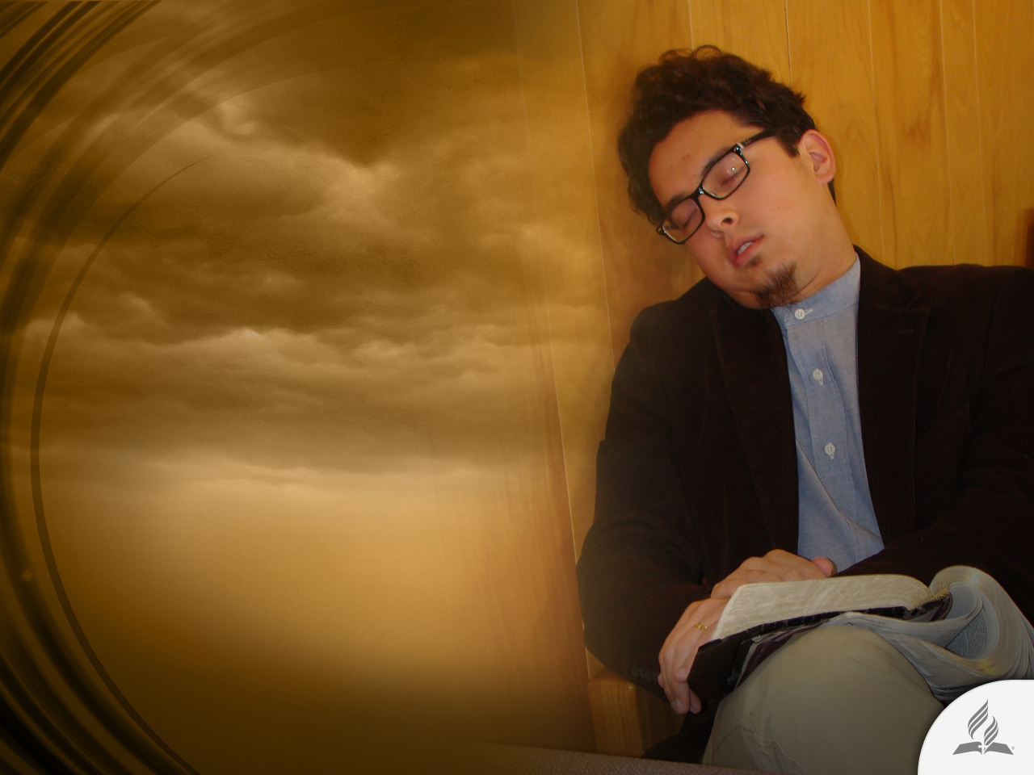
6. During sleep, human beings do not worship God (Ps. 115:17)
The dead are not in heaven, singing and praising God; they are not in hell suffering an eternal torment.
They are unconscious, as if they were asleep.

Slide 22
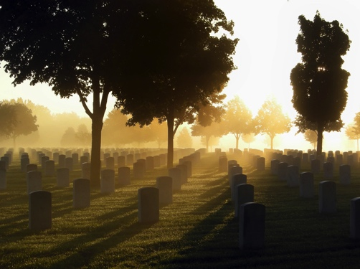
7. Sleep anticipates an awakening (John 5:28, 29)
All the dead will one day wake up to either to :
The resurrection of life, or
The resurrection of condemnation
Resurrection is the restoration of life, after death, including the essence of their being and personality.

Slide 23
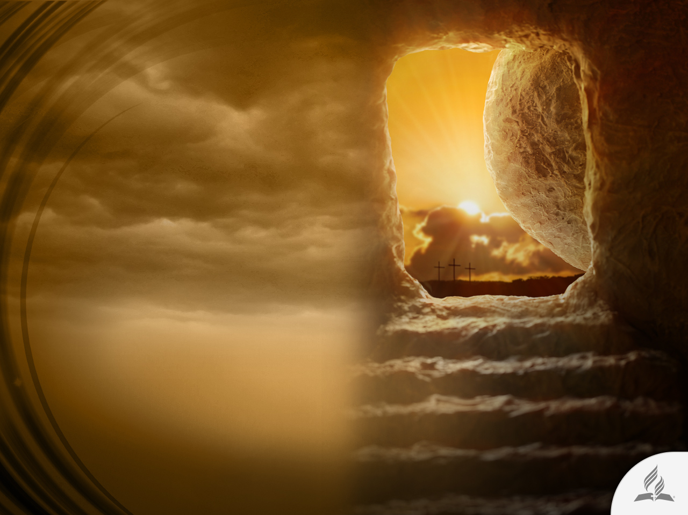
THE HOPE OF RESURRECTION

Slide 24
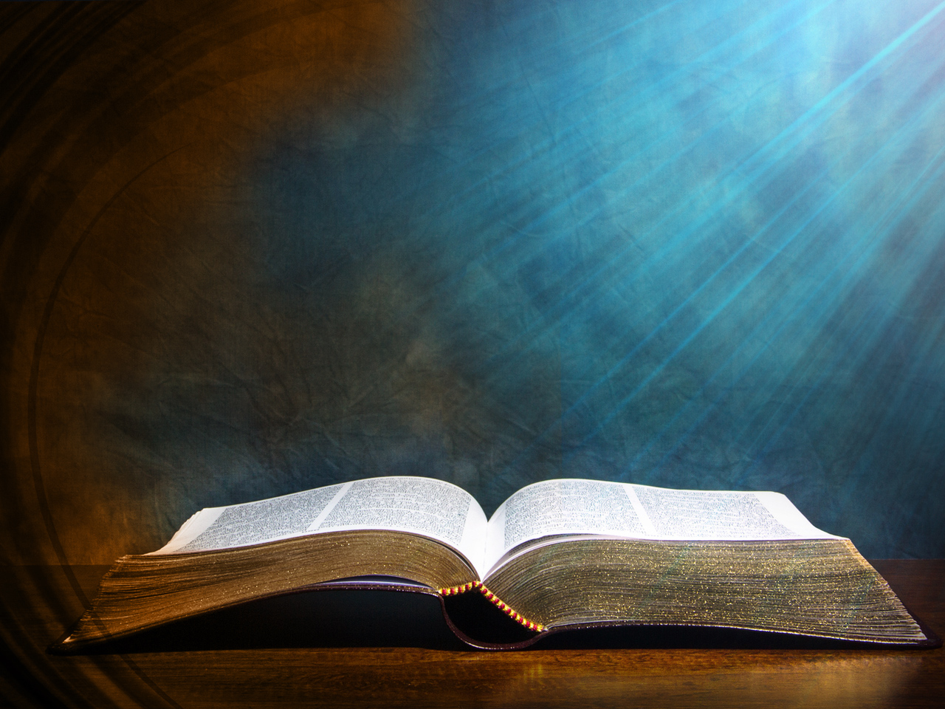
The Promise of His Coming
“Do not let your hearts be troubled. You believe in God; believe also in me. My Father’s house has many rooms; if that were not so, would I have told you that I am going there to prepare a place for you? And if I go and prepare a place for you, I will come back and take you to be with me that you also may be where I am” (John 14:1-3).

Slide 25
The Certainty of Resurrection
“And if Christ has not been raised, our preaching is useless and so is your faith. More than that, we are then found to be false witnesses about God, for we have testified about God that he raised Christ from the dead. But he did not raise him if in fact the dead are not raised. For if the dead are not raised, then Christ has not been raised either. And if Christ has not been raised, your faith is futile; you are still in your sins” (1 Cor. 15:14-17).

Slide 26
Who Saw the Resurrected Jesus?
The guards of the tomb
(Matt. 28:4)
The women that went to anoint Him (v. 9, 10)
Mary Magdalene
(John 20:11-18)
Simon Peter
(Luke 24:34; 1 Cor. 15:5)
Two disciples in the road
to Emmaus
(Luke 24:13-31; Mark 16:12, 13)

Slide 27
The Time of Resurrection
“For the Lord himself will come down from heaven, with a loud command, with the voice of the archangel and with the trumpet call of God, and the dead in Christ will rise first. After that, we who are still alive and are left will be caught up together with them in the clouds to meet the Lord in the air. And so we will be with the Lord forever” (1 Thess. 4:16-17).

Slide 28
Summary
According to the Bible, the soul is an intrinsic part of a human being. The soul is a living being.
Beings have no soul; they are a soul.
According to the Bible, only God has immortality. Human beings will receive immortality when Christ returns to this world.
Jesus compared death to a dream because when somebody sleeps, conscience is also absent. The dead cannot communicate with the living.
The dead will one day rise when Jesus returns to Earth.

Slide 29
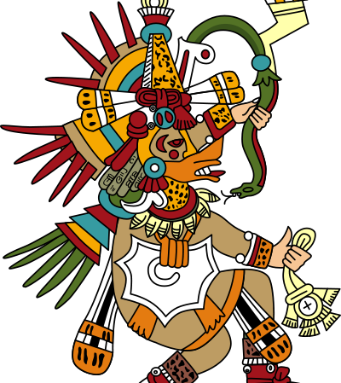
An Ancient Hope
The Aztecs, a Mexican Indian tribe, held the tradition that “Quetzal-coatl the white,” a kind and gracious god, who had come to earth to teach the people the domestic arts, would return after many centuries, and lead them to a land that was the abode of the gods, a place of eternal and highest happiness.

Slide 30
An Ancient Hope
This was the reason for the awe inspired by the Spanish conquerors.
Being white of skin and bearded, they were thought to be the descendants of the White God.

Slide 31
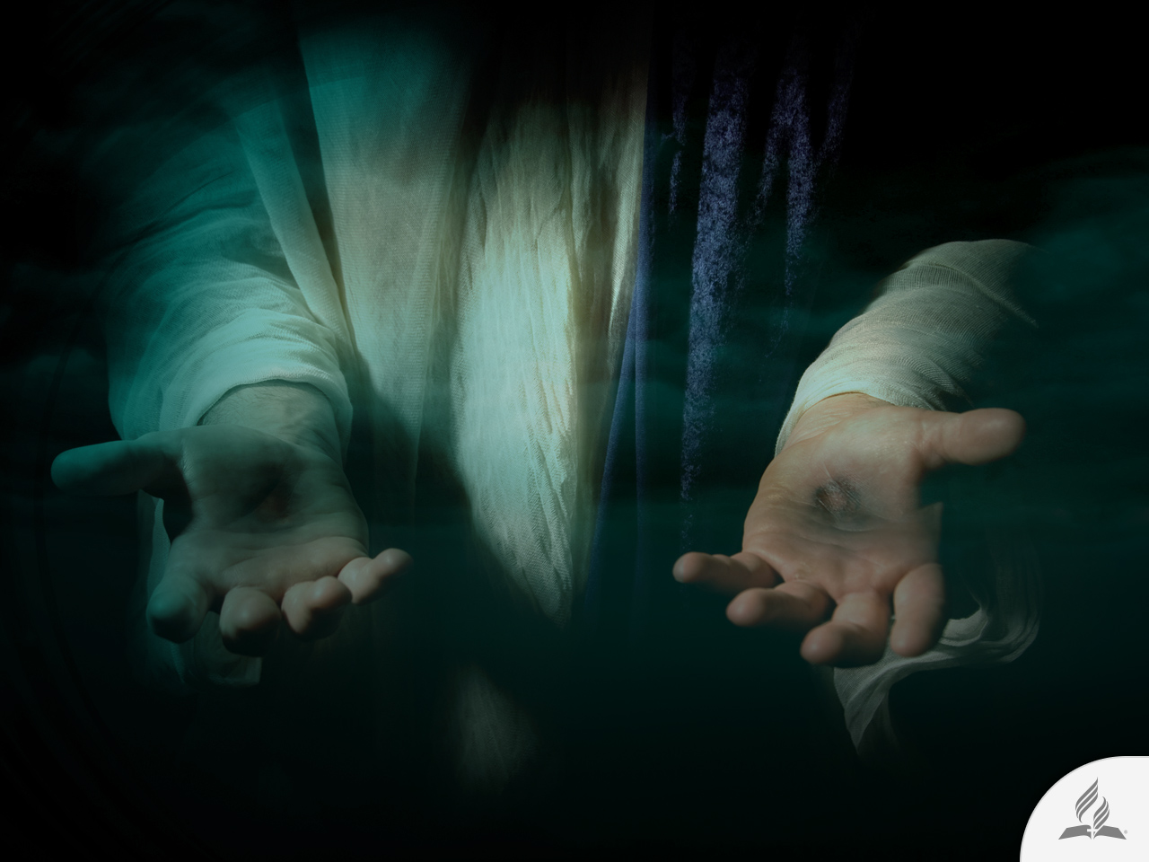
My Decision
Jesus said: “I am the resurrection and the life. The one who believes in me will live, even though they die” (John 11:25).
Are you willing to accept this promise Jesus offers you?

Slide 32
Next Topic:
WILL A NEW WORLD
ORDER BE ESTABLISHED?
The Shadow of a New World Order
The Search for Peace
A New Attempt at World Unity
No Time to Lose

